Slide 1
Staffordshire
Safeguarding and Education Overview & Scrutiny Committee
26 February 2026
Attendance and Exclusions Summary

Slide 2
Autumn Attendance - Headlines
Autumn attendance slightly decreased by 0.1% across all districts while South Staffs / Lichfield / Cannock improved by 0.05%.
  In the 2025/26 Autumn term, the average attendance for school-aged children in Staffordshire was 93.82%, based on unvalidated Capita data. This represents a modest reduction of 0.1% compared to the 93.92% recorded for Autumn term 2024/25, according to unvalidated Capita data.
Persistent absence decreased by 0.5% and severe absence also decreased by 1% in 2025 Autumn.
  Persistent absence decreased from 17.95% in Autumn 2024/25 to 17.43% in Autumn 2025/26.
  Severe absence decreased from 2.95% to 1.92% in the same period.
Attendance has slightly decreased by around 0.1% across all school types except PRU’s that improved by 2.5% in 2025 Autumn.
  Pupil Referral Units (PRUs): Increased from 58.24% to 60.82%.
The suspension rate decreased to 3.62% (4204 incidents) in 2025/26 from 3.83% (4458) in 2024/25, comparing the total suspensions to the total year 0-11 school census population.
  Lichfield and Newcastle saw an increased suspension rate (0.5% & 0.14%) while other districts saw a decrease of varied percentages.
  Vulnerable groups experienced higher suspension rates for their cohort size.
  Average suspended days decreased from 3.83 days (24 Autumn) to 3.70 days (25 Autumn).
The exclusion rate decreased across all Staffs districts to 0.06% (65) in 2025/26 Autumn from 0.09%(110) in 2024/25 Autumn.
  Cannock remained with the highest exclusion rate although percentage down by 0.02% (19 to 18 or 0.17% to 0.15%).
  All key stages saw a reduced exclusion rate.

Slide 3
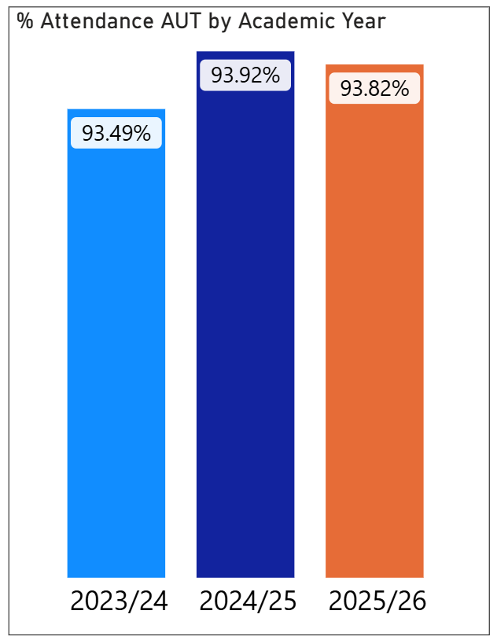
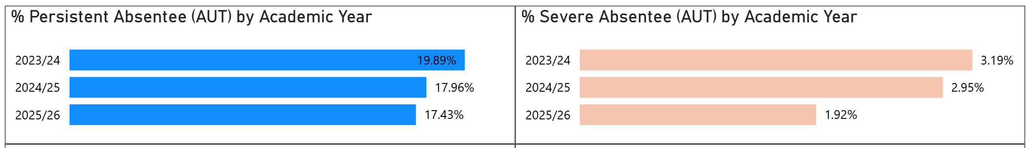
Autumn Term Attendance overview
The Autumn average attendance for school-aged children in Staffordshire schools in 2025/26 was 93.82%, reflecting a 0.1% decrease compared to Autumn 2024/25.
In 2025/26 Autumn term, both persistent and severe absence rate saw a reduction compared with the previous Autumn term, especially for severe absence rate reducing by over 1% (from 2.95% to 1.92%).
* Data source: Capita unvalidated data. All districts included. Year 0 to 11 only.

Slide 4
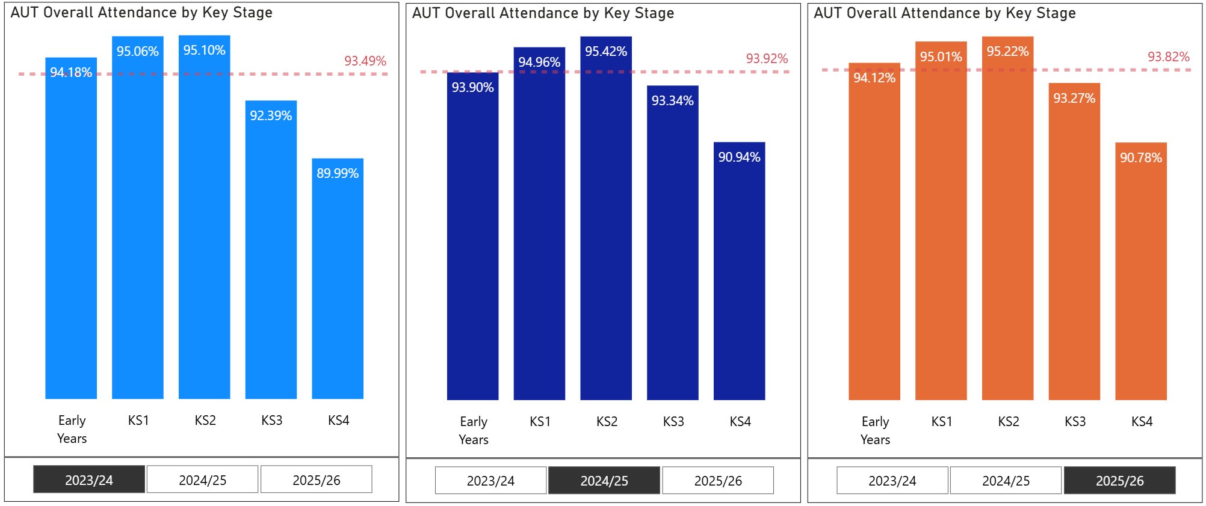
Autumn Term Attendance – Key stage breakdown
Key stage (KS), it was observed that the overall Autumn term attendance rate following the same pattern:
(From the highest to lowest)
KS2 > KS1 > Early years > KS3 > KS4
Although the figures showed variations.
In general, KS1/KS2 attendance rates were well above the average, Early Years was close and KS3/KS4 were below.
* Data source: Capita unvalidated data. All districts included. Year 0 to 11 only.

Slide 5
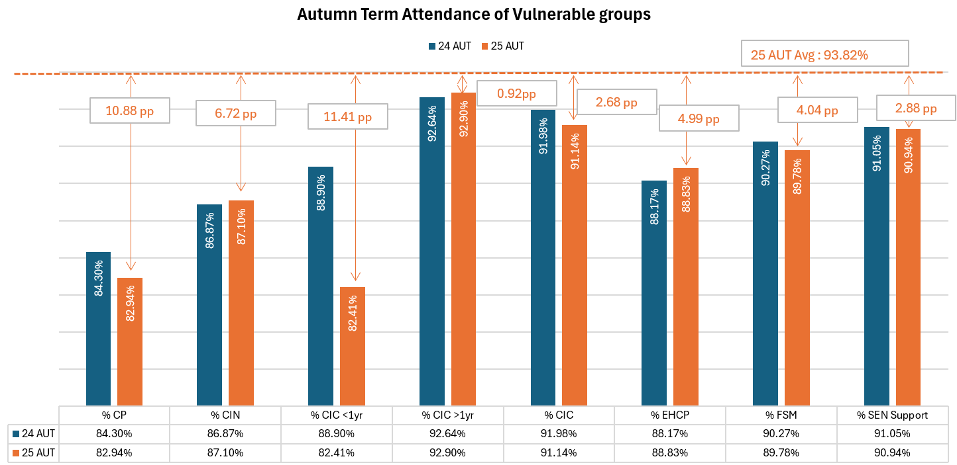
Autumn Term Attendance – Vulnerable groups in Staffordshire
In 2025 Autumn, term, nearly all the vulnerable groups had a lower attendance rate than Staffordshire average.
The biggest gap 10.88% happened in Children Protection (CP) cohort with 82.94% attendance rate which was a 1.4% dip from the same period last year. .
The smallest gap 2.68% was achieved by Children in Care (CIC), although this was a 0.84% dip from the previous year.
Two vulnerable cohorts saw improvements in the Autumn attendance rate:
CIN: 86.87% to 87.10% by 0.23%
EHCP: 88.17% to 88.83% by 0.66%
* Data source: Capita unvalidated data, Year 0 to 11 only, independent schools excluded.

Slide 6

Notes:
https://youtu.be/Y5h83IDKHIs

Slide 7
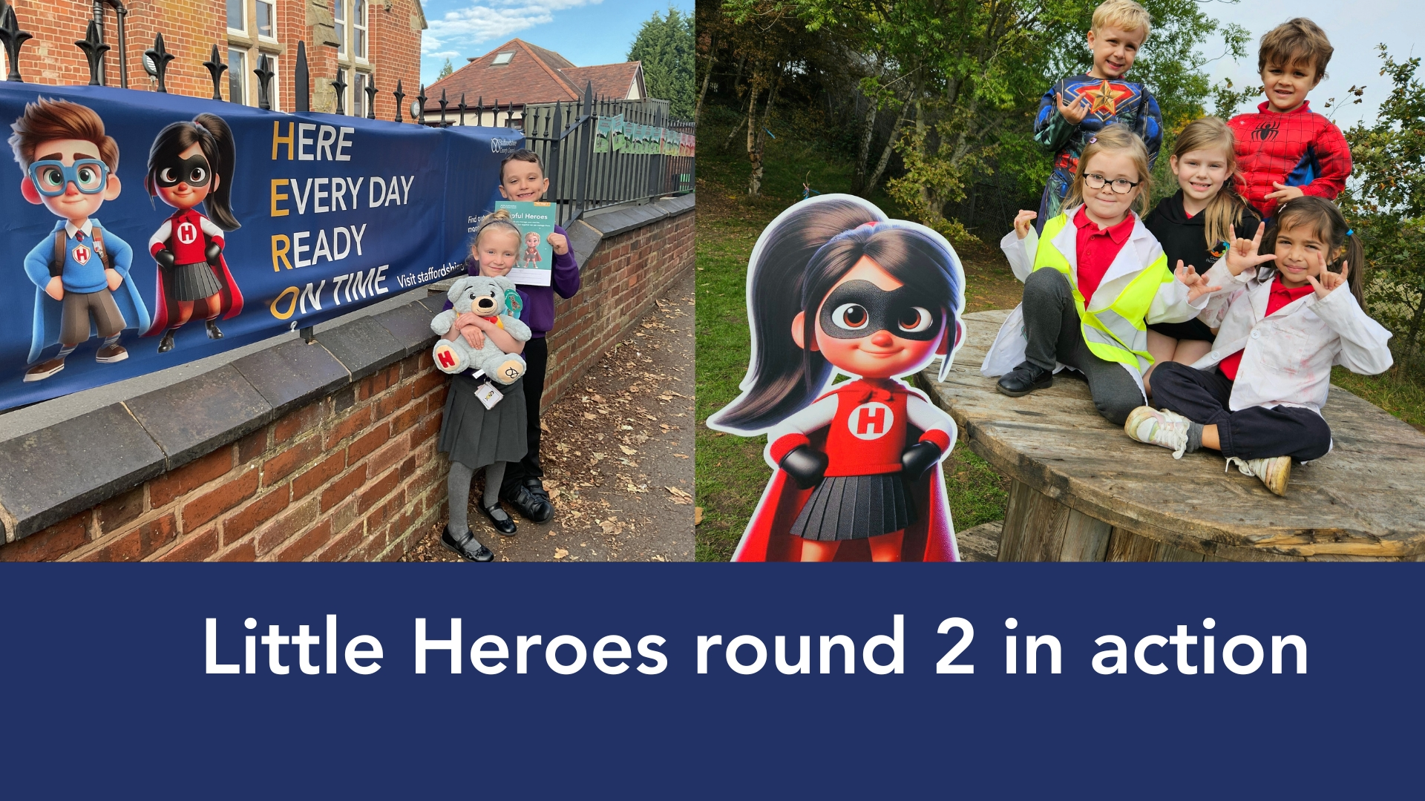

Slide 8


Slide 9
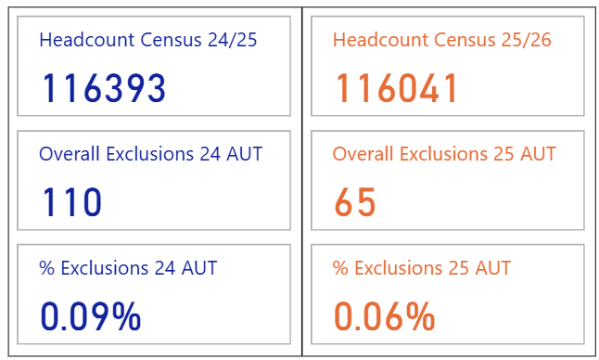
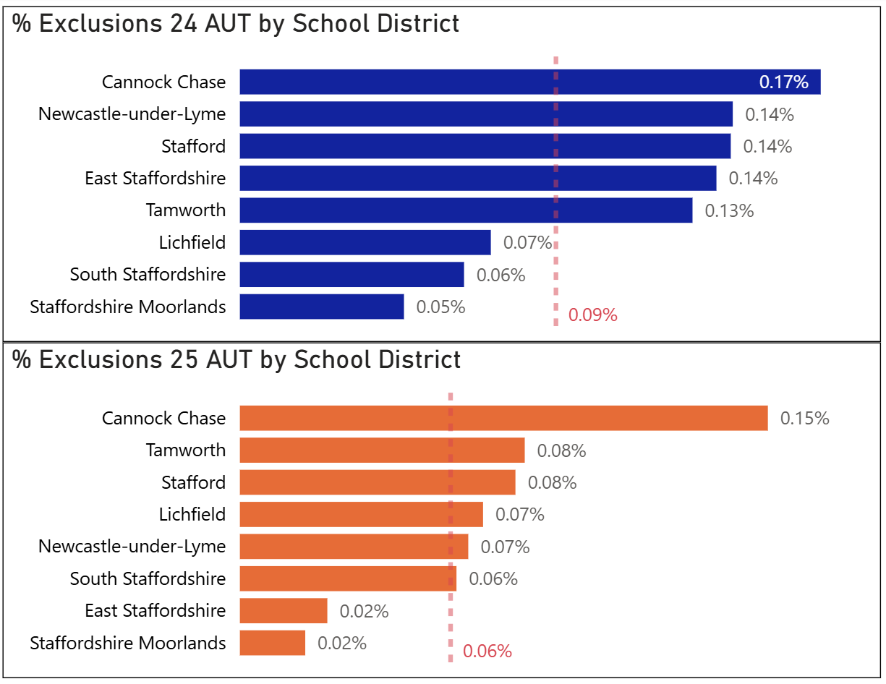
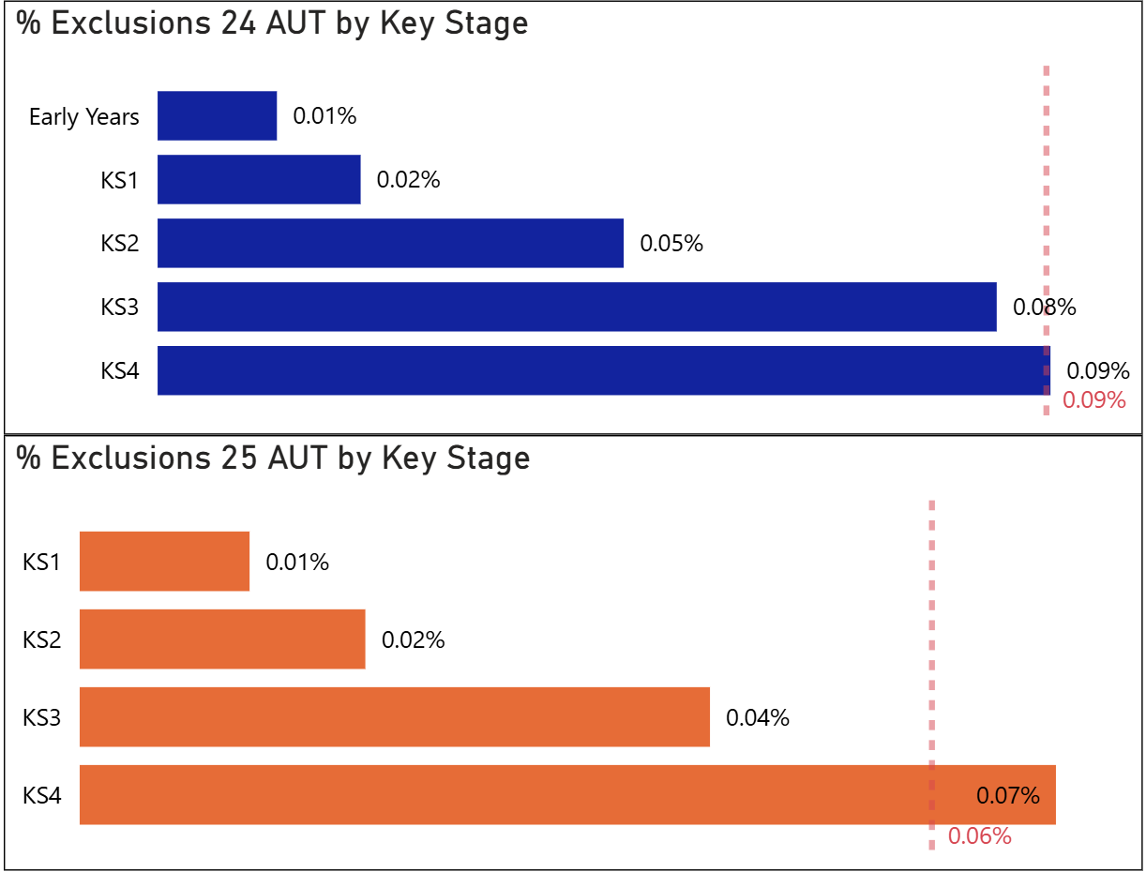
Autumn Term: Exclusion
In 2025/26 Autumn, both total number of exclusions and the rate of exclusion decreased from previous autumn term. A total number of 65 exclusions, dropping from 110 in 2024/25 Autumn, had been recorded, or 0.06% out of 116041 pupils (the correspondent school census pupil number of Year 0 to 11).
Cannock had the highest exclusion rate across all districts in both Autumn terms.
KS4 remained the highest exclusion rate although with a reduction of 0.02%. Early Years pupils had no permanent exclusion recorded in 2025 Autumn term.
All overall numbers and rates % were based on Capita unvalidated data of Year 0-11.
Overall cohort was based on School Census 2024 Autumn or 2025 Autumn figures (Year 0-11)

Slide 10
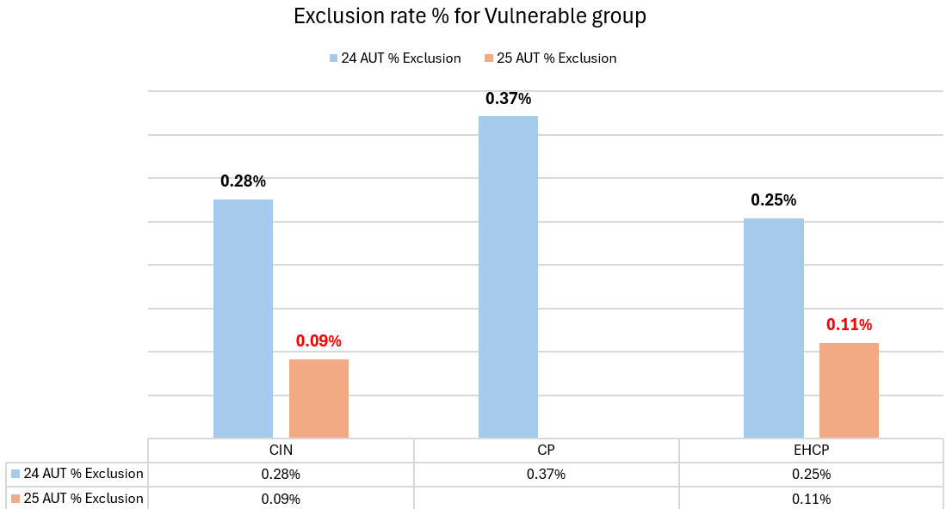
Autumn Exclusion of vulnerable groups in Staffordshire
Not all vulnerable groups experienced permanent exclusions in last two Autumn terms in Staffordshire, but if they did, the permanent exclusion rate has reduced compared with 2024
For example, in Autumn 2025 Children in need (CIN) evidenced a 0.09% exclusion rate compared to 0.28% in Autumn 2024
Children with an Education, Health Care Plan (EHCP) also saw a 0.11% permanent exclusion rate compared to 0.25% in Autumn 2024
Other vulnerable groups, namely children with a Care Protection plan (CP), those children in care (CIC) had no permanent exclusion recorded in Autumn 2025.
Notes:
Note:
A permanent exclusion incident occurred during Autumn term (starting from 1st Sep and ending at 31st Dec) will be counted as 1 record for permanent exclusion.
If a pupil started being a part of a vulnerable group at any point of Autumn term (from 1st Sep to 31st Dec), this pupil will be counted as a member of the relevant group.
The above is different from the understanding that an incident record is counted ONLY WHEN the incident happened AFTER the date when the pupil became a member of the vulnerable cohort.

