Slide 1
Regional Advocacy Strategy.
Pembrokeshire County Council Scrutiny, 20th March 2026.
Sarah Mackintosh, Carmarthenshire People First.
Kevin Pett, West Wales RPB Team.

Slide 2
Overview of session
Advocacy in context: what it is, who it is for and the benefits
Advocacy in West Wales: history, strategy and IPA service
An experience of advocacy

Slide 3
Advocacy in context: what it is, who it is for and what the benefits are

Slide 4
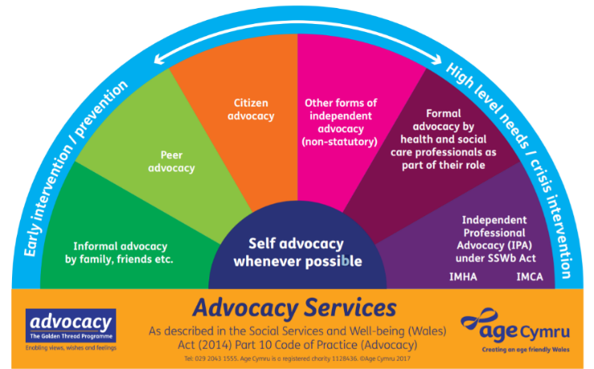
Types of advocacy

Slide 5



What is Independent Advocacy
A Voice When You Need It Most
Options and Consequences
Supporting Self-Advocacy
Listen without bias or judgement
Independent of all other services
Speaking up with/for the person
Exploring views and wishes
Providing information
Supporting informed decision making
Self-advocacy is the best advocacy
Promoting independence
Instructed or non-instructed

Slide 6
Who Can We Support and When?
Advocacy support with
Person with a need for care and support
No other appropriate individual
Mental Health,
Physical Health,
Learning Disability,
Autism,
Sensory Impairment,
Carer
Barrier to self-advocacy
No family member or friend able or willing to advocate or
Who the person wants as their advocate
Care and support assessment, planning and review
Safeguarding processes
Recent complaint about the above
As early as possible helps

Slide 7
Benefits of Advocacy
For the Person
Unbiased support to speak up – develop own self-advocacy skills
Securing rights and entitlements
Better informed decision making
Early intervention
Developing and maximising independence
Increased confidence and self-esteem
Safeguarding
For the Professionals
Early intervention = reduced service demand/costs
Maintain clearer focus on the invidividual.
Clarity around rights and entitlements.
Better decision making
Encourages a holistic approach
Some professionals describe it as having a good angel on the shoulder.

Slide 8
Advocacy in West Wales: history, strategy and IPA service

Slide 9
IPA in West Wales: a potted history
Social Services and Wellbeing Act (2014) requires local authorities to commission IPA services and promote access to the spectrum of advocacy provision
“Advocacy should be considered as an inherent part of the Act to focus social care around people and their well-being. Advocacy helps people to understand how they can be involved, how they can contribute and take part and whenever possible, to lead or direct the process”, (Code of Practice).
Three counties Advocacy Network (AN): improve, promote and develop advocacy services
AN and commissioners co-designed the regional service model: SPOC, local delivery, recognition of specialisms, links to IAA services
Trialled in Ceredigion (commenced 2019) – regional from 2022

Slide 10
Regional advocacy strategy
Signed off 2022
Built on extensive engagement with citizens, practitioners, commissioners and providers, via Golden Thread Advocacy Programme
Engagement included events, interviews, focus groups and a survey
Priority 1. Maintain and develop further our co-productive approach
Priority 2 Raise awareness of, and understanding of, advocacy.
Priority 3. Ensure advocacy is easily accessible and equitably available
Priority 4. Ensure advocacy is of a consistently high standard of quality
Priority 5. Maintain specialisms and non-statutory forms of advocacy

Slide 11
Regional advocacy strategy: progress
Strengthening links with the regional citizen’s engagement board.
Maximising effective alignment with Llais (citizen voice). Llais is represented on the ASIG.
ASIG is being provided with more detailed IPA contract monitoring information, which is assisting understanding of areas of greatest demand.
Implementation plan update is regularly considered by the Advocacy Strategy Network.
Self-advocacy toolkit developed, including easy read version, with sessions being held with other providers.
A rolling programme of awareness raising sessions has taken place, with a series of dates scheduled through to October 2026.
Strong support for Advocacy Awareness Week (October annually).
Digital stories under development, working with people with lived experiences.
Awareness raising infomercials are nearing completion.
Liaison with local mosques to ensure culturally appropriate advocacy provision.

Slide 12
IPA: delivery and impact
325 new referrals (142 Pembs) 1/4/25-31/1/26
479 receiving support (179 Pembs) same period
Growth on the previous period – increasing demand
Mental health, then physical health, the top two presenting needs – for both the region and Pembrokeshire
Social care was the top primary issue at referral – region and Pembs. Housing and healthcare were next in prevalence
Challenge: significant advocate pay disparities vs (for instance) Llais, budget considerations are constraints

Slide 13
An experience of advocacy

Slide 14
One Person’s Experience – Impact of Advocacy Relationship:
My advocate has always been my safe person. She knows me so well. She is consistent and boundaried.
She has supported me to have my own needs and boundaries met.
She has been so vital to me, supporting me to self-advocate, I feel empowered by the way she works.
She always focuses just on me. She empowers me to take the power I've given away before.
But if there is one function I can highlight about the benefit of her being my advocate, it is supporting my voice and valuing me as a sentient adult human being.
I know it doesn't guarantee a positive outcome but to be sure I feel
seen and heard and worthy of respect and belonging.

Slide 15

Diolch/
Many thanks
https://www.wwrpb.org.uk

