Slide 1

Social Care Overview and Scrutiny Committee
Citizens Advice Pembrokeshire
Jayne O’Hara, CEO & Dan Hewitt, Service Delivery Manager
20th March 2026

Slide 2
Citizens Advice Pembrokeshire
1. Introduction
2. Client issues and outcomes
3. Strategic Priorities – progress 2025/26
4. Strategic Priorities – 2026/27
5. Any questions
Notes:
Unique clients

Slide 3
What we do
We are an independent charity giving free and confidential advice to people in our community. However simple or complex the problem, we want to help and give people the tools and the confidence to find a way forward.
In 2025/26
We helped nearly 3000 people
Dealt with over 15,000 issues including debt, income maximisation, housing, employment and consumer issues.
95% of clients surveyed said they wouldn’t be able to sort out their problem without our help
Notes:
Unique clients

Slide 4

Client issues
51% Welfare Benefits/Universal Credit (managed migration to UC)
29% debt and financial capability
66% of all Welfare Benefits issues were regarding disability benefits
234 clients referred for 323 food parcels
74% clients disabled or with a long-term health condition
Notes:
WB/UC issues same level as last year
Debt/fin cap more than double compared to previous year
Attendance Allowance, PIP and DLA – twice the amount of issues compared to 2024/25
Similar numbers of clients referred for food parcels to previous year.
The percentage of clients with a disability or long-term health condition remains static

Slide 5
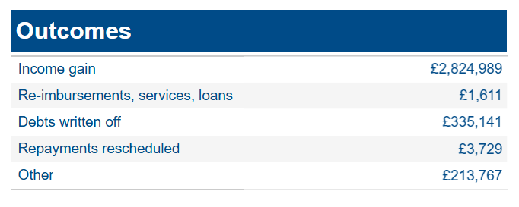
Client Outcomes 2025-26
Notes:
Average annual income gain of £977 per client in 2025/26, a 24% increase on previous year

Slide 6
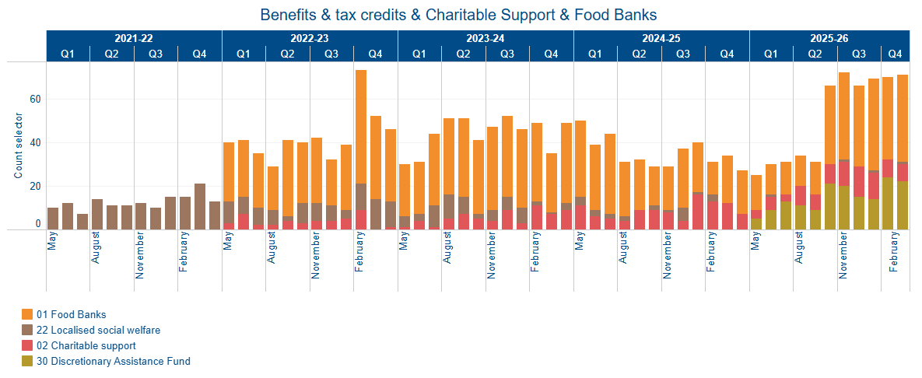
Crisis Support (Clients)
2022/23 to 2025/26
Notes:
There has been an upward trend in clients needing crisis support over the last 6-month period, higher on average than in previous years during the same period
6

Slide 7
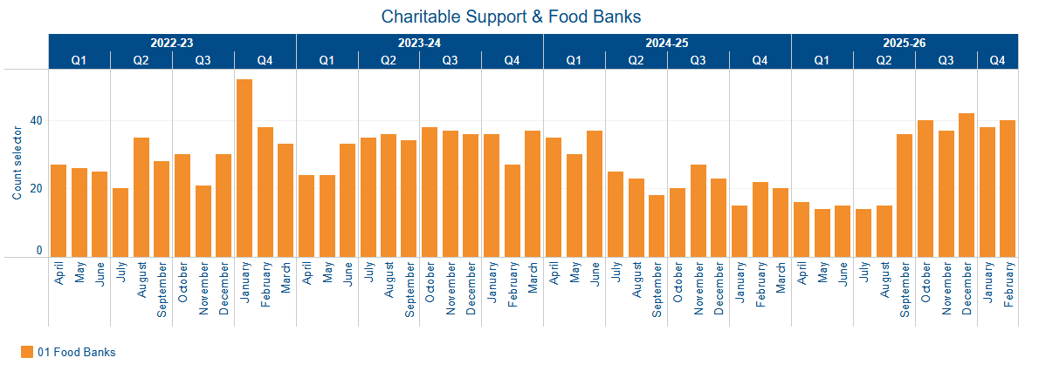
Food Bank Referrals(Clients)
2022/23 to 2025/26
Notes:
Increase in foodbank referrals during the last 6 months and much higher than in the same period last year.
7

Slide 8
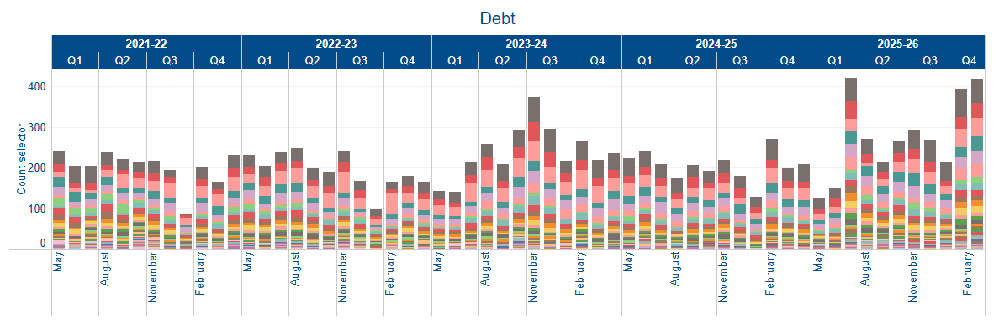
Debt
2021/22 to 2025/26
Notes:
Upward trend in debt clients with complex debt issues, and an increase in numbers of clients with ‘priority debts’ including council tax, rent arrears and utilities.

Slide 9
Our strategic priorities
1. Provide advice to people in the best way for them and be flexible in how we do this
Email
Telephone
In person
- Outreach in Pembroke Dock, Haverfordwest, Tenby, Kilgetty,
Narberth, Fishguard, Neyland & Milford Haven
- Home visits
- Office appointments at Pembroke Dock & Haverfordwest
AI Chatbot on website
Clear voice interpretation service

Slide 10

Our strategic priorities
2. Improve advice access for the most vulnerable through focused partnerships
Partners for the Journey – in partnership with Pembrokeshire MIND
PWR Pembrokeshire Welfare Rights and Money Cares - in partnership with PCC
Beyond the Foodbank – in partnership with Pembrokeshire Foodbank (Trussell) and PATCH
Notes:
Partners for the Journey – supporting people with mental health issues with a range of issues including debt, benefits and housing
PWR – supporting families with young children to maximise income and improve financial resilience. Half a million financial gains secured for families this year to date.
Beyond the foodbank – first year of the project funded by Trussell Trust to support clients with maximizing income and improving financial resilience to reduce reliance on foodbanks; increasing numbers of clients are being referred with positive income gains for clients

Slide 11

Our strategic priorities
3. Focus on our People and Culture
    27 paid staff
    Real Living Wage applied in 2025/26 through uplift in funding from PCC
    21 volunteers
    Help with delivering Adviceline, appointments and form filling, administration, Trustees
    Remuneration review
    Currently underway to review pay structure and wider reward/terms and conditions

Slide 12
What our volunteers say….
"Volunteering here is such a rewarding experience. The team is incredibly welcoming, and the support and training are top-notch. I love knowing that the advice I give has a real, positive impact on people’s lives. It’s truly fulfilling, and I couldn’t recommend volunteering at CAP enough!“

Slide 13

Our strategic priorities
4. Improve client outcomes through our profile, positioning and influence
Bureau Evidence forms – submitted to National Citizens Advice to evidence issues experienced by clients in Pembrokeshire
Regular meetings with MPs - informing elected representatives of the wider issues their constituents are facing
Words to Action – set up a Community of Practice for frontline service delivery
Well positioned within 3rd sector – representation on steering groups within Pembrokeshire and nationally.
Notes:
BEFs – feeding into the wider policy work of Citizens Advice nationally
We meet regularly with MPs Henry Tufnell and Ben Lake to raise issues affecting our clients, as well as receiving referrals from their caseworkers on behalf of constituents
Pembrokeshire Community of Practice set up to address and tackle poverty through collaboration and problem solving with frontline workers and commissioners
We attend steering groups locally, regionally and nationally including Tackling Poverty working group, Financial Capability forum and Carers Strategy meetings

Slide 14

Our strategic priorities
5. Maintain a financially robust, sustainable organisation
Single Advice Fund – Welsh Government
Currently Year 1 2025/26 – secured for 3 + 3
Regional delivery with Ceredigion, Carmarthenshire and Powys
RIF – Partners for the Journey
Secured for 2026/27 with match funding
Beyond the Foodbank
Trussell Trust funding Year 1
Moondance Funding secured for Year 2 and 3

Slide 15
Forecast income 2026/27
Notes:
Total funding of nearly £800k
47% of funding is from Welsh Government Single Advice fund
37% of funding is from PCC, including funding for the Money Cares and Welfare Rights projects
6% RIF
6% foodbank project
4% other

Slide 16
Priorities for 2026/27
Secure continuation funding for Partners for the Journey project for 2027/28
Bid for the PCC Specialist Advice contract
Develop relationships with new Members of Senedd
Staff consultation – remuneration review
Recruit new volunteers
Words to Action – Community of Practice
Explore further collaboration/partnerships to improve access to advice for vulnerable groups including gypsy traveller community, farming community and foster carers

Slide 17
Thank you, any questions?
Jayne O’Hara, CEO - email jayne.ohara@pembscab.org
Dan Hewitt, Service Delivery Manager - email dan.hewitt@pembscab.org
www.pembscab.org

