Slide 1

ICETR Summary Statistics for July/August 2025 – Annex A
Item 5.1
CM/09/25/51 Annex A

Slide 2
Summary of people in Long Term Segregation at end August 2025
The numbers of people in long-term segregation (LTS) have fluctuated throughout the qualifying period from May 2024 to date.
At the end of August 2025 there continues to be 74 autistic people and/or people with a learning disability in LTS.
19 of the 71 people (65 Adults and 6 children and young people) CQC have completed an IC(E)TR for have since left LTS.
CQC have a further 22 IC(E)TRs left to complete which we hope to achieve by the end of the programme (November 2025), 12 of which are scheduled.
Source: ICETR Data, 30 August 2025.

Slide 3
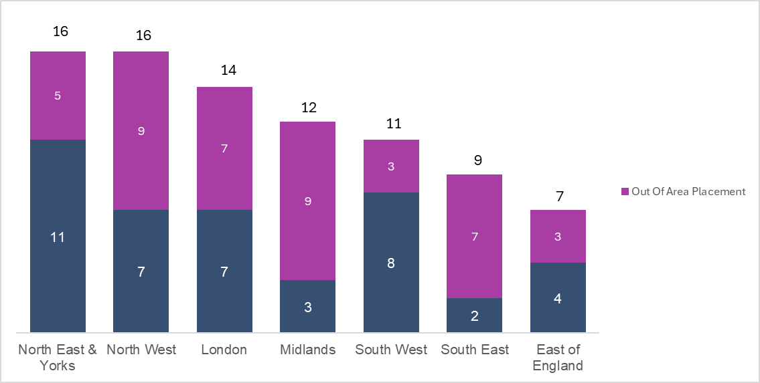
Numbers in LTS by NHS Commissioning Region – July 2025
Northwest and Northeast & Yorkshire fund the highest number of people in long-term segregation [16 respectively]
Each region funds out of area placements (over 30 miles away from home) that are denoted in pink.
Source: ICETR Data, 7th July 2025.

Slide 4
Numbers of people in LTS by Age Group and Gender
Most people in LTS are aged between 20 to 29. Age is unknown for 2 people. This appears in line with detention figures across the country.
The majority of people in LTS are male.
Over a third of people in LTS are aged 20 to 29…
Over two-thirds of people in LTS are male…
Note: Age was assumed as data only contains year of birth. For example, someone born in 2023 could be either 0 or 1 in 2024. For this analysis, the upper value of the range has been used
Source: ICETR Data, 7th July 2025.

Slide 5
Numbers of people in LTS by Ethnicity
White people make up the majority of people in LTS who are autistic and/or have a learning disability. This aligns to proportion of white people in the population, therefore there is not an overrepresentation. However, we know that there are wider mental health inequalities that people experience who are black and from other minority groups.
More than 8 in 10 people in LTS are White…
Source: ICETR Data, 7th July 2025.

Slide 6
Length of hospital admission and length of time in LTS for people currently in LTS
More than half of people in LTS have been in hospital for over 5 years…
1 in 7 of people in LTS has been in long-term segregation for over 5 years…
Source: ICETR Data, 7th July 2025.

