Slide 1


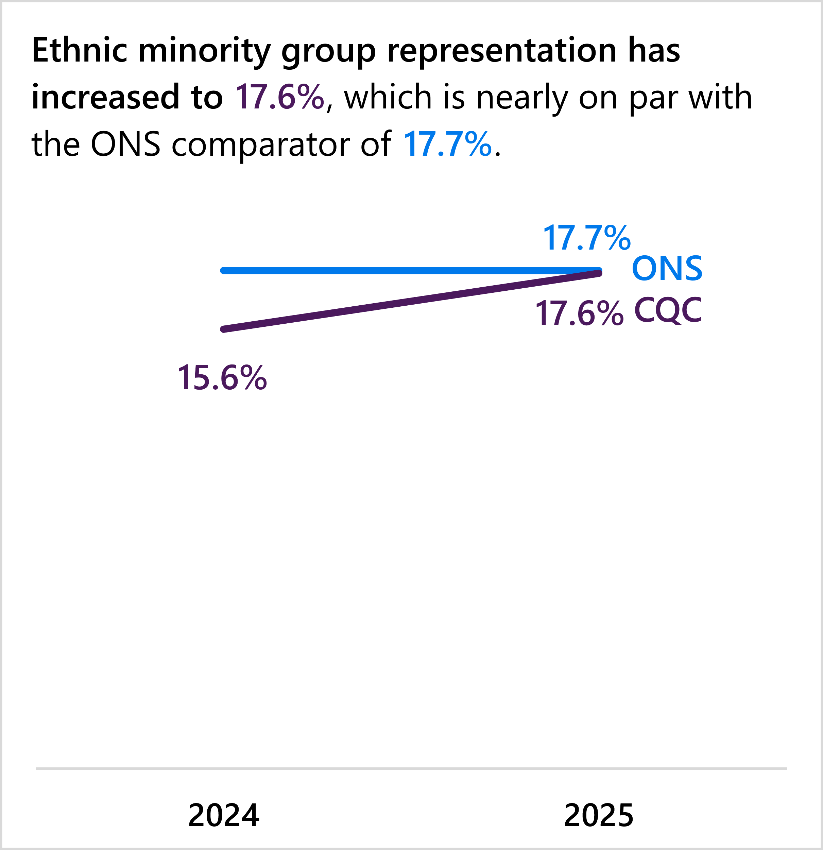
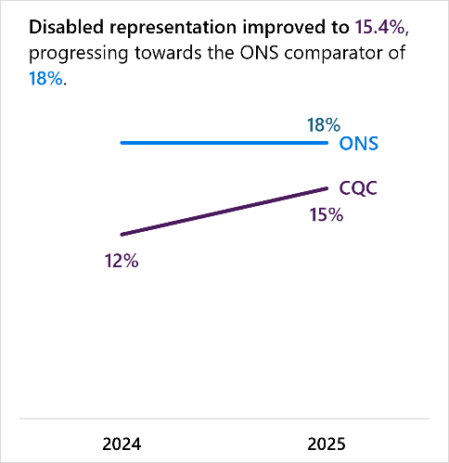
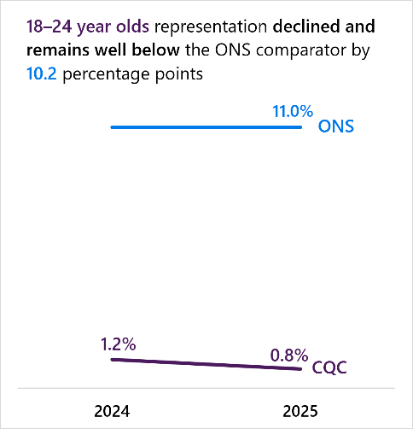
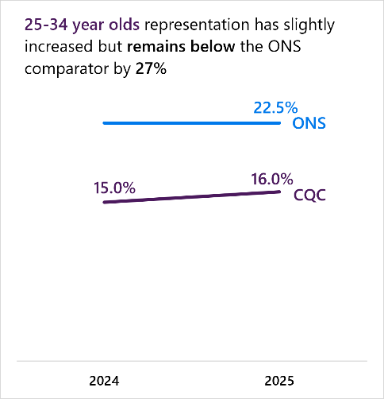
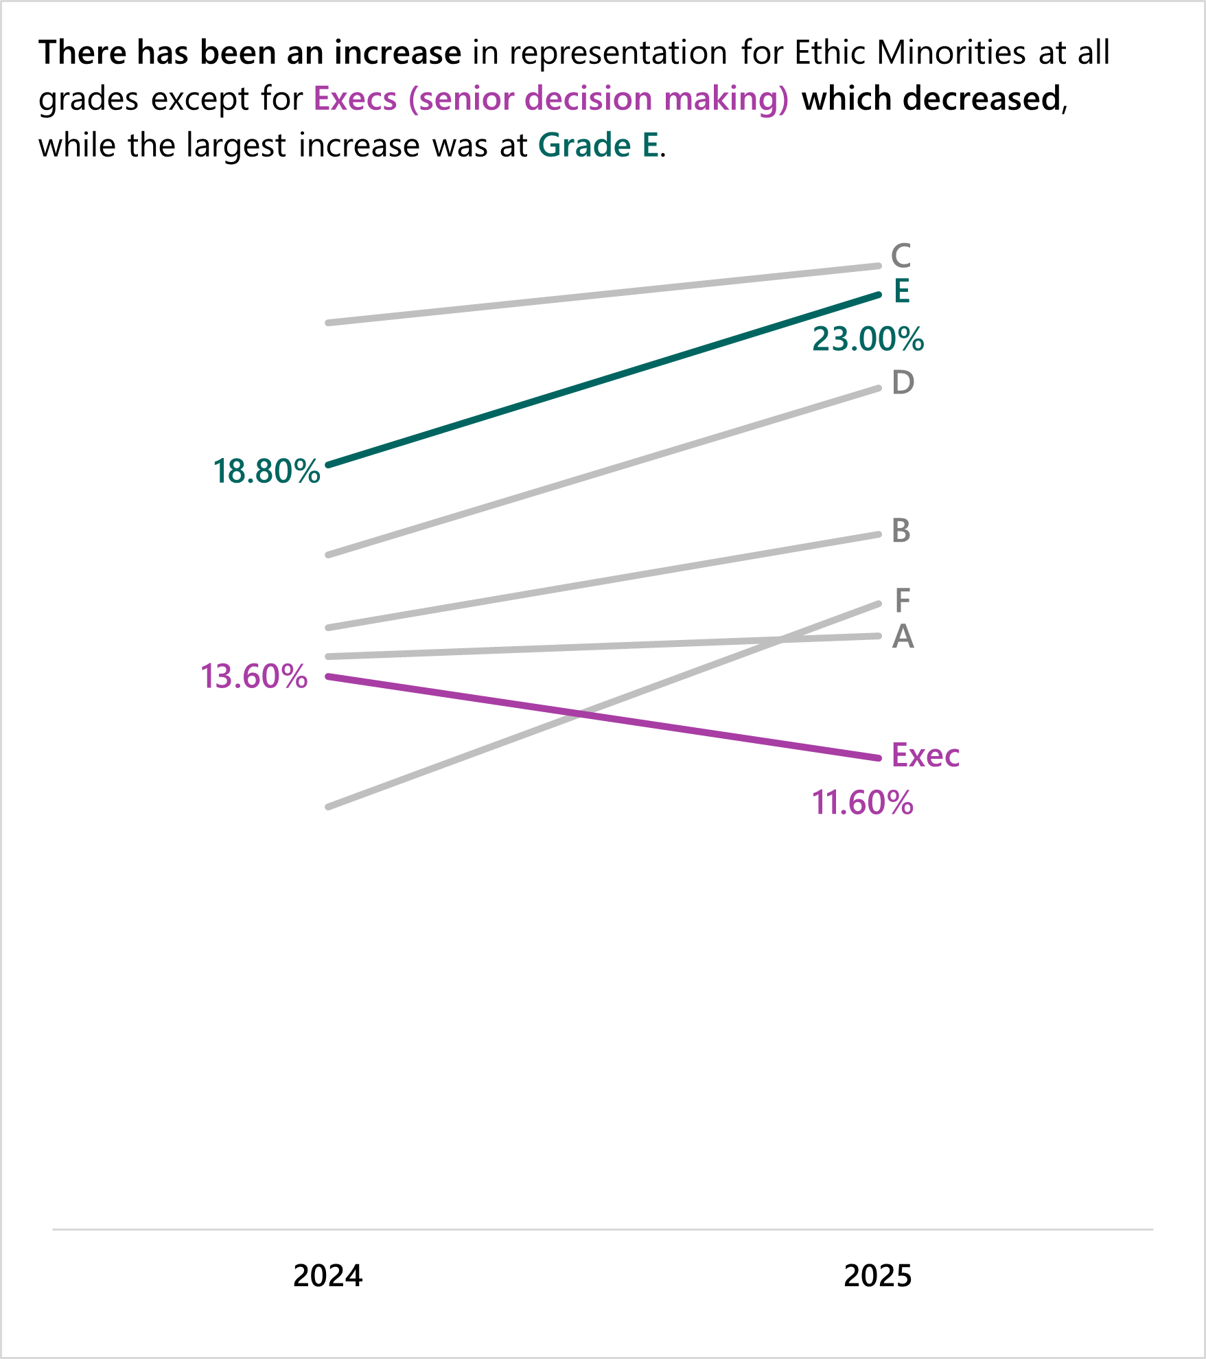
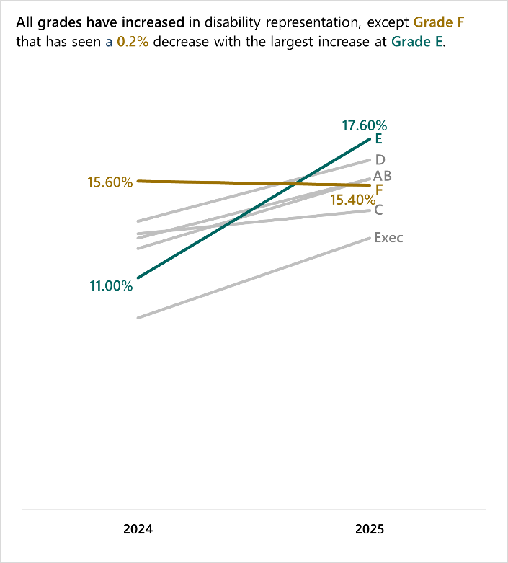
What we’ve found this year across our overall representation…
Recruit talented colleagues: Representation
And representation across our bands…
Key takeaways…
1
Overall representation of colleagues from Ethnic Minority backgrounds is nearly in line with our goal to meet ONS
2
We have more to do for overall disability and age representation
3
However disabled Exec and Grade A representation rose more than ethnic minority background representation at senior grades

Slide 2
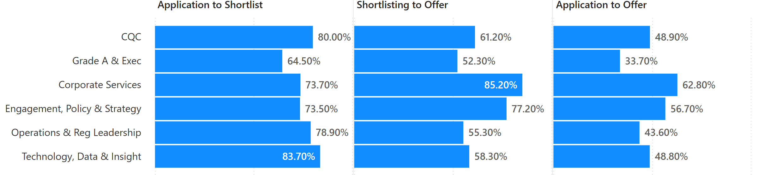
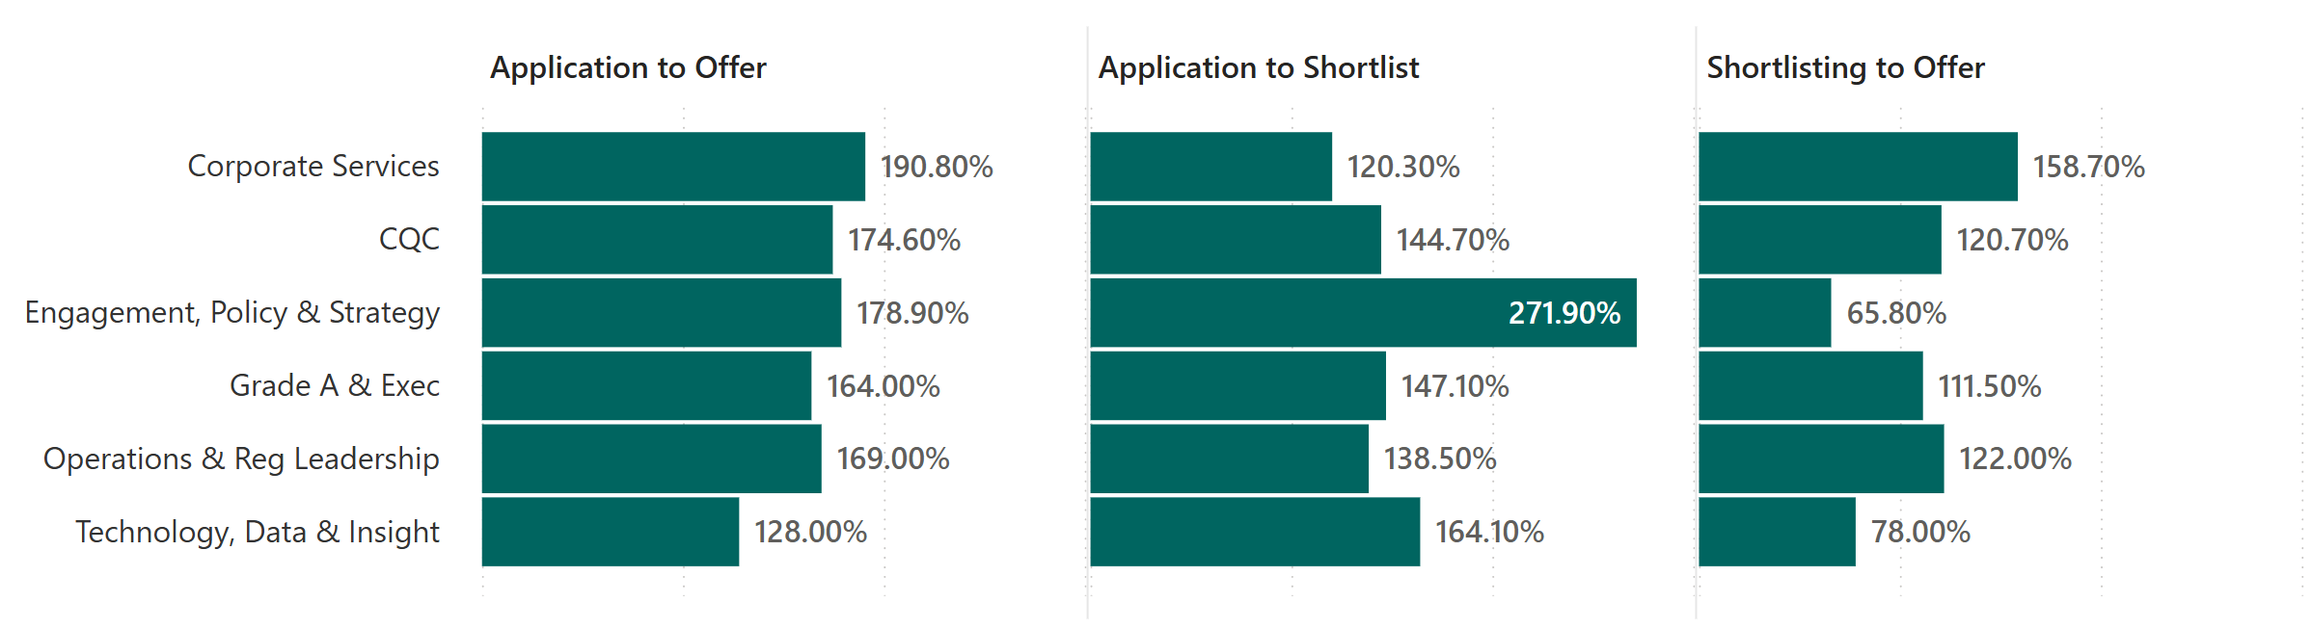
Recruit talented colleagues: Adverse Impacts during recruitment
Colleagues from an Ethnic Minority background
Disabled Colleagues
2
Key takeaways…
1
Ethnic minority background applicants continue to face adverse impacts at each stage of recruitment.
Disabled and LGB+ applicants have a higher chance of successful recruitment against the majority.

Slide 3
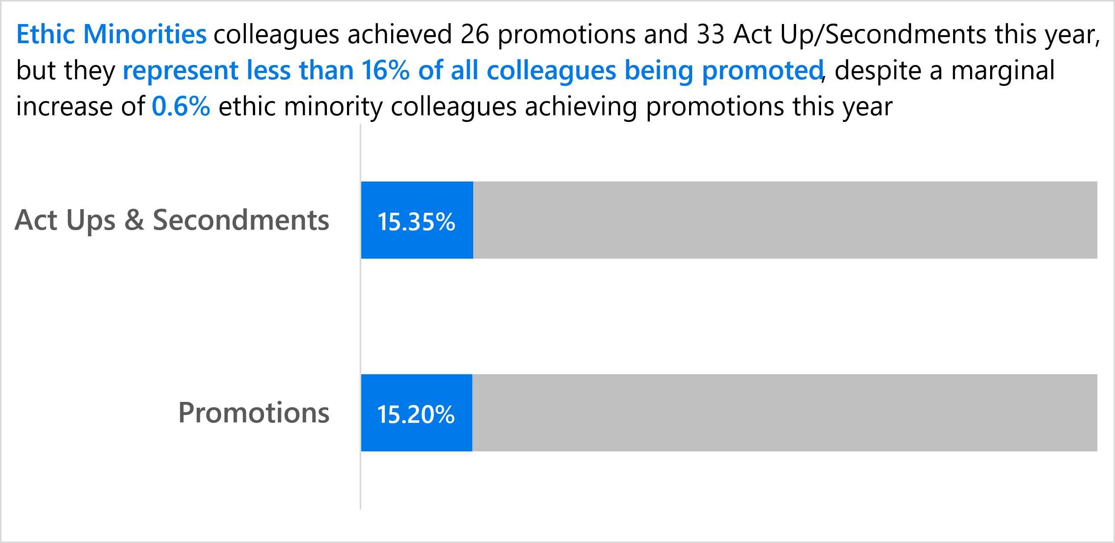
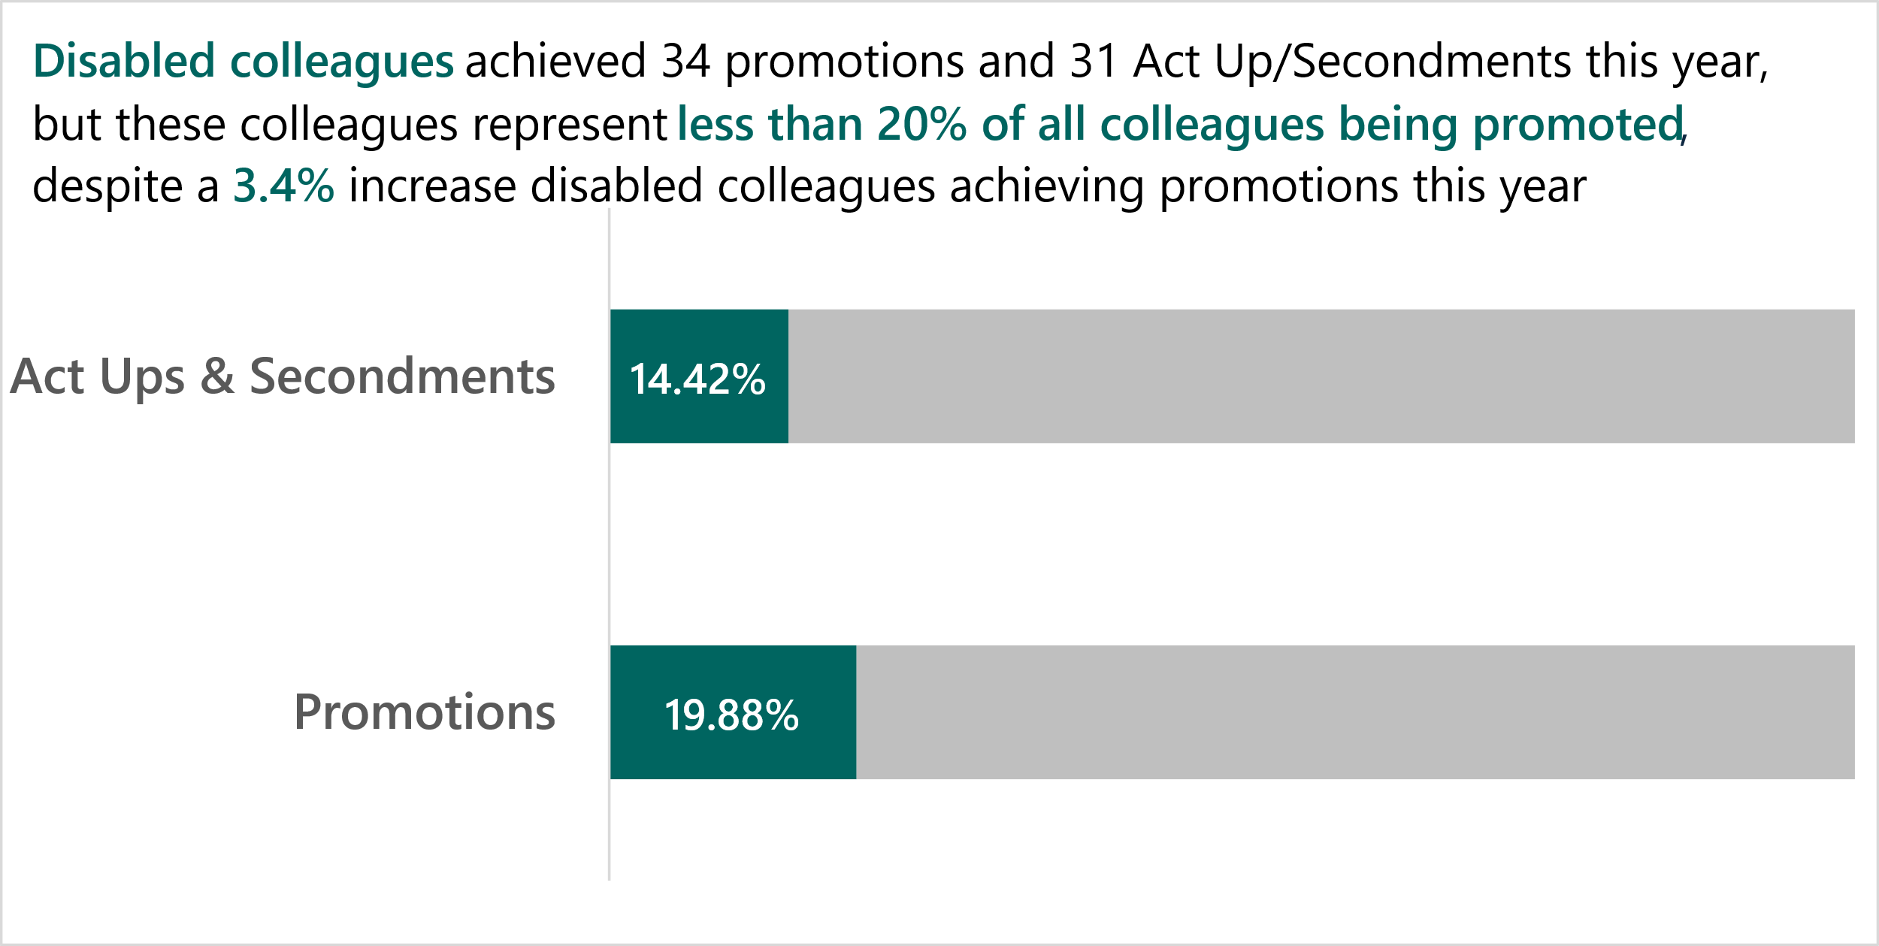
2024-2025 emerging promotion trends….
Invest in our colleagues: Promotions and Leavers
Top 3 reasons for leaving CQC comparison…
Key takeaways…
Group | Resignation – Promotion |  | Resignation – Not Known |  | Retired
 | 2024 | 2025 | 2024 | 2025 | 2024 | 2025
Ethnic Minorities | 1 | 1 | 1 | 1 |  | 0
Disabled |  | 1 | 1 | 1 | 1 | 1
LGB+ |  | 0 | 1 | 1 |  | 0
Age 21-30 |  | 1 | 1 | 1 |  | 0
Age 61+ |  |  | 1 | 1 | 1 | 1
1
There has been a larger increase of promotions for disabled colleagues compared to ethnic minority colleagues. PCC should agree an overall CQC promotion goal to support assessing progress fairly, including time for promotion parity and by characteristics.
2
Promotion remains one of the main reasons for ethnic minority background colleague Leavers. Promotion is also now one of the main reasons for ages 21-30 and disabled colleagues leaving.

Slide 4
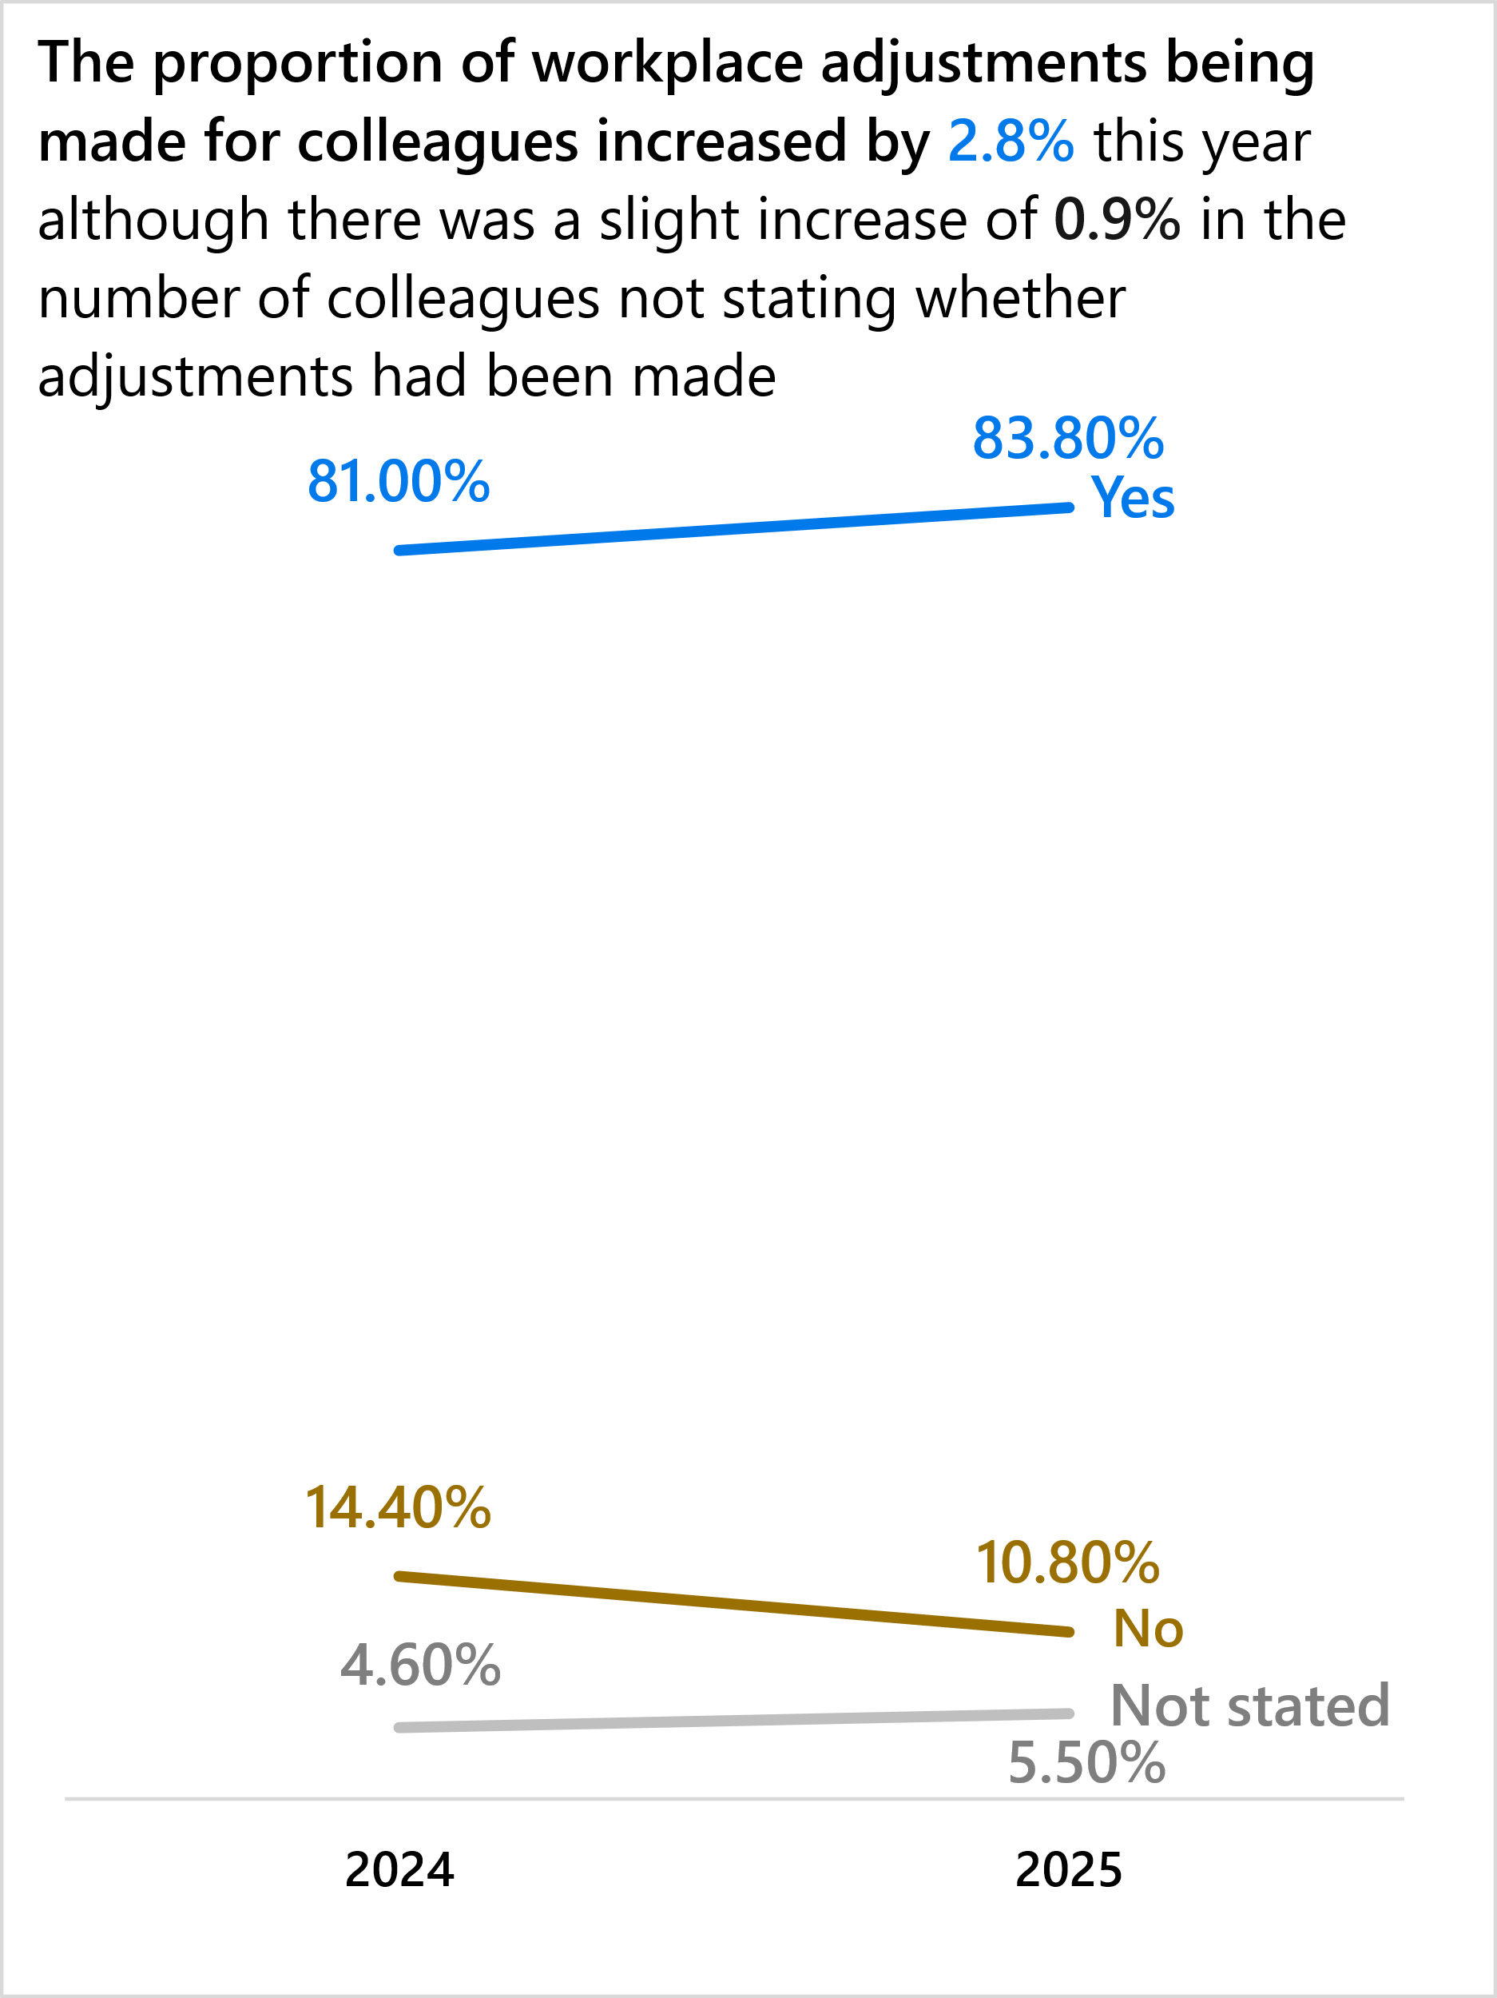
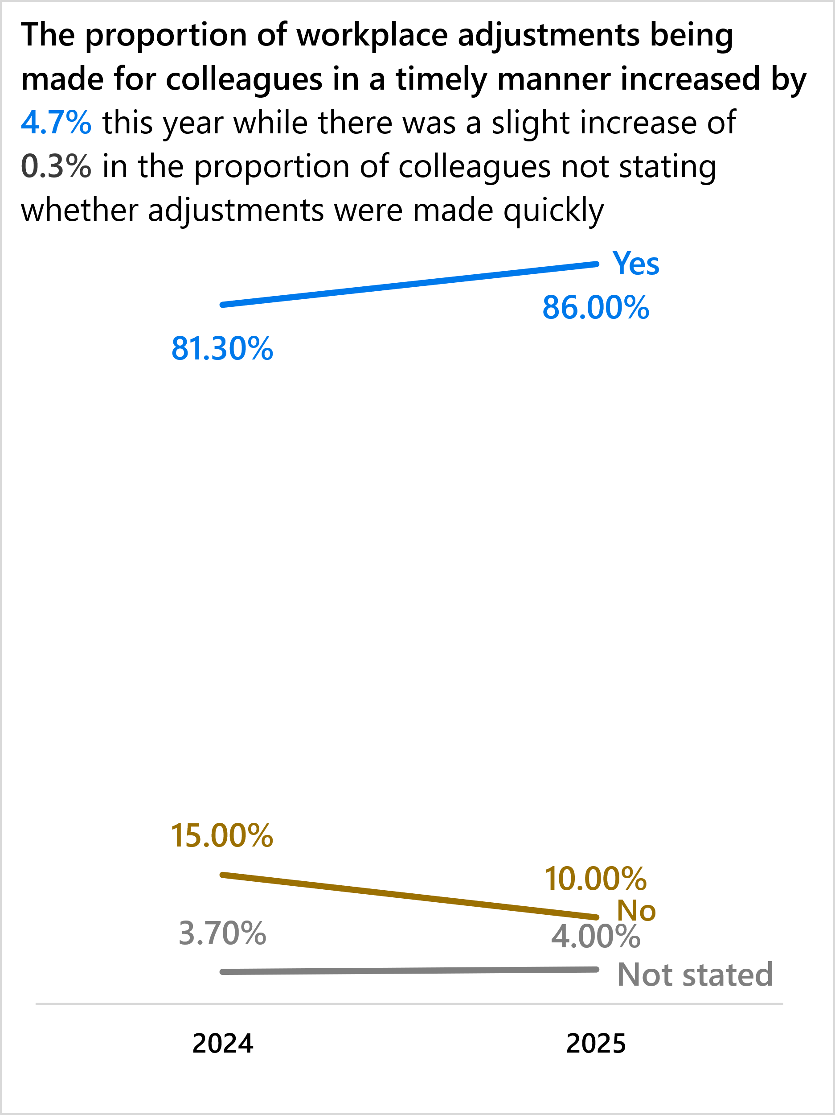
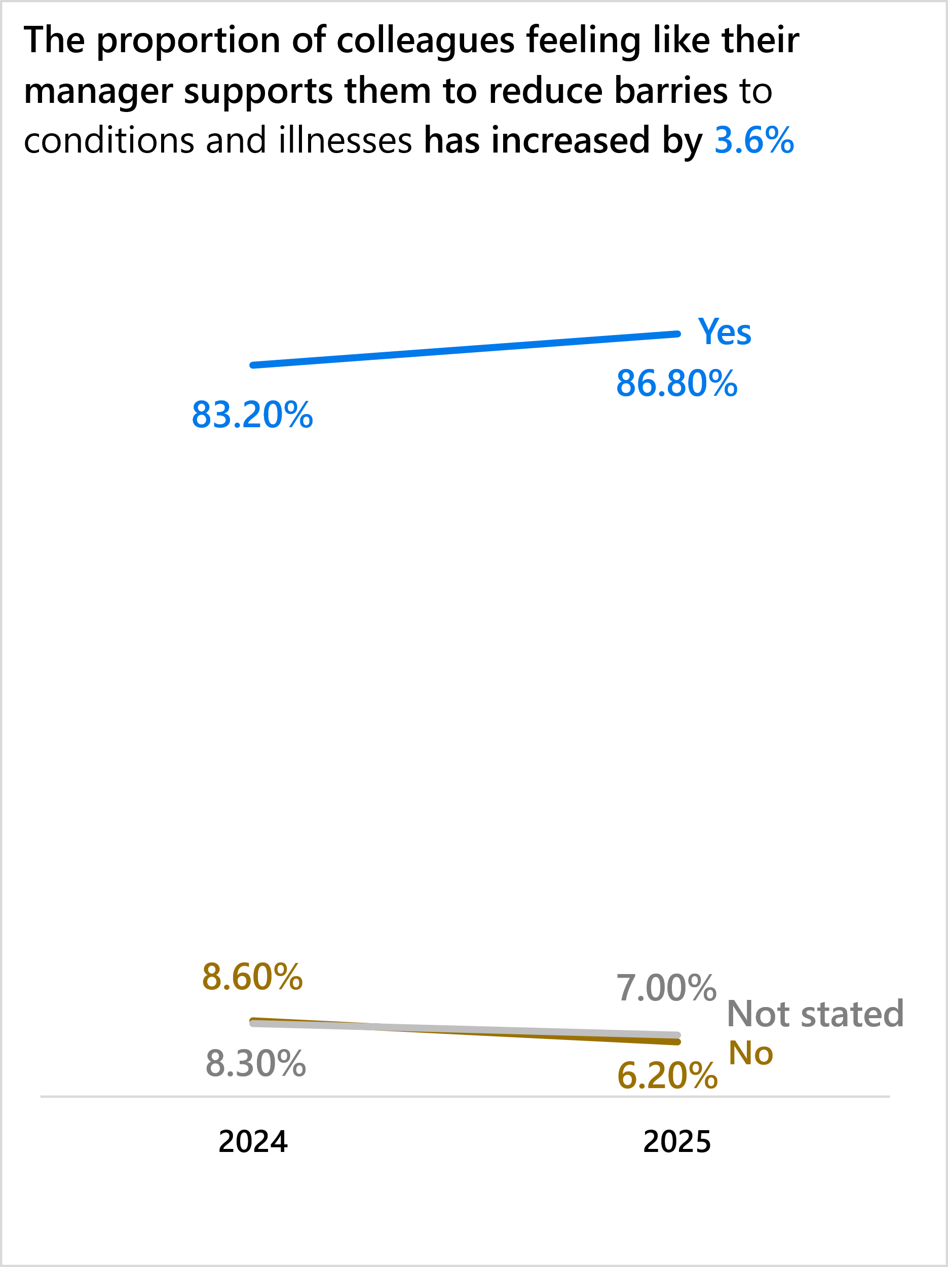
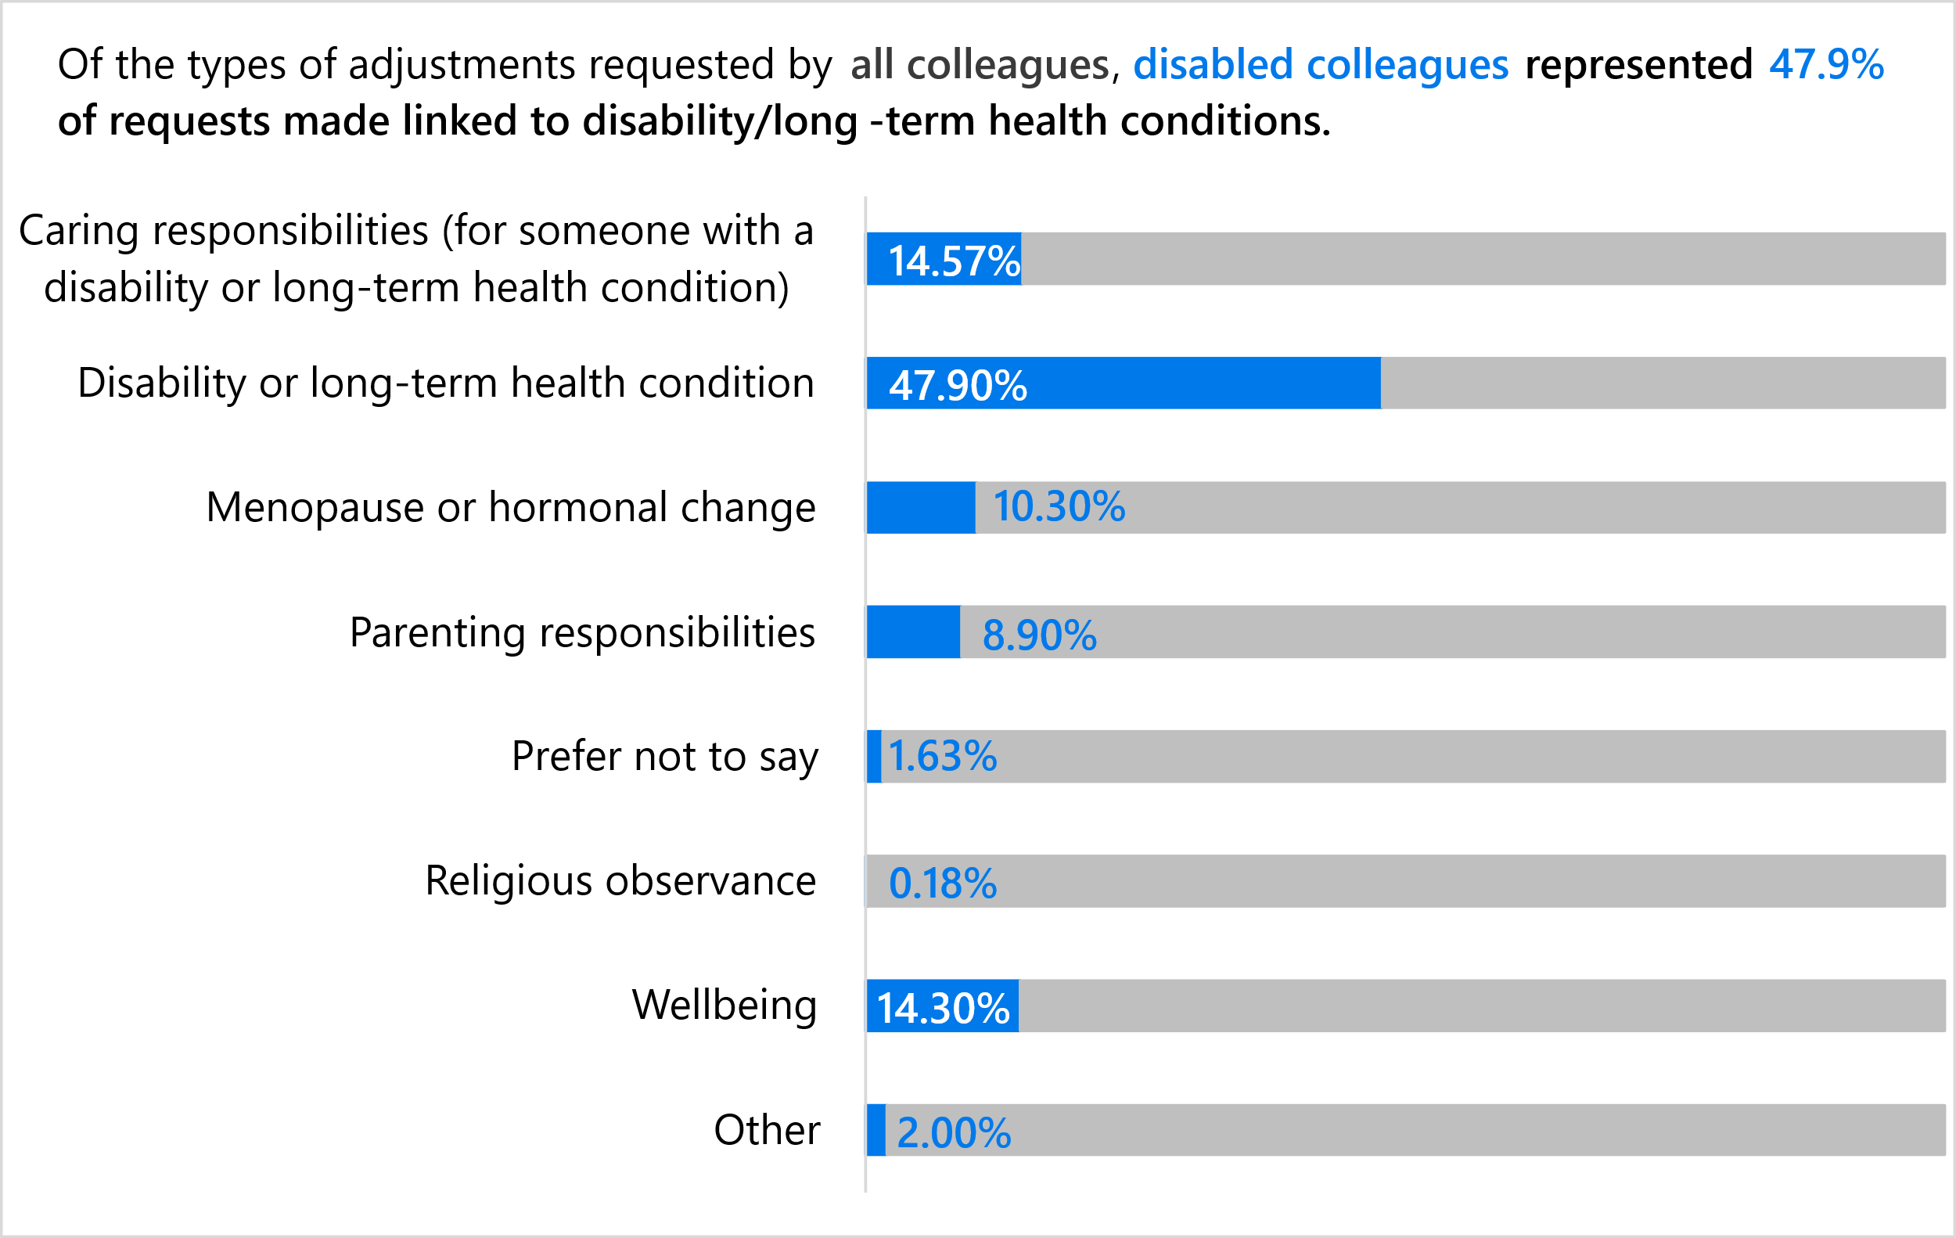
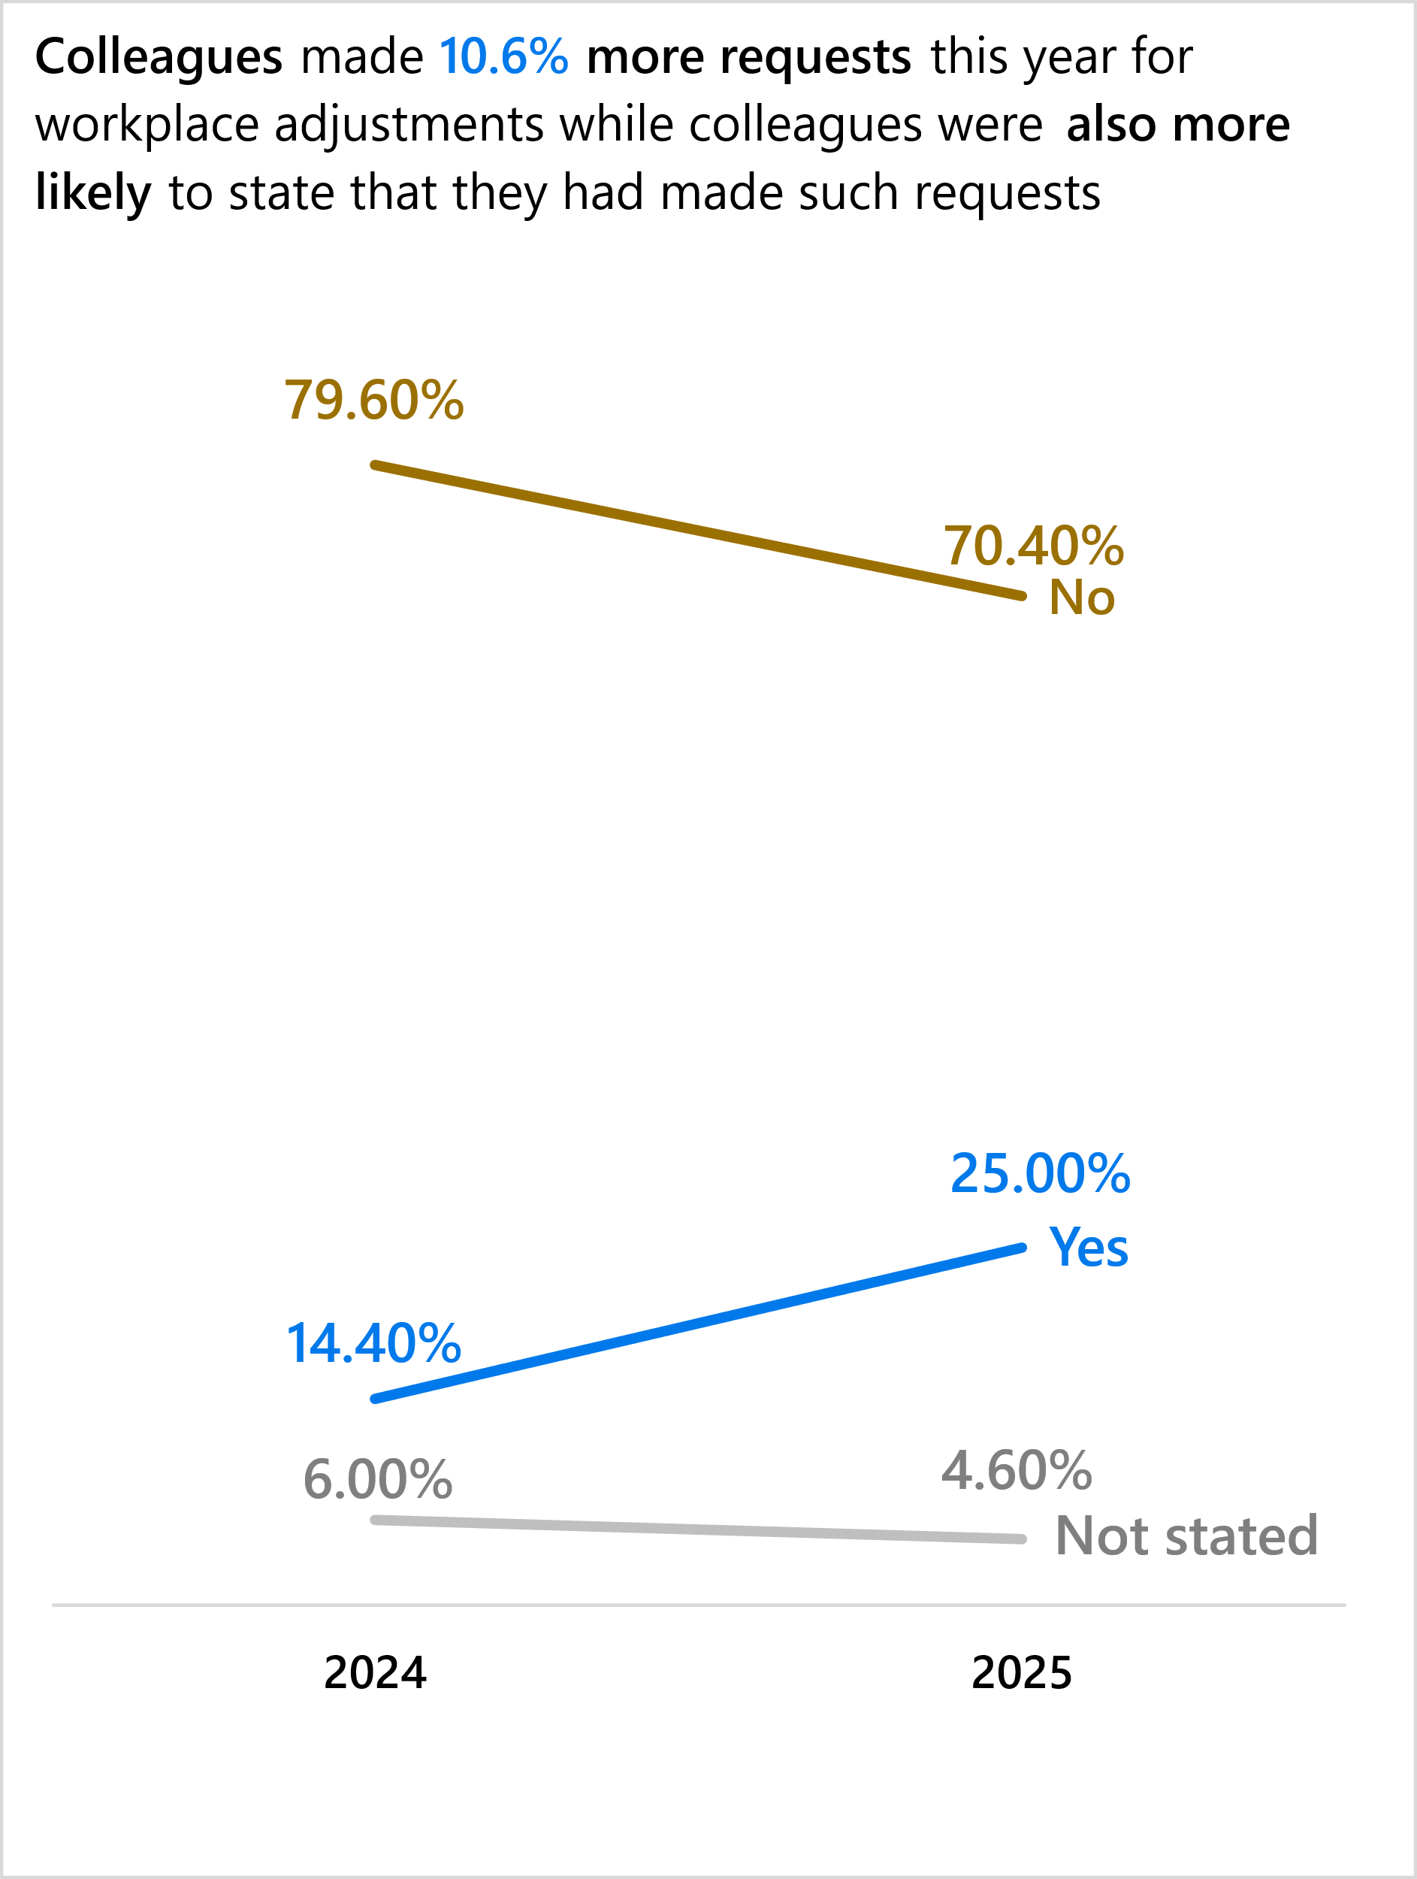
This year, 2,121 staff responded to the question of adjustments being requested, with 25% (530) saying they requested adjustments….
Foster Inclusion and Belonging:
Workplace Adjustments survey feedback
Notes:
See Annex slide,,,, ,for further data from Passport uptake

Slide 5
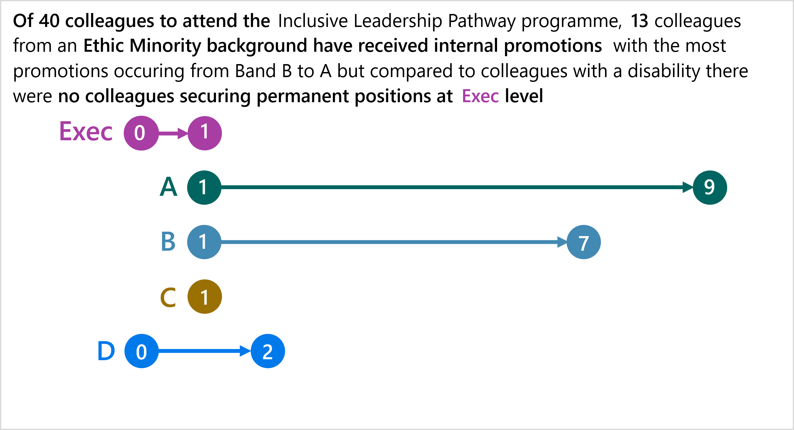
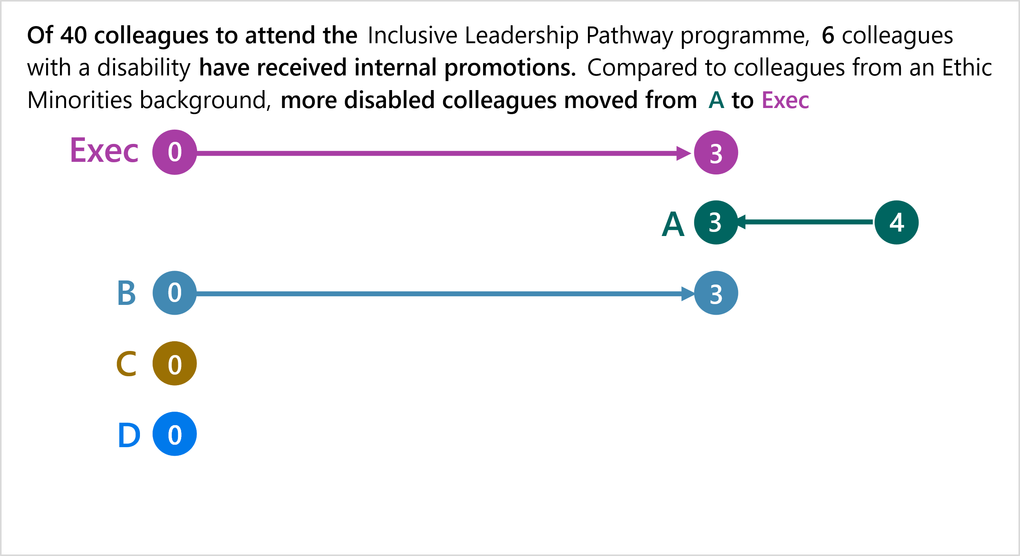
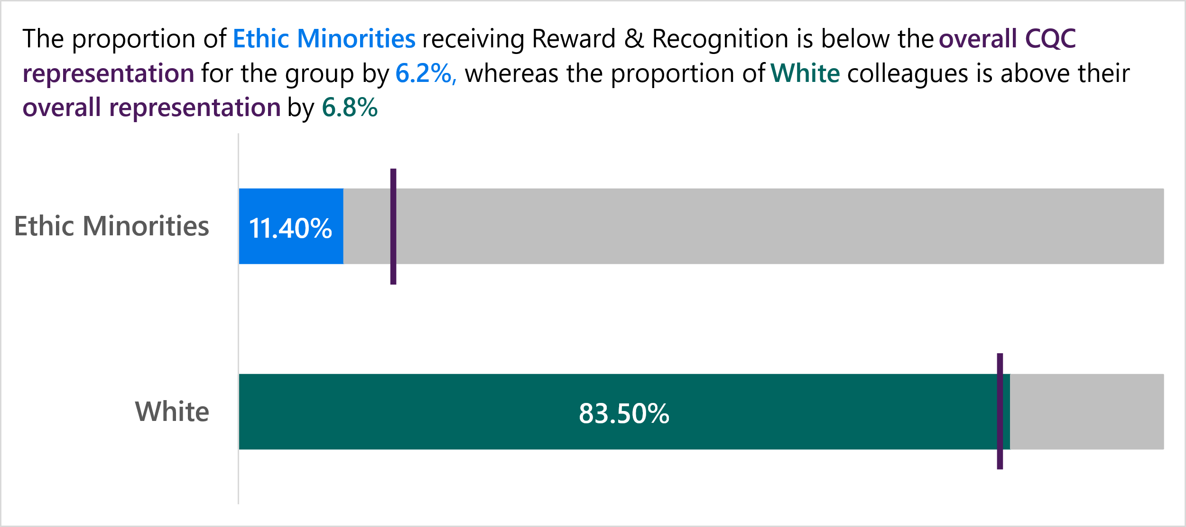
Inclusive Leadership Pathway career development positive action
Foster Inclusion and Belonging & Invest in our colleagues: Inclusive Leadership Pathway and Recognition
How we reward & recognise our colleagues…
Key takeaways…
1
The ILP can support Grade A- E3 appointments to build our diverse talent pipeline
2
For R&R, we should aim for distribution across all groups as closely as possible in line with overall CQC representation, to ensure a fair distribution. Ethnic minority colleagues face disparities

Slide 6
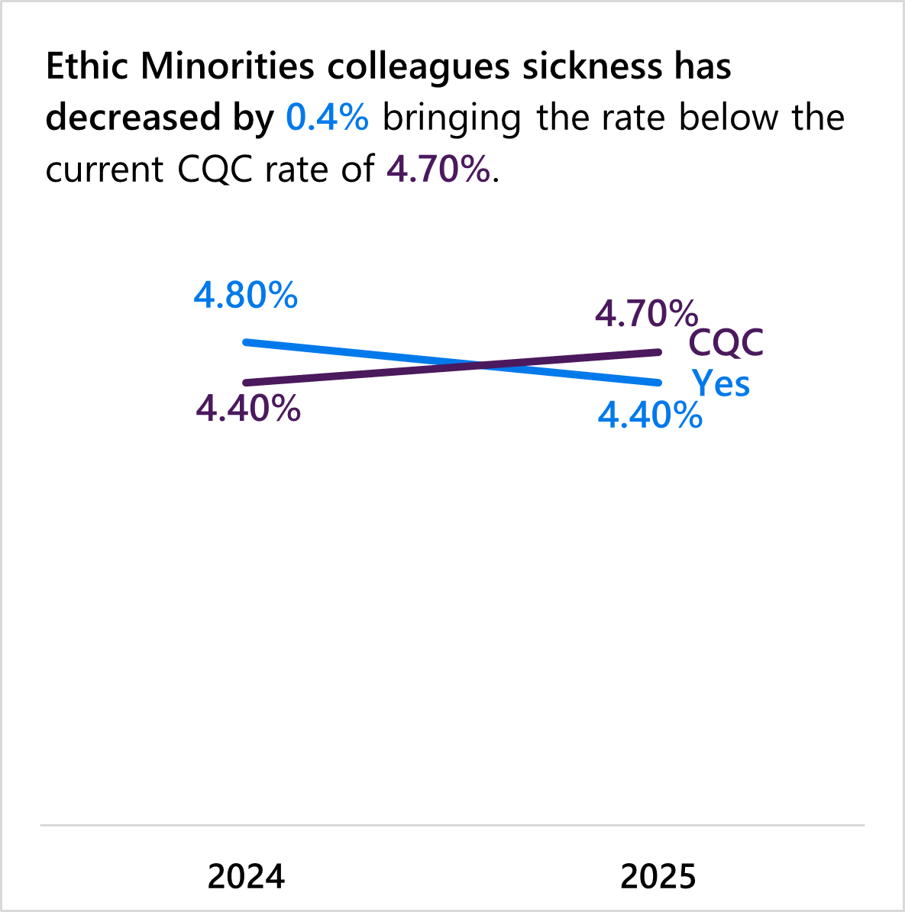
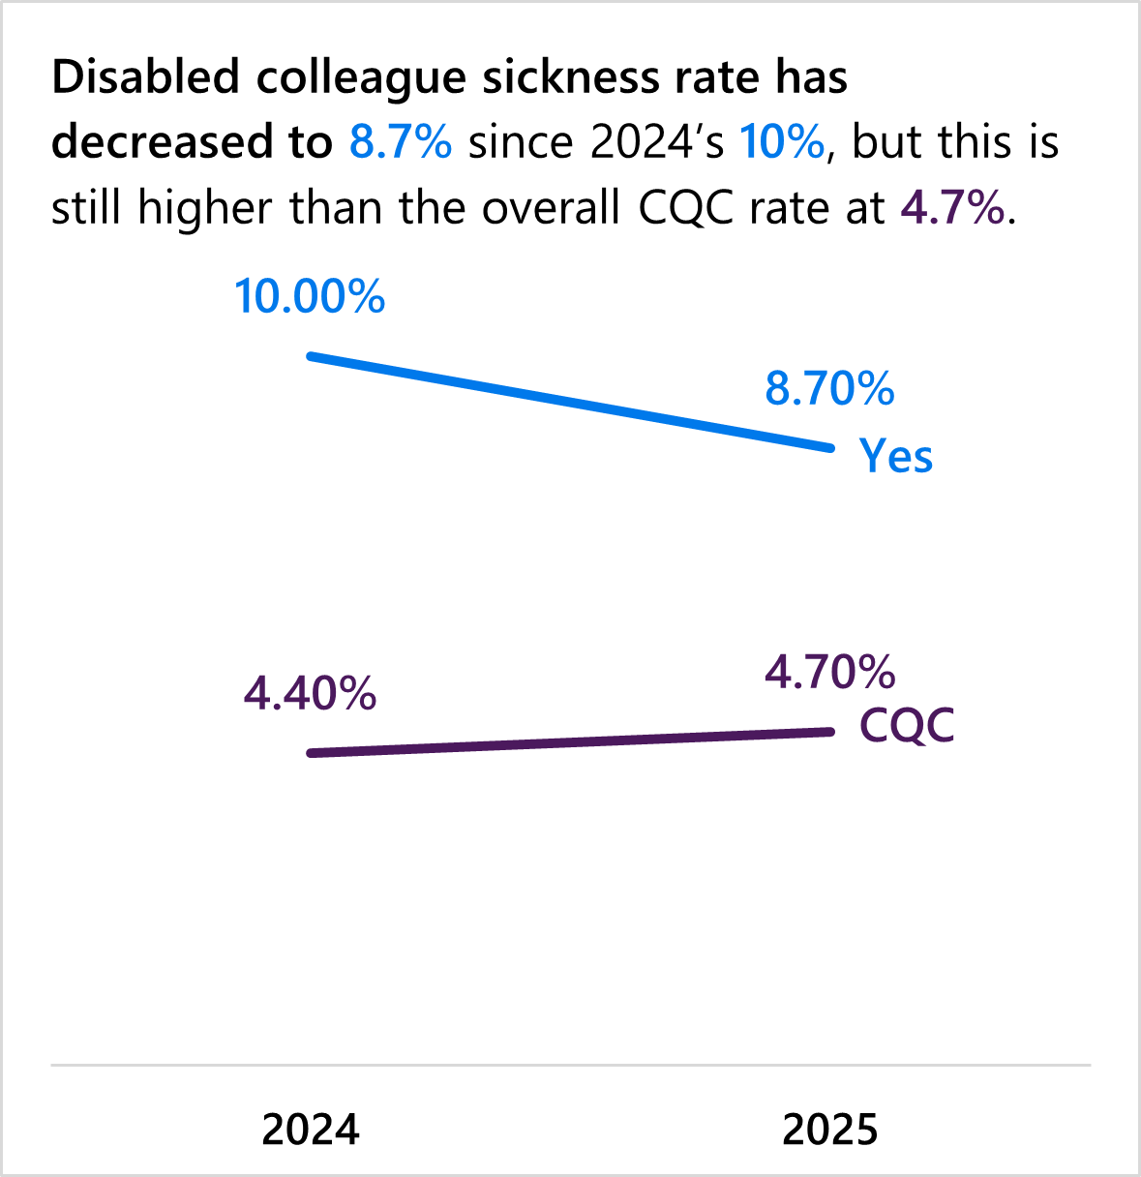
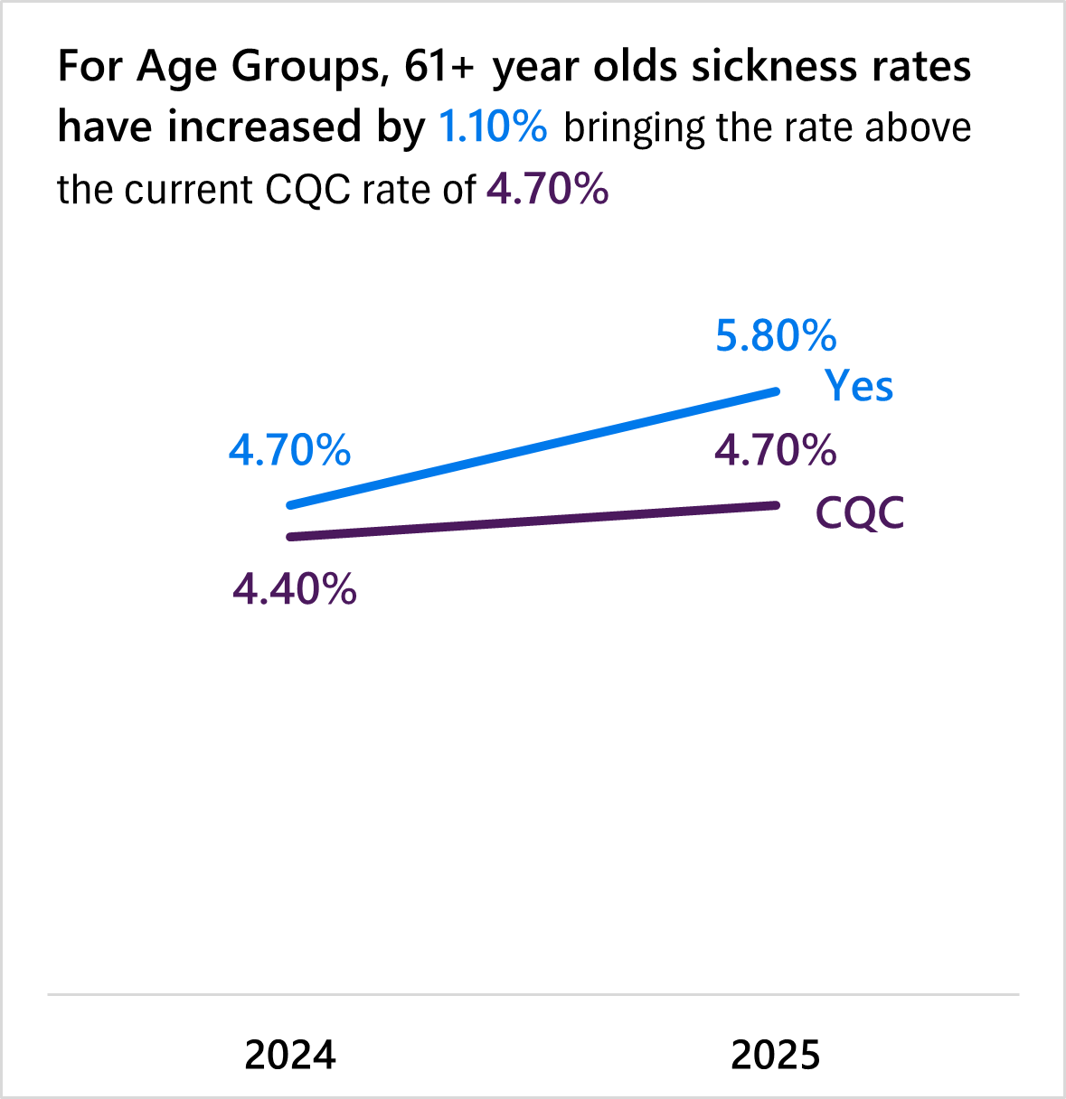
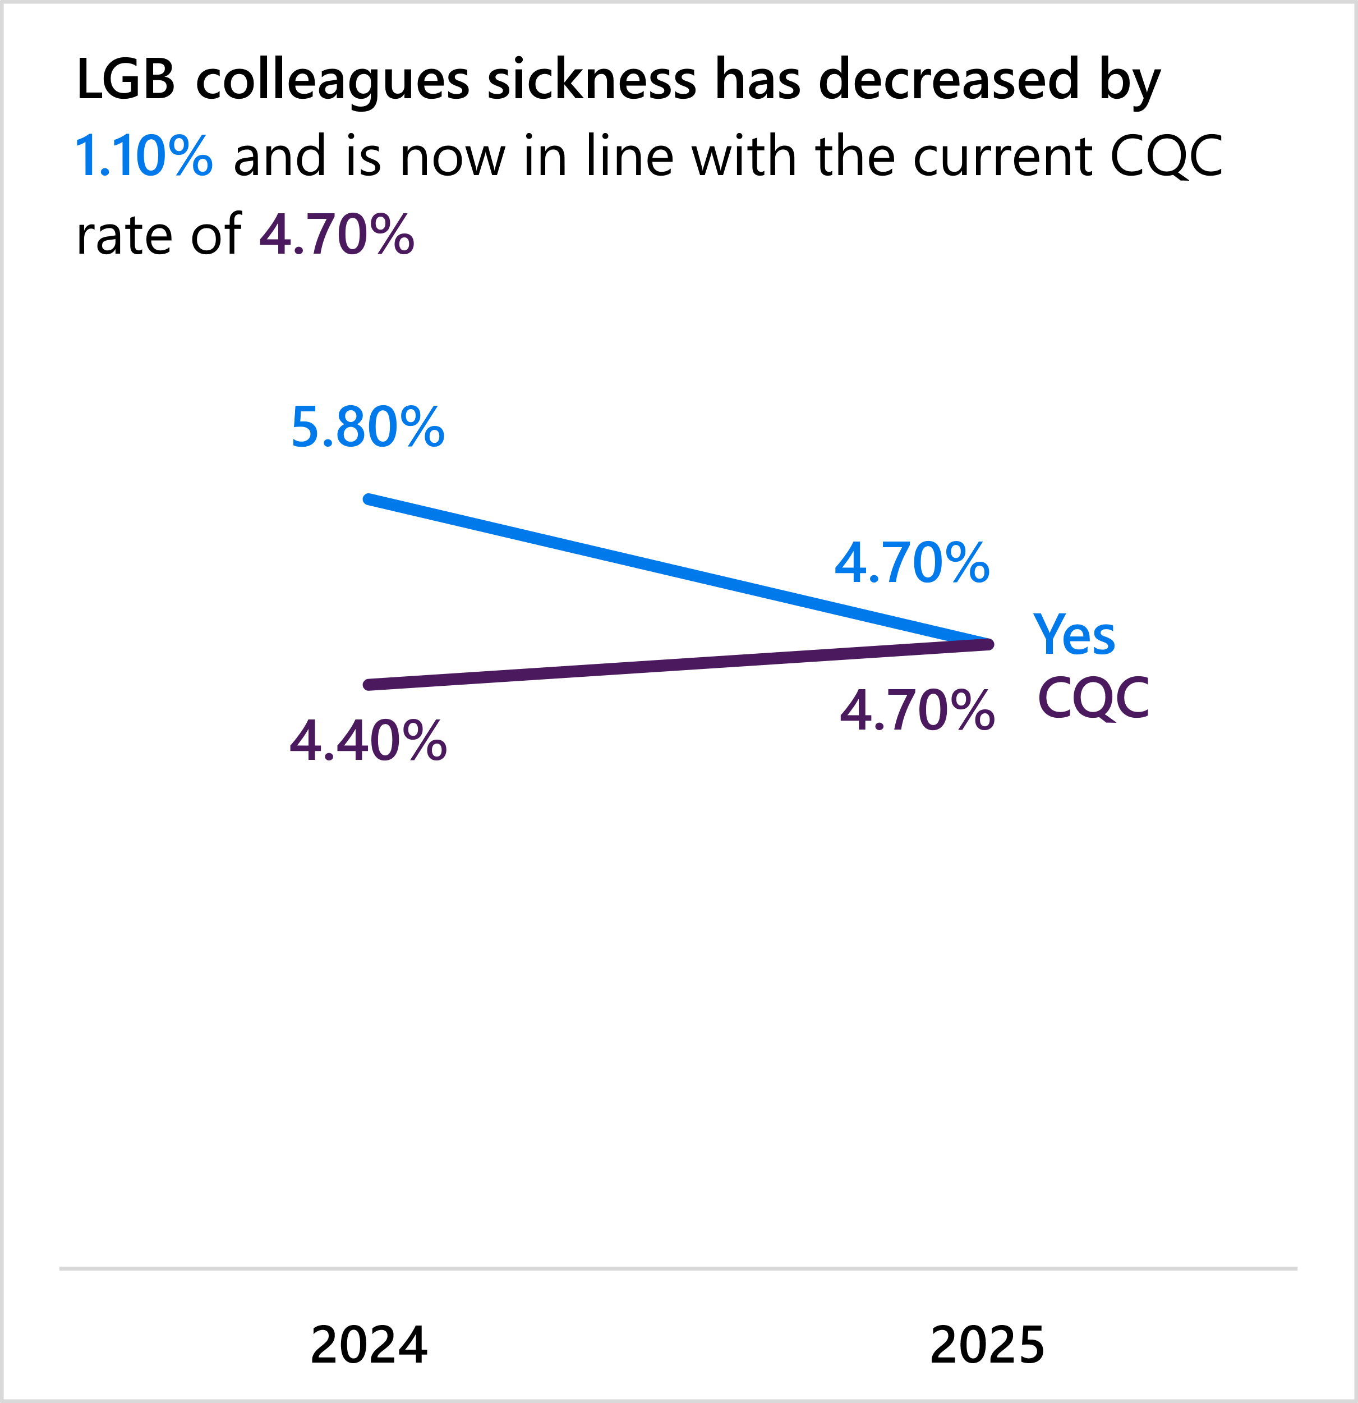
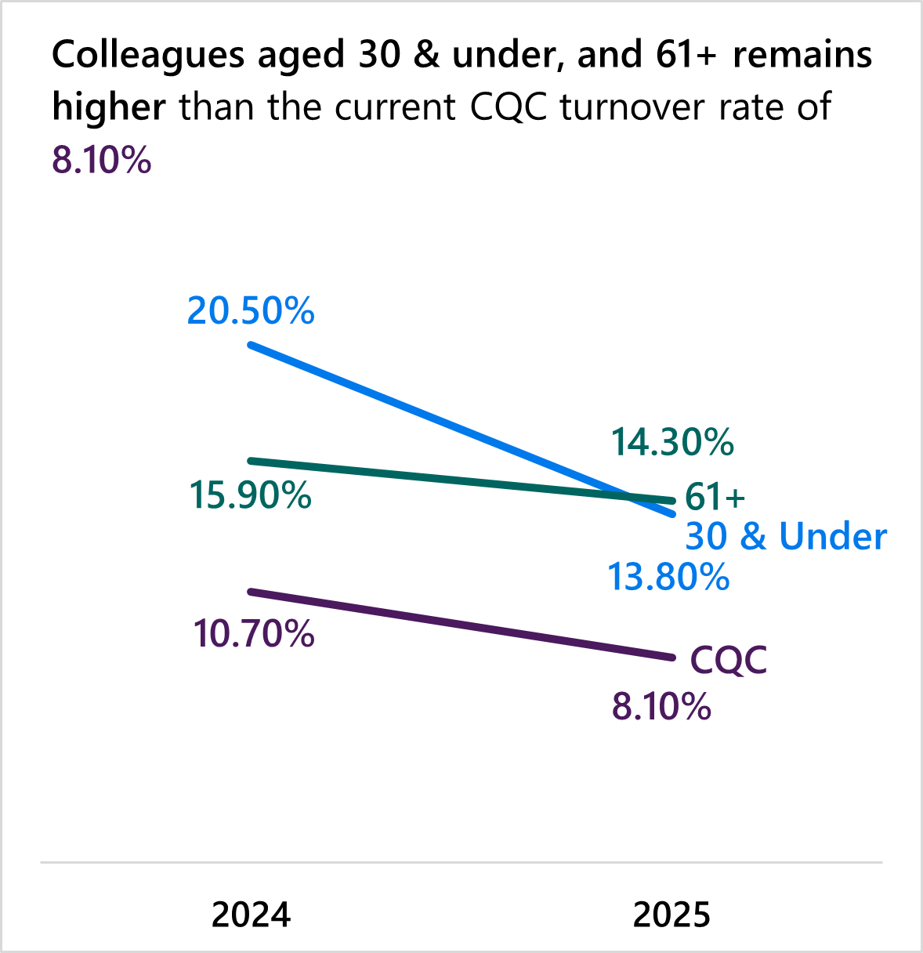
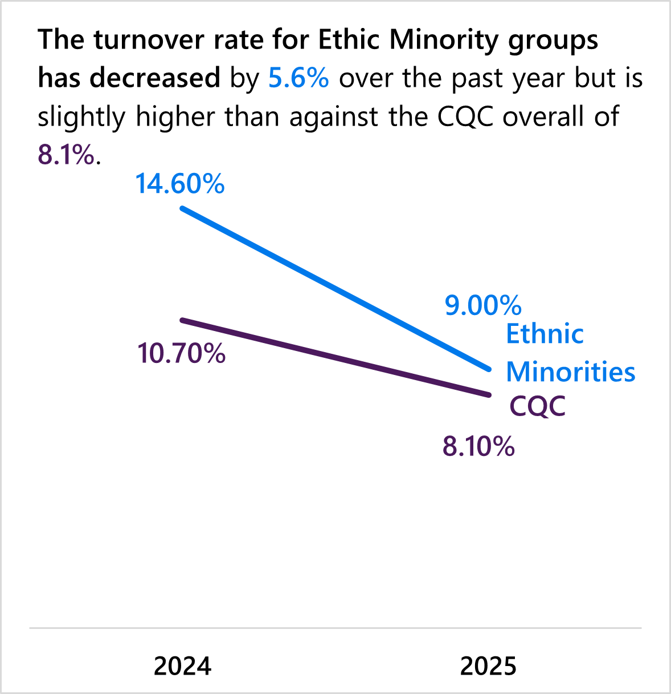
How our sickness rates are changing…
Foster Inclusion and Belonging and Invest in our colleagues: Sickness and Turnover
And key changes with our staff turnover…
Key takeaways…
1
Sickness rates for disabled colleagues is decreasing, but still above CQC targets
2
Our older age bracket colleague's sickness rates remain above our
target
3
And they are one of our highest groups for turnover, along with colleagues aged 30 and under, both over our CQC turnover KPI of 10%

Slide 7
EDI Strategy action plan measurables in detail Annexed
Recruit talented colleagues:
Page 8: YoY Representation increase for Race, Disability and Age to meet ONS, aim for 95% ESR sharing rates
Page : Meet ONS with senior representation at grade A and Exec for race and disability
Page 9: Reduce Adverse Impacts* for race, and maintain no adverse for other protected characteristics
Page 10: Improve GIS appointments, Adjustments used and Adjustments experience, and Flexible Working adverts use
to increase diverse appointments
Invest in our colleagues:
Page 11: Career Conversations, Leaders annual Talent round and Successful Manager Programme uptake, and
Inclusive Leadership Pathway promotions
Page 12: Improve Promotions, Secondments & Act Ups for disability 2024-2025
Page 13: Improve Promotions, Secondments & Act Ups for race 2024-2025
Page 14: Retention; overall and all protected characteristic groups to be below CQC Turn over KPI of 10%
Page 15: Promotions, interim roles, secondments and turnover for race and disability; 1 April 2024 to 31 March 2025
Page 16: Reward and Recognition parity with representation for protected characteristic groups
Page 17: Leaving Reasons 2024-2025; aim by 2027 promotions is not a top reason, including for race and disability
Foster Inclusion and Belonging:
Page 18: Increase Freedom to Speak Up completion from March 2025 and aim for 100% Bullying, Harassment e
-learning completion
Page 19: Increase Workplace Passport uptake from October 2024, including by directorate
Page 20: Increase Workplace Passports completed by disability against ESR, and uptake for wider backgrounds, and
Accessibility Hub usage from 2025, Accreditations
Page 21: YoY sickness rate reduction for disability and meet overall CQC rate by 2027; annual reduction with wider
protected characteristics

Slide 8
Recruit talented colleagues:
YoY Representation increase for Race, Disability and Age to meet ONS*, aim for 95% ESR** sharing rates
Ethnicity (94.2%) | 2024 | 2025 | ONS*
Ethnic Minority Groups | 15.6% | 17.6% | 17.7%
White | 77.3% | 76.7% | 82.3%
Not Stated | 7.1% | 5.7% | -
Religious Belief (73.1%) | 2024 | 2025
Atheism | 16.2% | 17.8%
Buddhism | 0.5% | 0.7%
Christianity | 41.0% | 40.3%
Hinduism | 1.9% | 2.2%
Islam | 3.2% | 3.5%
Jainism | 0.0% | 0.0%
Judaism | 0.3% | 0.3%
Sikhism | 1.1% | 1.1%
Other | 6.7% | 7.2%
Not Stated | 29.1% | 26.9%
Sexual Orientation (87.4%) | 2024 | 2025
LGB+ | 7.0% | 8.0%
Heterosexual | 79.4% | 79.4%
Not Stated | 13.6% | 12.6%
Disability (94.1%) | 2024 | 2025 | ONS*
Yes | 12.2% | 15.4% | 18.0%
No | 81.3% | 79.0% | 82.0%
Not Stated | 6.5% | 5.9% | -
Context | 2024 | 2025
Overall staff | 3,277 | 3,479
Age (100.0%) | 2024 | 2025 | ONS*
16 - 17 | - | - | 1.3%
18 - 24 | 1.2% | 0.8% | 11.0%
25 - 34 | 15.0% | 16.0% | 22.5%
35 - 49 | 44.8% | 44.1% | 33.2%
50 - 64 | 36.0% | 36.1% | 27.4%
65 + | 3.0% | 3.0% | 4.6%
Representation is affected by ESR, which have increased through the 2024 "Countmein" campaign.
‘Religious Belief’ remains the lowest at 73.1%, ‘Sexual Orientation’ at 87.4% with smaller increases through the campaign for Ethnicity and Disability.
Ethnic minority group overall representation has increased to 17.6%, which is nearly on par with the ONS comparator of 17.7%.
Disabled representation improved to 15.4%, progressing towards the ONS comparator of 18%.
Age representation remained static and above the ONS comparator for 35-64. Whilst, 18–24-year-old representation declined and remains well below the ONS comparator, with 25–34-year-olds rising by 1% but still under ONS representation.
Sex (100.0%) | 2024 | 2025 | ONS*
Female | 72.4% | 72.8% | 48.2%
Male | 27.6% | 27.2% | 51.8%
Notes:
* ONS economic active population data from 18th February 2025 release. Comparison not available for Sexual Orientation or Religious Belief.
**Sharing ESR rates have been added in brackets next to the protected characteristic box title. They are from 31 March 2025, after the 2024 Countmein campaign. We aim to measure Socio Economic background in the future as we have new ESR questions.

Slide 9
Recruit talented colleagues:
Meet ONS with senior representation at grade A and Exec for race and disability
Ethnic Minority Groups | March 2024 | March 2025 | Trend
Exec | 13.6% (18) | 11.6% (17) | ⬇ (-1)
A | 14.1% (70) | 14.6% (81) | ⬆ (+11)
B | 14.8% (230) | 17.1% (280) | ⬆ (+50)
C | 22.3% | 23.7% | ⬆
D | 16.6% | 20.7% | ⬆
E | 18.8% | 23.0% | ⬆
F | 10.4% | 15.4% | ⬆
ONS Economic Active Population Stats | Ethnic Minority Groups | Disability - Yes
18th February 2025 | 17.7% | 18.0%
Ethnicity
There has been an increase in representation at all grades except for Execs (senior decision making) which decreased.
The largest increases were at junior grades.
CQC is below ONS comparator representation at 17.7% for each grade, except grade B. The largest variance is Execs, at 11.6% - 6.1% below.
Disability
All grades have increased in representation, except Grade F that has seen a 0.2% decrease.
The largest increase is at Grade E.
CQC is below ONS comparator representation at 18% for each grade, the largest variance is for Execs, at 12.9% - 5.1% below .
Disabled Exec and Grade A representation rose more than ethnic minority representation at these grades.
*As data may be affected by increased sharing following the Countmeincampaign in 2024, we have included new starter information in Notes.
Disability - Yes | March 2024 | March 2025 | Trend
Exec | 9.1% (12) | 12.9% (19) | ⬆ (+7)
A | 12.9% (64) | 15.7% (87) | ⬆ (+23)
B | 12.4% (193) | 15.7% (257) | ⬆ (+64)
C | 13.1% | 14.2% | ⬆
D | 13.7% | 16.6% | ⬆
E | 11.0% | 17.6% | ⬆
F | 15.6% | 15.4% | ⬇
Notes:
*543 New starters excluding contactors and including those with contracting hours
Ethnic Minority Groups – 148
White – 375
Not Shared – 20
Disability Yes – 77
Disability No – 417
Not Declared – 49

Slide 10
Recruit talented colleagues:
Reduce Adverse Impacts* for race, and maintain no adverse for other protected characteristics
Ethnic Minority Groups | Application to Shortlist | Shortlisting to Offer | Application to Offer
CQC 2023-24 | 60.5% | 70.6% | 42.7%
CQC 2024-25 | 80.0% | 61.2% | 48.9%
Grade A & Exec | 64.5% | 52.3% | 33.7%
Corporate Services | 73.7% | 85.2% | 62.8%
Engagement Policy & Strategy | 73.5% | 77.2% | 56.7%
Operations & Reg Leadership | 78.9% | 55.3% | 43.6%
Technology, Data & Insight | 83.7% | 58.3% | 48.8%
Sexual Orientation – LGB+​ | Application to Shortlist​ | Shortlisting to Offer​ | Application to Offer​
CQC 2023-24​ | 96.8%​ | 103.4%​ | 100.1%​
CQC 2024-25​ | 96.8%​ | 103.4%​ | 100.1%​
Grade A & Exec​ | 100.1%​ | 110.1%​ | 110.2%​
Corporate Services​ | 119.7%​ | 117.6%​ | 140.8%​
Engagement Policy & Strategy​ | 135.3%​ | 114.3%​ | 154.6%​
Operations & Reg Leadership​ | 89.5%​ | 90.4%​ | 80.8%​
Technology, Data & Insight​ | 101.7%​ | 98.8%​ | 100.5%​
Disability - Yes | Application to Shortlist | Shortlisting to Offer | Application to Offer
CQC 2023-24 | 139.3% | 88.9% | 123.8%
CQC 2024-25 | 144.7% | 120.7% | 174.6%
Grade A & Exec | 147.1% | 111.5% | 164.0%
Corporate Services | 120.3% | 158.7% | 190.8%
Engagement Policy & Strategy | 271.9% | 65.8% | 178.9%
Operations & Reg Leadership | 138.5% | 122.0% | 169.0%
Technology, Data & Insight | 164.1% | 78.0% | 128.0%
Across all directorates and at decision making/senior roles, there largely remains adverse impacts for ethnic minority applicants at each stage of the recruitment process, despite increased recruitment activity during 2024 ‘recovery’ work.
Green indicates the figure is higher than 80%, which means it is less likely there is an adverse impact within the recruitment process – this is largely seen as above 100% for Disabled and LGB+ applicants, who have a higher chance of successful recruitment against the majority.
Notes:
*Adverse Impact compares the minority and the majority group. Where the percentage is 100%, this means there is an equal chance of selection. If the selection rate is less than 80% this would be an adverse impact.
Success rates can be provided due to challenges with adverse impact data for sex and religion, as adverse impact compares one minority to one majority group. It is worth noting that some Religious Beliefs are also too small to calculate a success rate for.

Slide 11
Recruit talented Colleagues:
Improve GIS appointments, Adjustments used and Adjustments experience, and Flexible Working adverts use to increase diverse appointments
Out of the 13.1% disabled applicants (4,569), 5.6% (1,954 ) requested to apply under the guaranteed interview scheme, 348 were shortlisted and 84 offered roles - an overall conversion rate of 4.3%*.
At Grade A and Exec there is a slightly higher conversion rate of 5.2%. which denotes that GIS candidates have had slightly higher success rates in Exec and Grade A than overall.
Recruitment recorded 272 candidates who requested adjustments. We do not have analysis on how many of these candidates were successful.**
Out of 267 responses to the Candidate Experience Survey in the last 6 months , 84% confirmed that they felt comfortable requesting an adjustment or did not require one.
We currently do not collate data against appointments but there has been an increase in flexible working adverts since 2023-2024. The number of adverts with all flexible patterns considered is 47.5% in 2024-2025.
Adverts Opened 2024-25 | No. | %
All Flexible Patterns Considered | 228 | 47.50%
Full Time Only | 217 | 45.20%
Part Time Role | 12 | 2.50%
Not Stated | 23 | 4.80%
Guaranteed Interview Scheme | 2024-25 Overall | 2024-25 A & Exec
Applicants | 1,954 | 306
Shortlisted | 348 | 56
Offered | 84 | 16
Notes:
* Overall conversion rate offered GIS candidates / number of GIS applicants.
**The most common recorded adjustments at interview are, extra time, extra time and questions in advance, questions in advance and panel awareness only.

Slide 12
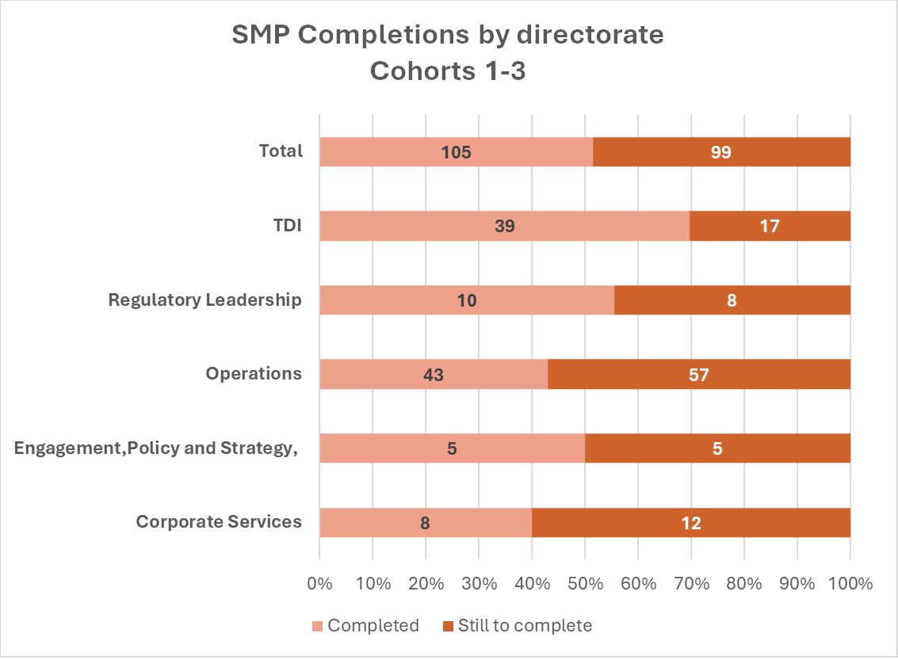
Invest in our colleagues delivery: Career Conversations, Leaders annual Talent round and improve Successful Manager Programme uptake, and Inclusive Leadership Pathway promotions,
Inclusive Leadership Pathway Promotion information
Number | Grade Change from/to | Demographic breakdown
4 | A-E3 | Disabled | 3
8 | B-A | Ethnic Minority | 11
1 | C-A | Both | 2
1 | C-B
224 Successful Manager Pathway Programme participants were onboarded, and 204 colleagues remain in CQC.*
Inclusive Leadership Pathway outcomes: 4 Grade A-E3 appointments and 8 B-A appointments to support senior race and disability diversity pipeline and retention.
Career Conversations: **All Exec 3-1 completed their Talent round conversations in 2024 with People Directorate providing succession plans, however this was not tracked against appointments.
There were less than 100 Grade A- F career conversations, which were not mandatory. There may have been unrecorded local conversations. Alongside this, there is inconsistency with use of 1-2-1 check ins on ED.***
Notes:
*We have been promoting participation though senior leadership endorsement and exploring barriers to completion, so we inform Cohort 4’s approach which has recently launched. Just over half of delegates have completed the Successful Manager Pathway Programme (51%). The highest number of completions are within Operations (43), proportionately this represents 43% of the total of those from Operations who were onboarded. By contrast, 70% of those attending from TDI directorate have completed the Programme. The lowest proportion of completions against those onboarded is within Corporate Services at 40%. 99 colleagues across directorates still need to finish the programme.
We will explore goals for SMP and the ILP promotions, alongside the potential for ringfenced opportunities for under-represented colleagues in the SMP.
**We are unable to provide further information or analysis, including by directorate and grade because of less than 100 submissions to People Directorate.
*** We were unable to secure Apprenticeships statistics, and we do not currently keep participation records by protected characteristic. We will start to collate in the future.

Slide 13
Invest in our colleagues: Improve Promotions, Secondments & Act Ups for disability 2024-2025
 | Disability – Yes | Disability - No | Not Shared
Promotions | 34 | 132 | <10
Act Ups & Secondments | 31 | 172 | 12
Overall (Grouped) | 65 (16.8%) | 304 (78.8%) | 17 (4.4%)
Promotions, Acting Up & Secondment Numbers (Grouped)
Grade | Disability – Yes | Disability - No | Not Shared
Exec | <10 | 34 | <10
A | 17 | 112 | <10
B | 21 | 96 | <10
C | <10 | 30 | <10
D | <10 | 19 | <10
E | <10 | 10 | <10
F | <10 | <10 | <10
Promotions, Acting Up & Secondment Numbers (Grouped)
Directorate | Disability – Yes | Disability - No | Not Shared
Corporate Services | <10 | 41 | <10
EPS | 10 | 42 | <10
Reg Leadership & Ops | 28 | 150 | 11
TDI | <10 | 41 | <10
*At 16.8% Promotions, Act-Ups and Secondments increased by 3.4% compared to 2023-24.
Colleagues who are not disabled show a pipeline of Promotion, Act-Ups and Secondments across all grades except F. Disabled Colleagues are only represented at A and B grades, and notably not at Exec level. An area of focus could be Corporate Services and TDI.
Notes:
*Overall CQC- 171 promotions, 215 secondments and act ups recorded between 1st April and 31st March. We need to agree with Learning and wider colleagues an overall CQC promotion goal to support assessing progress, including time for promotion parity. This will support with strategic workforce planning.

Slide 14
Invest in our colleagues: Improve Promotions, Secondments & Act Ups –for race 2024-2025
 | Ethnic Minority Groups | White | Not Declared
Promotions | 26 | 137 | <10
Act Ups & Secondments | 33 | 172 | 10
Overall (Grouped) | 59 (15.3%) | 309 (80.1%) | 18 (4.6%)
Promotions, Acting Up & Secondment Numbers (Grouped)
Grade | Ethnic Minority Groups | White | Not Declared
Exec | <10 | 32 | <10
A | 18 | 111 | <10
B | 23 | 95 | <10
C | <10 | 29 | <10
D | <10 | 25 | <10
E | <10 | 13 | <10
F | <10 | <10 | <10
Promotions, Acting Up & Secondment Numbers (Grouped)
Directorate | Ethnic Minority Groups | White | Not Declared
Corporate Services | <10 | 37 | <10
EPS | 10 | 42 | <10
Reg Leadership & Ops | 28 | 150 | 11
TDI | <10 | 40 | <10
15.3% Promotions, Act-Ups and Secondments is a marginal increase of 0.6% from 2023-24, and smaller than disabled colleagues. White colleagues show a pipeline of Promotion, Act-Ups and Secondments across all grades except F. Ethnic minority groups are only represented at A and B grades, and notably not at Exec level.
Corporate Services and TDI could be areas of focus, as well as monitoring numbers at Grade A and B promotions annually.

Slide 15
Invest in our colleagues:
Retention; overall and all protected characteristic groups to be below CQC Turn over KPI of 10%
 | 2024 | 2025 | Change
CQC Overall | 10.7% | 8.1% | ⬇
Disability | 2024 | 2025 | Change
Yes | 11.1% | 8.2% | ⬇
No | 10.8% | 8.2% | ⬇
Ethnicity | 2024 | 2025 | Change
Ethnic Minority Groups | 14.6% | 9.0% | ⬇
White | 10.4% | 8.4% | ⬇
Age | 2024 | 2025 | Change
30 & Under | 20.5% | 13.8% | ⬇
31 - 40 | 10.6% | 8.4% | ⬇
41 - 50 | 9.0% | 6.4% | ⬇
51 - 60 | 10.2% | 7.3% | ⬇
61 + | 15.9% | 14.3% | ⬇
Sex | 2024 | 2025 | Change
Female | 11.2% | 7.9% | ⬇
Male | 11.1% | 9.8% | ⬇
Sexual Orientation | 2024 | 2025 | Change
LGB+ | 8.1% | 7.4% | ⬇
Heterosexual | 11.0% | 8.2% | ⬇
The CQC overall turnover rate has decreased, including for protected characteristics, since 2023- 2024. Our rate in 2024 was 10.7%, and it is 8.1% in 2025.
Whilst most turnover rates are also now below our KPI, they remain highest in the ‘61+’ and ‘30 & Under’ age groups, where the rate is 14.3% and 13.8%, respectively. Notably, these are age groups we want to increase comparable to ONS representation.*
Turnover is calculated as:
(Leavers FTE / average FTE) x 100
For protected characteristics this is calculated as:
(FTE of protected characteristic leavers / average FTE of those with that characteristic) x 100
Notes:
*We are unable to share directorate level data. This data is important, particularly for strategic workforce planning considering age profile and retirement risk.

Slide 16
Invest in our colleagues:
Improve proportionality in promotions, interim roles, secondments and turnover for race and disability; 1 April 2024 to 31 March 2025
Ethnicity | Ethnic Minority Groups | White | Not Shared
Promotions | 26 | 137 | <10
Interim roles and secondments | 33 | 172 | 10
Overall | 59 (15.3%) | 309 (80.1%) | 18 (4.6%)
Average time in grade* | 3.3 years | 4.2 years | 4.7 years
Ethnicity | Ethnic Minority Groups | White | CQC Overall
Turnover Rate | 9.0% | 8.4% | 8.1%
Average leaver length of service | 3.7 years | 6.5 years | 6.1 years
Disability | Disabled | Not Disabled | CQC Overall
Turnover Rate | 8.2% | 8.2% | 8.1%
Average leaver length of service | 5.8 years | 6.1 years | 6.1 years
Disability | Yes | No | Not Shared
Promotions | 34 | 132 | <10
Interim roles and secondments | 31 | 172 | 12
Overall | 65 (16.8%) | 304 (78.8%) | 17 (4.4%)
Average time in grade* | 4.3 years | 4.1 years | 4.0 years
On 31 March 2025, 17.6% of colleagues had shared that they were from an ethnic minority background. Of all promotions and secondments made during the 2024/25 financial year, 15.3% were achieved by colleagues from ethnic minority backgrounds.*
The turnover rate in 2025 is also slightly higher for colleagues from ethnic minority backgrounds against the CQC overall - whilst under the CQC turnover KPI of 10%.
Notes:
*15.3% refers to the proportion of total promotions and secondments that went to colleagues from ethnic minority backgrounds, not the promotion rate of ethnic minority specifically. That is, out of all the promotions and secondments across the organisation during the year, 15.3% went to colleagues from ethnic minority backgrounds, while the remaining 84.7% were accounted for by white colleagues or those who chose not to share their ethnicity.
This compares with 2024, where 14.7% of promotions, interim roles and secondments were secured by ethnic minority colleagues, against their overall workforce representation of 15.6%.
Proportionality can be a useful way to assess fairness in outcomes. It means a group’s share of progression opportunities should broadly reflect their share of the workforce. In this case, while 17.6% of staff are from ethnic minority backgrounds, only 15.3% of promotions and secondments went to them, suggesting a slight underrepresentation.
The overall CQC average leavers length of service has not changed since 2024, at 6.1 years. Colleagues are not staying at CQC for as long as colleagues from the majority, white backgrounds- almost half the number of years in 2025. The difference has increased since 2024, when it was 4.6 years for ethnic minority colleagues and 6.6 years for white, majority colleagues.
For disabled colleagues, there is a positive difference with 16.8% of promotions, interim roles and secondments being from those who shared they had a disability, compared to 15.4% of overall disabled colleague representation in March.
The turnover rates for disabled colleagues is equal to colleagues that are not disabled, and below the CQC turnover KPI. This is an improvement from 2024, when disabled colleagues turn over was 11.1% compared to 10.8% for colleagues that are not disabled.
The difference in length of service for leavers is small, however disabled colleagues’ leavers time is now less than colleagues that are not disabled; in 2024 it was 7.2 years for disabled colleagues and 5.9 years for colleagues that are not disabled.

Slide 17
Invest in our colleagues:
Reward and Recognition parity with representation for protected characteristic groups
Sexual Orientation | R&R 23-24% | R&R 24-25 % | *CQC Rep %
LGB+ | 7.4% | 9.0% | 8.0%
Heterosexual | 80.3% | 78.7% | 79.4%
Not Stated | 12.2% | 12.3% | 12.6%
Between 1st April 2024 and 31st March 2025:
1252 Vouchers Issued
927 Voucher Recipients
271 Voucher Issuers
Comparison to CQC Stats 31st March 2025
Religious Belief | R&R 23-24% | R&R 24-25 % | *CQC Rep %
Atheism | 13.7% | 17.2% | 17.8%
Buddhism | 0.6% | 0.5% | 0.7%
Christianity | 41.8% | 39.7% | 40.3%
Hinduism | 1.1% | 0.8% | 2.2%
Islam | 1.9% | 2.4% | 3.5%
Judaism | 0.6% | 0.3% | 0.3%
Sikhism | 1.1% | 1.6% | 1.1%
Not Stated | 39.3% | 37.6% | 26.9%
Sex | R&R 23-24 % | R&R 24-25 % | *CQC Rep %
Female | 74.6% | 72.9% | 72.8%
Male | 25.4% | 27.1% | 27.%
Disability | R&R 23-24 % | R&R 24-25 % | *CQC Rep %
Yes | 12.0% | 14.3% | 15.1%
No | 83.4% | 80.9% | 79.0%
Not Stated | 4.5% | 4.8% | 5.9%
Age | R&R 23-24 % | R&R 24-25 % | *CQC Rep %
21 - 30 | 6.8% | 5.6% | 7.5%
31 - 40 | 29.5% | 26.4% | 27.9%
41 - 50 | 29.9% | 33.6% | 28.9%
51 - 60 | 26.9% | 26.2% | 25.7%
61+ | 6.9% | 8.3% | 10.0%
Ethnicity | R&R 23-24 % | R&R 24-25 % | *CQC Rep %
Ethnic Minority Groups | 12.0% | 11.4% | 17.6%
White | 82.6% | 83.5% | 76.7%
Not Stated | 5.4% | 5.1% | 5.7%
Notes:
For Reward and Recognition, we would aim for distribution across all groups as closely as possible in line with overall CQC representation, to ensure a fair distribution.
Across most groups we can see that this is the case, although for ethnic minority groups, there is a higher negative difference of 5.6%. This has also decreased on the previous year’s percentage.

Slide 18
Invest in our colleagues:
Leaving Reasons 2024-2025; aim by 2027 promotions is not a top reason, including for race and disability
Top 3 Reasons for Leaving | Overall | Ethnicity |  | Disability |  | Sex |  | Sexual Orientation |  | Age Band
Top 3 Reasons for Leaving | Overall | Ethnic Minority Groups | White | Yes | No | Male | Female | LGB+ | Hetero-sexual | 21-30 | 31-40 | 41-50 | 51-60 | 61+
Resignation – Other/Not Known | ✓ | ✓ | ✓ | ✓ | ✓ | ✓ | ✓ | ✓ | ✓ | ✓ | ✓ | ✓ | ✓ | ✓
Retirement | ✓ |  | ✓ | ✓ | ✓ | ✓ | ✓ |  | ✓ |  |  |  | ✓ | ✓
Resignation – Promotion | ✓ | ✓ | ✓ | ✓ | ✓ |  | ✓ |  | ✓ | ✓ | ✓ | ✓
End of Fixed Term Contract |  | ✓ |  |  |  | ✓ |  |  |  |  |  | ✓ | ✓ | ✓
Resignation - Health |  |  |  | ✓
Resignation – Work Life Balance |  |  |  |  |  |  |  |  |  |  |  | ✓
Resignation - Relocation |  |  |  |  |  |  |  |  |  |  |  | ✓
Resignation – Pay & Reward Related |  |  |  |  |  |  |  |  |  |  | ✓
Resignation due to promotion remains as one of the top reasons for colleagues to leave the CQC across all groups apart from Males and LGB+ colleagues. Notably, Disabled and 21-30 groups now also citing this as a top reason compared to 2023-24.*
Ethnic Minority Groups continue to be impacted by the End of Fixed Term Contracts, with Males also impacted this year.
Notes:
*Any leaving reasons where less than 5 people across CQC have selected these from a particular group have not been included, and leaving numbers excluded to ensure anonymity, meaning not all groups have three top reasons, however, where top 3 reasons for leaving have the same number of leavers, some of these also have more than 3.
We are unable to present information by grade, as broken down, data for leaving reasons are too small.
Compared to 2023-24, there are no major changes to top leaving reasons. Most continue to follow the top overall reasons for leaving with some differences, although worth noting that this could be due to small numbers having a bigger impact in making a leaving reason one of the top three.
Some patterns could be expected, such as retirement being a top reason in 51-60 and 61+ age groups. There are also several leavers for fixed term contract end dates, this reason is more prevalent in the top three reasons for 2024-25 than 2023-24 and can be seen from those from ethnic minority groups, male, and 41-50, 51-60 and 61+ age groups. In 2023-24 this was only seen as a top three leaving reason for those from ethnic minority groups, and those in the 21-30 age group.
The previous year comparator can be seen in the next page.

Slide 19
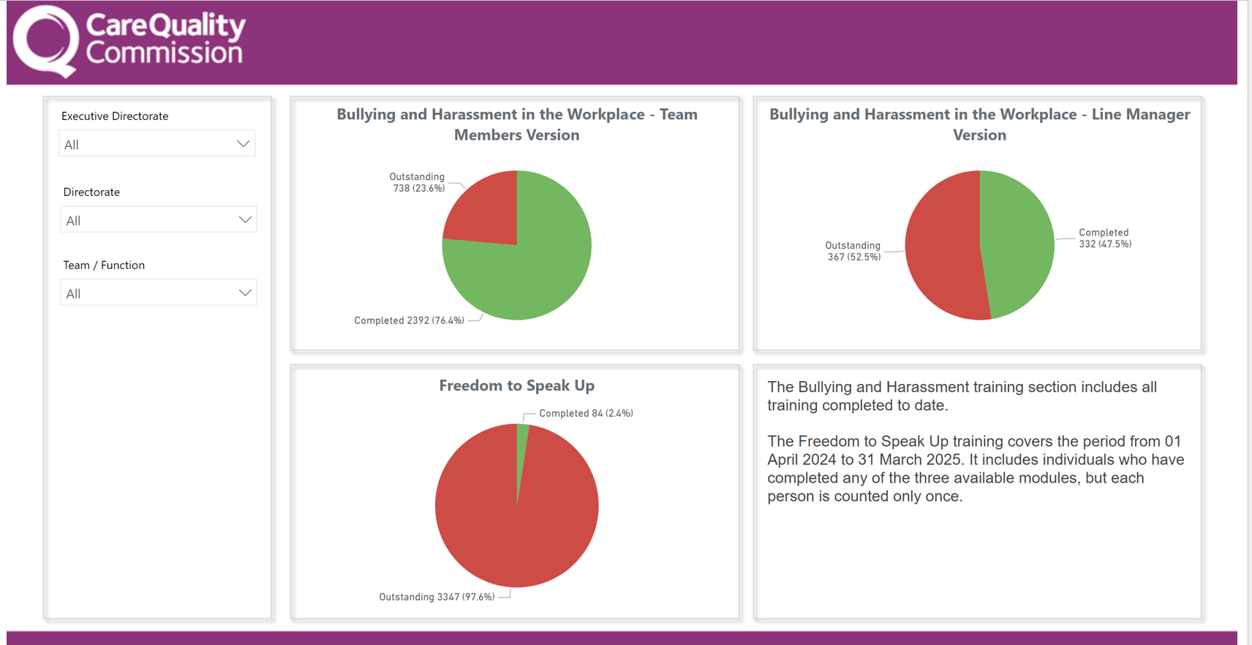
Foster Inclusion and Belonging:
Increase Freedom to Speak Up completion from March 2025 and aim for 100% Bullying, Harassment e-learning completion
Notes:
Freedom to Speak Up Guardian data is reported separately as FTSU does not sit in People Directorate. FTSU e-learning was launched last year to support the policy refresh and is not mandatory. It was completed by 84 colleagues (2.4%) and 3347 colleagues did not complete this learning. This learning data capture is from April 2024-March 2025.
Bullying, Harassment in the Workplace mandatory e-learning for team members; 738 outstanding and 2392 completed, which is a 76.4% completion rate since the April 2025 launch. For line managers, additional mandatory learning has 367 outstanding colleagues and 332 completions, so less that half, at 47.5%, of all managers have completed. We can take a targeted approach to support completion.

Slide 20
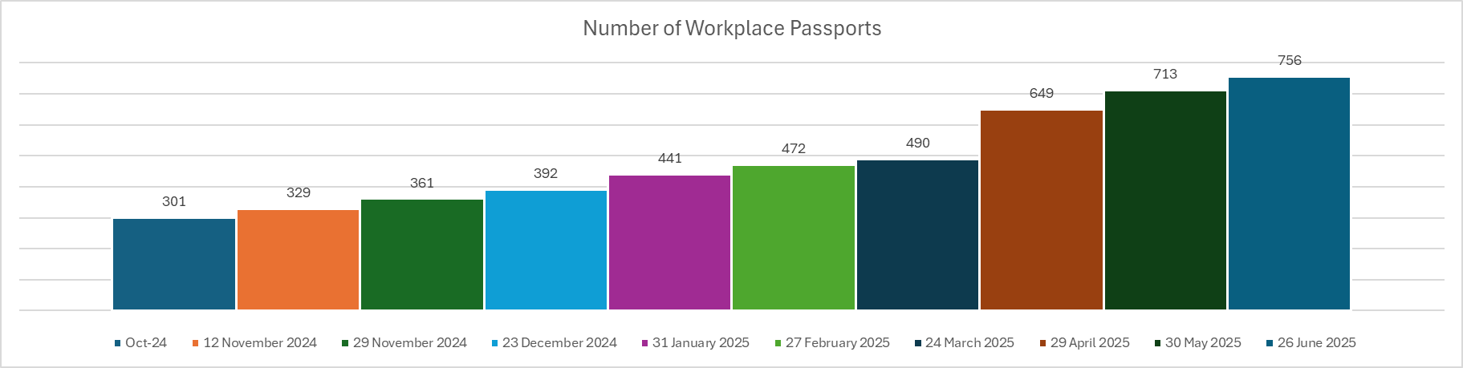
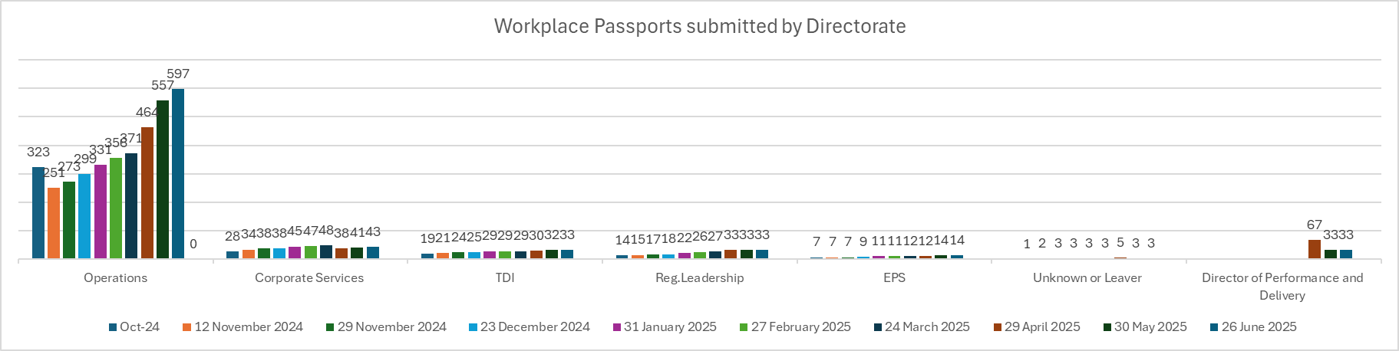
Foster Inclusion and Belonging:
Increase Workplace Passport uptake from October 2024, including by directorate
Notes:
There has been a steady increase since we started to monitor uptake in October 2024, when it was 301 Passports usage. By June, this was 756 (455 increase), representing a 151% rise. We currently do not record HR queries for Workplace Adjustments or SLAs for query completion.

Slide 21
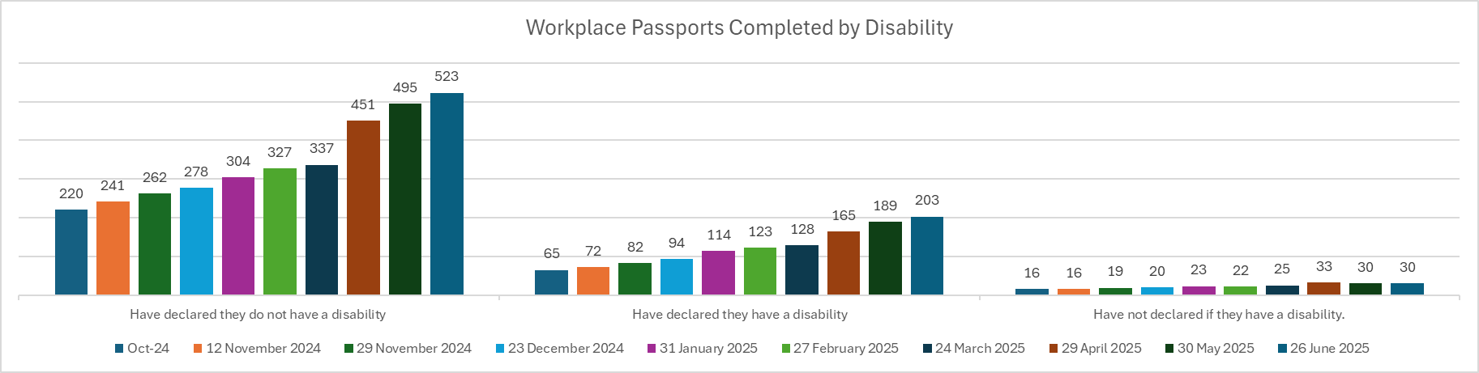
Foster Inclusion and Belonging:
Increase Workplace Passports completed by disability against ESR, and uptake for wider backgrounds, and Accessibility Hub usage from 2025, Accreditations
Colleagues can choose multiple categories for adjustments reasons; Health is at 501, Caring is at 394*, Personal Circumstances is at 193, and Other at 34.**
196 (25.9%) colleagues also shared they have a mental health condition, compared to 560 colleagues that shared they do not
(74.1%).
The number of disabled colleagues on ESR as of 31 June is 551.
To note, not all colleagues will use a Passport as they are not mandatory. As such, there may be locally agreed adjustments not
recorded.
Facilitating adjustments access, Accessibility Hub usage from April 2024-March 2025:
596 Assistive Technology requests and 148 Accessibility Assessments. There were 39 face to face events to increase awareness
and support uptake; and 81 external engagements across Civil Service to share best practice.
We also achieved 62% in our first Business Disability Forum Smart Audit in May 2025, following achieving Disability Confident
Level 2 in 2025.
Notes:
*The Passport and Adjustments activity, as well as Equality Network events activity, supported us to achieve Carers Confident Level 2 in Q3 2024.
**In the long term, we aim to transition the Passport to a technology-based solution. This will improve the consistency, visibility, and analysis of workplace adjustments data
to strengthen business planning, through more accurate, adjustments informed KPIs. It will also enable proactive and targeted interventions to reduce sickness and stress.
Crucially, it will enhance the experience of colleagues by driving more responsive, inclusive support, and embed the social model of disability by removing structural barriers.

Slide 22
Foster Inclusion and Belonging: YoY sickness rate reduction for disability and meet overall CQC rate by 2027; annual reduction with wider protected characterictics
Overall CQC Sickness Rate:
23/24 - 4.4%
24/25 - 4.7%
Religious Belief | 2023-24 % | 2024-25 % | Trend %
Atheism | 4.1% | 3.8% | ⬇
Buddhism | 11.7% | 6.5% | ⬇
Christianity | 4.9% | 5.2% | ⬆
Hinduism | 2.0% | 3.6% | ⬆
Islam | 4.3% | 4.5% | ⬆
Jainism | 0.0% | 0.3% | ⬆
Judaism | 0.9% | 1.8% | ⬆
Sikhism | 6.4% | 3.4% | ⬇
Not Stated | 4.2% | 4.6% | ⬆
Disability | 2023-24 % | 2024-25 % | Trend %
Yes | 10.0% | 8.7% | ⬇
No | 3.8% | 4.0% | ⬆
Not Stated | 2.2% | 4.1% | ⬆
Ethnicity | 2023-24 % | 2024-25 % | Trend %
Ethnic Minority Groups | 4.8% | 4.4% | ⬇
White | 4.6% | 4.9% | ⬆
Not Stated | 3.2% | 3.6% | ⬆
Sexual Orientation | 2023-24 % | 2024-25 % | Trend %
LGB+ | 5.8% | 4.7% | ⬇
Heterosexual | 3.3% | 3.7% | ⬆
Not Stated | 5.2% | 4.2% | ⬇
Age | 2023-24 % | 2024-25 % | Trend %
21 - 30 | 2.4% | 1.8% | ⬇
31 - 40 | 3.1% | 2.9% | ⬇
41 - 50 | 3.5% | 3.7% | ⬆
51 - 60 | 4.3% | 4.4% | ⬆
61+ | 4.7% | 5.8% | ⬆
Sex | 2023-24 % | 2024-25 % | Trend %
Female | 4.8% | 4.9% | ⬆
Male | 3.6% | 4.2% | ⬆
Notes:
Whilst the disabled colleague sickness rate has decreased to 8.7% since 2024’s 10%, this is still higher than the overall CQC rate at 4.7% (overall rate was 4.4% in 2024).

