Slide 1
Equity, Diversity and Inclusion Pulse Survey
Summary
Item: 4.1(a)
CM/09/2541(a) Pulse Survey June 2025 Summary

Slide 2
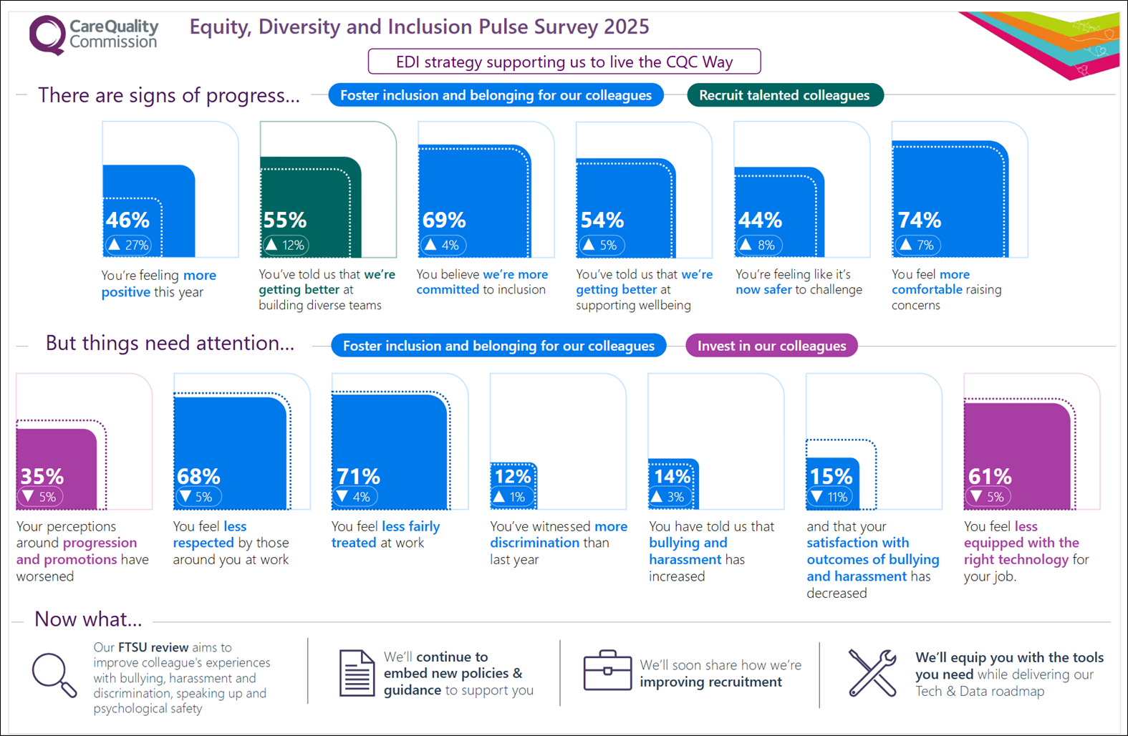
Data Visual Summary

Slide 3
Context
  Survey took place 11 – 25 June 2025.
  2,121 colleagues responded, a participation rate of 66%.
  The survey was based around the theme of Equity, Diversity and Inclusion (EDI). This is to review the progress we are making against the Equity Diversity and Inclusion Strategy 2024 – 2027, and to enable reporting for our 2025 Workforce Disability Equality Standard (WDES) and Workforce Race Equality Standard (WRES).
  The data also helps us understand how colleagues are feeling about the progress we are making as we continue our rebuilding journey to become an effective regulator – and a great place to work.
  The organisation overall results were published at the end of July via a news story on HOME.
  Department results were shared first with leaders and then published on HOME in mid-August.
  For the first time, reporting also includes data visualisations of the overall results and executive directorate level results to support digestibility in different ways.

Slide 4
Overall results
  Increase in positive sentiment: 46% feel positive about working here, an increase of 27 percentage points (pp) on October 2024.
  Improvement to scores relating to psychological safety: 44% of colleagues feel safe to challenge, up 8pp and 74% feel they can raise concerns, up 7pp.
  Increased confidence in efforts: 55% believe diverse teams are being built, an increase of 12pp. The results also showed improved scores for our commitment to inclusion, and support for the health and wellbeing of colleagues.
  Decrease in the perception of equal opportunities for career progression and promotion, down by 8pp to 35% positive.
  Fewer feel that they are treated with respect and fairness at work, down by 5pp and 4pp respectively.
  There are increases to the proportion of respondents experiencing bullying, harassment, discrimination, and victimisation at work (see notes for details).
  Satisfaction with equipment and technology is down by 5pp to 61% positive.
Unless otherwise stated comparisons are with the last main people survey conducted in January/February 2024.
Notes:
Fair Treatment
In the last 12 months, I have witnessed bullying, harassment or abuse at work from other CQC colleagues: 24% (up 5 percentage points)
In the last 12 months, I have experienced bullying, harassment or abuse from other CQC colleagues: 14% (up 3 percentage points)
In the last 12 months, I have witnessed bullying, harassment or abuse at work from people other than CQC colleagues (e.g. members of the public and service users): 14% (up 4 percentage points)
In the last 12 months, I have experienced harassment, bullying or abuse at work from people other than CQC colleagues (e.g. members of the public and service users): 10% (up 3 percentage points)
In the last 12 months, I have witnessed discrimination at work: 12% (up 1 percentage point)
In the last 12 months, I have personally experienced discrimination at work from any of the following: my manager, team leader or other colleagues: 8% (up 1 percentage point)
In the last 12 months, I have experienced victimisation from other CQC colleagues: 3% (up 1 percentage point)

Slide 5
Summary of executive directorate results
  Respondents in Corporate Services and Technology, Data & Insight tended to be most positive throughout. Lower scores were seen in Operations, and Engagement, Policy & Strategy.
  Those most likely to feel positive about working at CQC are those in People (65%), and Finance, Commercials & Workplace (64%) directorates within Corporate Services (58%).
  Those least likely to feel positive about working at CQC are those in Engagement, Policy & Strategy (39%) and its component directorates (Policy & Strategy 37%, Engagement 39%), and in Operations (42%), particularly the Midlands (34%) and North (34%) networks.
  Significant variation is evident between executive directorates. The largest differences are:
    “I have the equipment/technology to carry out my role”: Corporate Services 85%; Operations 51% (34 percentage point difference)
    “I believe our organisation supports the health and wellbeing of colleagues”: Corporate Services 75%; Operations 47% (28 percentage point difference)
    “I have a manageable workload”: Regulatory Leadership 65%; Operations 40% (25 percentage point difference)
Notes:
Areas of greatest variation between executive directorates:
“I have the equipment/technology to carry out my role”: Corporate Services 85%; Operations 51% (34 percentage point difference)
“I believe our organisation supports the health and wellbeing of colleagues”: Corporate Services 75%; Operations 47% (28 percentage point difference)
“I have a manageable workload”: Regulatory Leadership 65%; Operations 40% (25 percentage point difference)
“I believe we are actively building diverse teams that reflect the communities we serve and the organisations we regulate”: Corporate Services 73%; Regulatory Leadership 51% (23 percentage point difference)
“I feel valued for the work I do”: Corporate Services 68%; Engagement, Policy & Strategy 47% (20 percentage point difference)
“I work in an inclusive working environment, where individual differences and my expertise and views are valued”: Technology, Data & Insight 79%; Engagement, Policy & Strategy 58% (20 percentage point difference)
“How do you feel about working for CQC right now?”: Corporate Services 58%; Engagement, Policy & Strategy 38% (20 percentage point difference)
“I am treated with respect by the people I work with across our organisation”: Technology, Data & Insight 79%; Performance and Delivery 60% (19 percentage point difference)
“I feel empowered by my line manager”: Corporate Services 81%; Performance and Delivery 62% (19 percentage point difference)
“I believe that we are committed to creating an inclusive workplace”: Corporate Services 80%; Engagement, Policy & Strategy 63% (16 percentage point difference)

Slide 6
Summary of demographic results
  Initial data has been shared with the equality networks and the full data will be shared soon.
  It is worth noting that there were significant increases to the number of participants with a disability or long-term health condition (654, up 124 on 2024) and from an ethnic minority background (297, up 50 on 2024).
  Regarding the data, respondents with a disability or long-term health condition score lowest across almost every result (compared to respondents without a disability and all other demographic groups). They also experience the highest levels of bullying, harassment, discrimination, and victimisation of all groups, often the figure is double that of the lowest scoring group (see notes).
  Within demographic groups, Bisexual and Lesbian respondents are the most positive. There is little difference between those with and those without caring responsibilities. Male respondents are slightly more positive than Female respondents, particularly regarding workload (55% vs 49%) and equal opportunities (41% vs 35%). Results for respondents from an ethnic minority background are mixed compared to White respondents with some good scores (equipment/technology 73% vs 61%; feeling valued 63% vs 53%) alongside lower scores (knowing how to report bullying, harassment or abuse 80% vs 91%; knowing how to raise a concern 77% vs 87%).
  At question level, the largest differences between groups are “I believe that we are committed to creating an inclusive workplace” (Lesbian 87%; respondents with a disability 63% = 24 percentage point difference), and “I think it is safe to challenge the way things are done in our organisation” (Bisexual 61%; respondents with a disability 40% = 21 percentage point difference).
Notes:
Fair Treatment
In the last 12 months, I have experienced bullying, harassment or abuse from other CQC colleagues
Overall: 14%
Carer: 15%
Non-carer: 13%
Disability or long-term health condition: 19%
No disability or long-term health condition: 11%
Ethnic minority background: 14%
White: 12%
Female: 14%
Male: 10%
Bisexual: 12%
Gay: 15%
Lesbian: 15%
Heterosexual: 12%
In the last 12 months, I have experienced harassment, bullying or abuse at work from people other than CQC colleagues (e.g. members of the public and service users)
Overall: 10%
Carer: 11%
Non-carer: 7%
Disability or long-term health condition: 14%
No disability or long-term health condition: 8%
Ethnic minority background: 7%
White: 10%
Female: 10%
Male: 7%
Bisexual: 9%
Gay: 10%
Lesbian: 9%
Heterosexual: 9%
In the last 12 months, I have personally experienced discrimination at work from any of the following: my manager, team leader or other colleagues
Overall: 8%
Carer: 8%
Non-carer: 8%
Disability or long-term health condition: 15%
No disability or long-term health condition: 3%
Ethnic minority background: 12%
White: 6%
Female: 7%
Male: 7%
Bisexual: 7%
Gay: 5%
Lesbian: 9%
Heterosexual: 7%
In the last 12 months, I have experienced victimisation from other CQC colleagues
Overall: 3%
Carer: 3%
Non-carer: 2%
Disability or long-term health condition: 6%
No disability or long-term health condition: 1%
Ethnic minority background: 2%
White: 2%
Female: 2%
Male: 2%
Bisexual: 2%
Gay: 2%
Lesbian: 0%
Heterosexual: 2%

