Slide 1
Speed Review Around Educational Establishments
22 Schools have been checked
6 Further Education Colleges / Universities.
Also included list of educational establishments where roads are 20 mph but roads around the educational establishments are 30 mph or above.

Slide 2
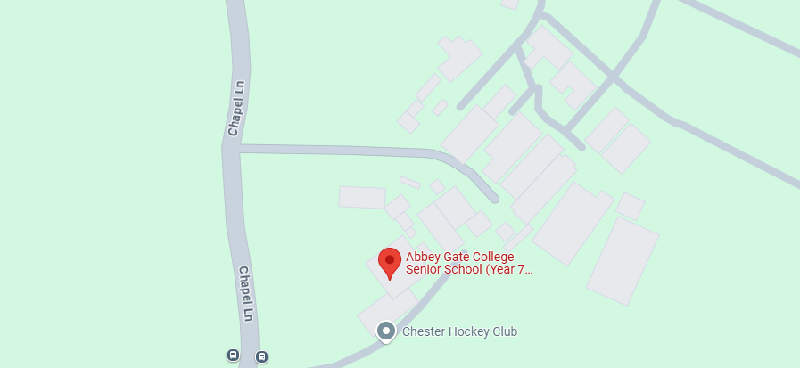
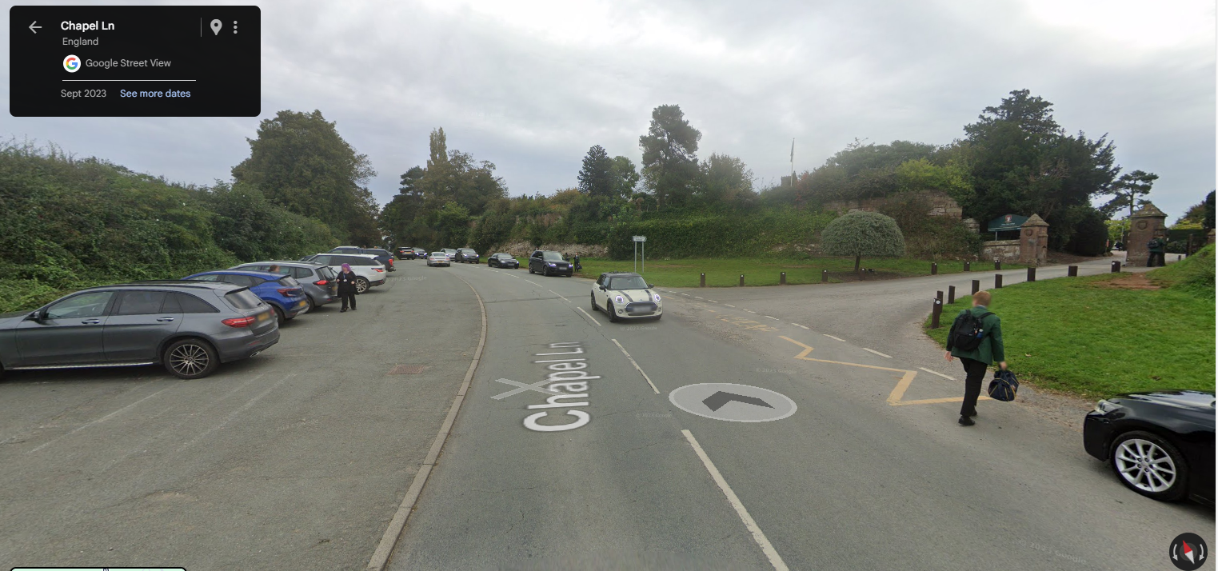
Abbeygate College, Chapel Lane, Saighton
Current Speed Limit 30 mph
Abbeygate was assessed as part of the original the 20 mph project where the lowest speed was assessed at 30.7 mph.
Abbeygate has been re-assessed, and the mean speed was 29.7 mph
Saighton Parish Council had planned to pay for the new signs and TRO to be installed. Stu B is going to consult with Cllr Waddelove to see if he still wants to pay 50/50.
No personal injury collisions (PIC) in the last five years up to 13/08/24.
Consultation will be completed by end of July 2025.
Subject to consultation. Proposed installation of Scheme prior to school return in September 2025.

Slide 3
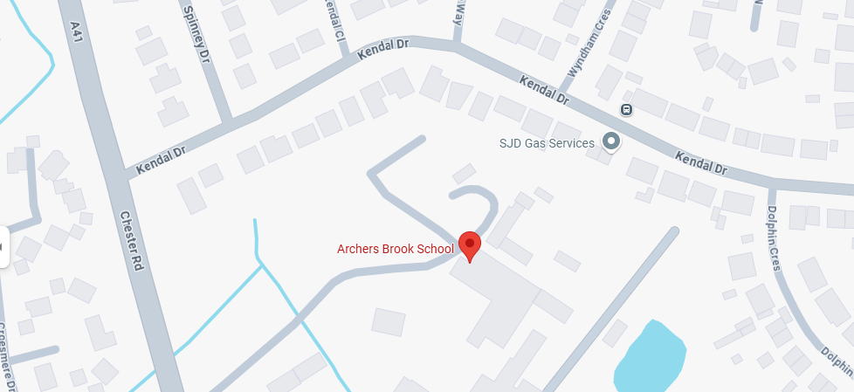
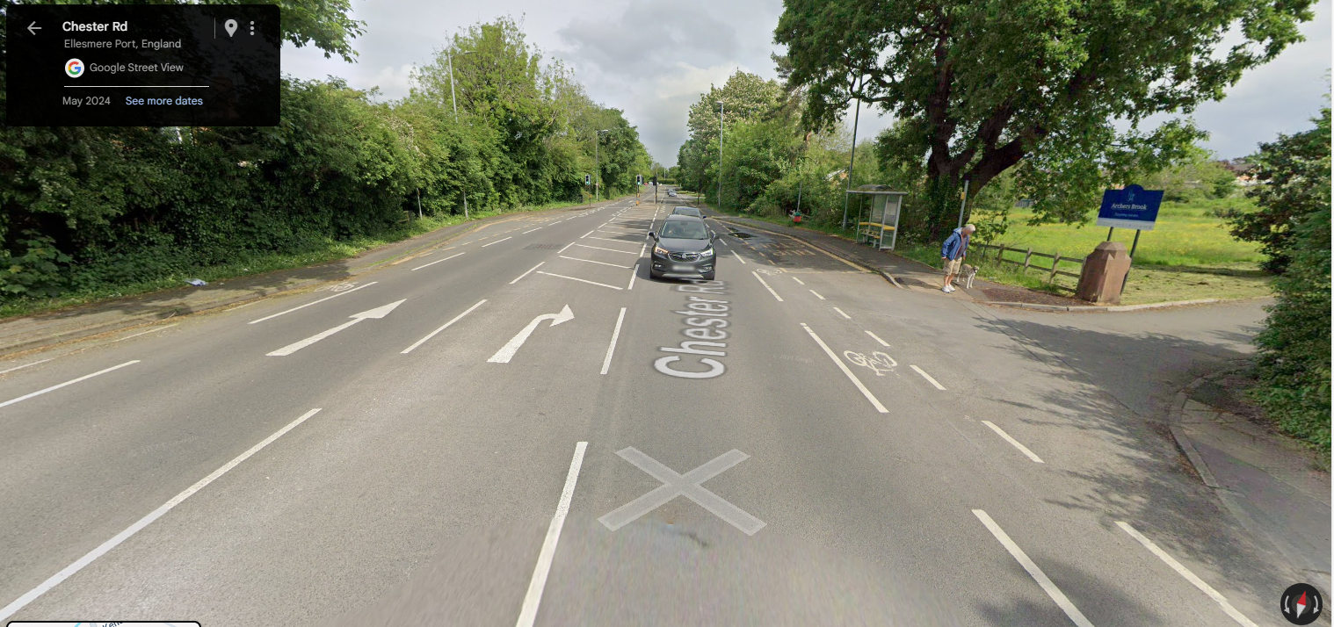
Archers Brook SEMH School, Chester Road, Ellesmere Port
Current Speed Limit 40 mph.
Archers Brook is a Residential School which has a drive which leads onto the A41. Children are mostly dropped by vehicles on site.
Archers Brook was not assessed as part of the 20 mph project.
No personal injury collisions (PIC) in the last five years up to 13/08/24.
No pedestrian facilities within the grounds. Speed limit to remain at 40 mph, no further action.

Slide 4
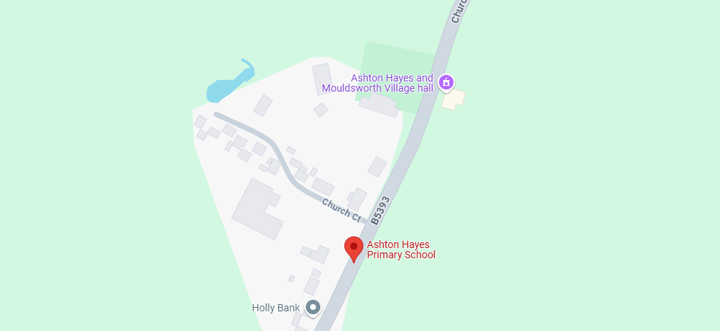
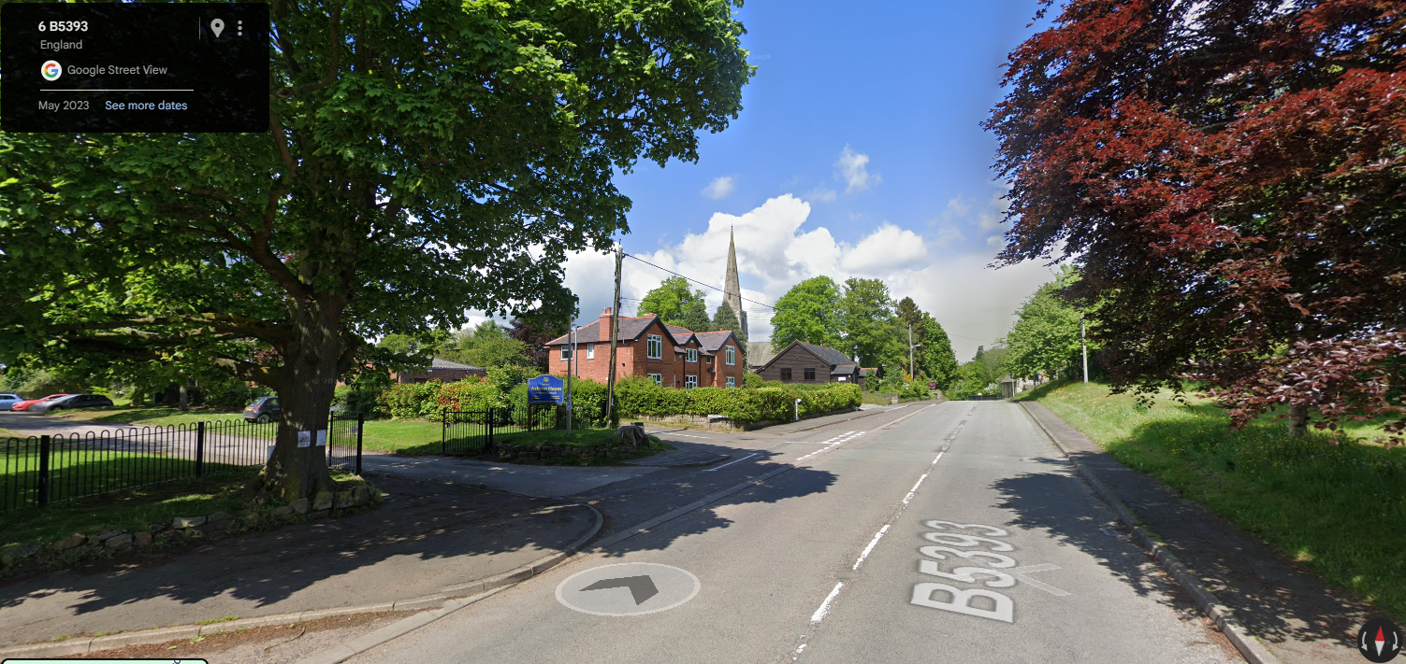
Ashton Hayes Primary School, Church Road, Ashton Hayes
Current Speed Limit 30 mph
Church Road was assessed as part of the 20 mph project where the lowest speed was assessed at 30.5 mph.
No personal injury collisions (PIC) in the last five years up to 13/08/24.
Speed survey results 2025: 30.2 mph.
Advisory 20mph when lights are flashing

Slide 5
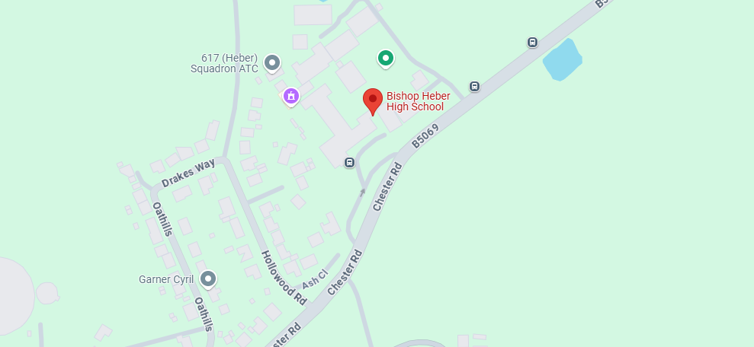
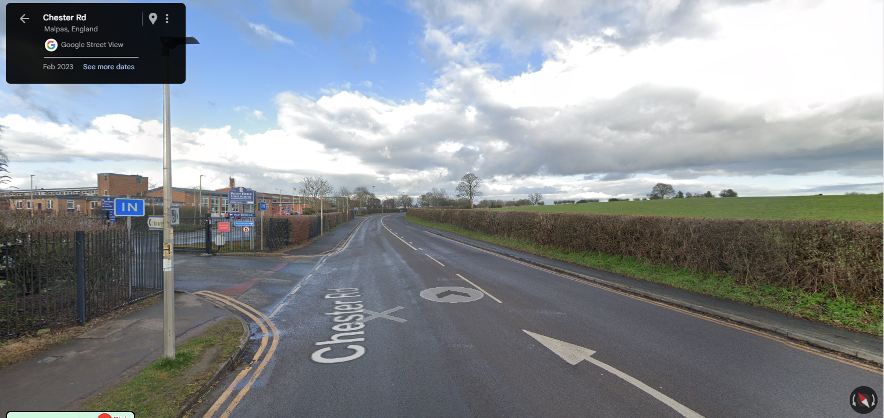
Bishop Heber High School, Chester Road, Malpas
Current Speed Limit 30 mph
Church Road was assessed as part of the 20 mph project where the lowest speed was assessed at 31.7 mph.
1 slight personal injury collision (PIC) in the last five years up to 13/08/24.
Vehicle 1 (Car) collision with parked vehicles on Thursday 21 November 2019 at 17:30.
Speed survey results 2025: 30.3 mph.
Advisory 20mph when lights are flashing

Slide 6
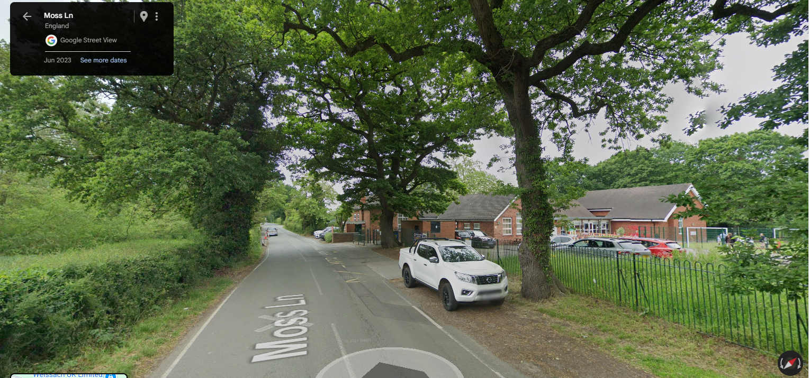
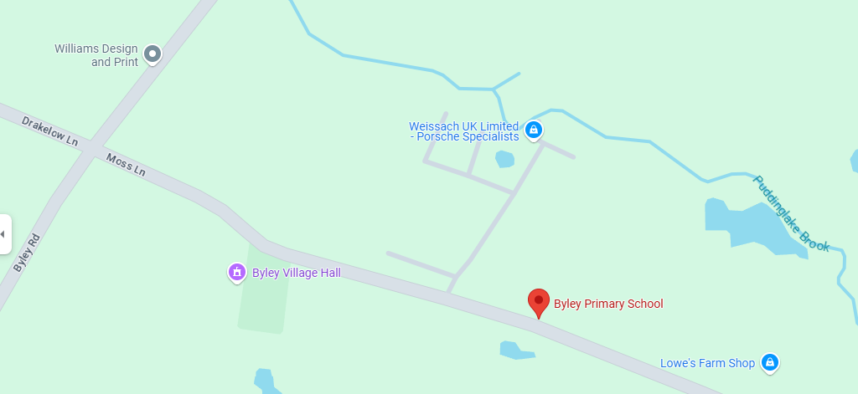
Byley Primary School, Moss Lane, Byley
Current Speed Limit 30 mph
Church Road was assessed as part of the 20 mph project where the lowest speed was assessed at 33 mph.
Some parents park in the village hall carpark and walk to the school along Moss Lane.
No personal injury collisions (PIC) in the last five years up to 13/08/24.
Speed survey results 2025: 29.8 mph.
Signed 20mph to be progress.

Slide 7
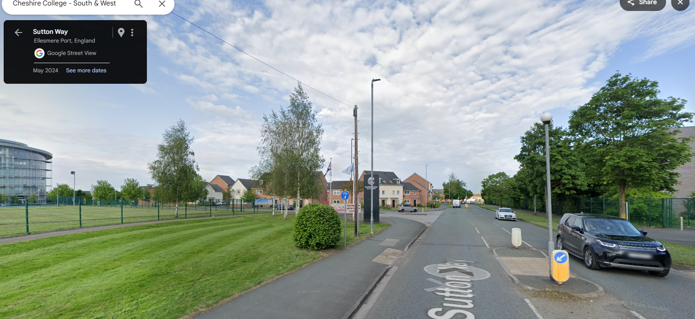
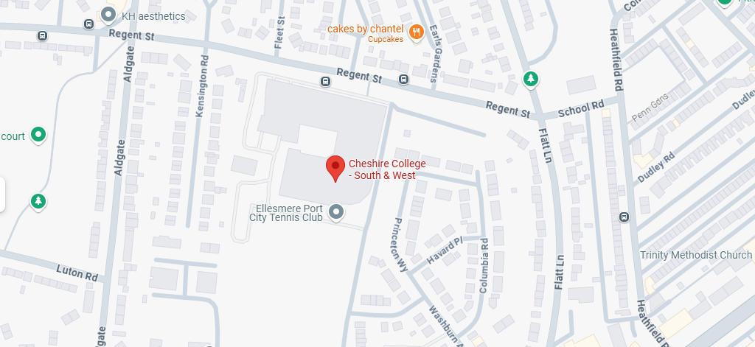
Cheshire College, South and West Ellesmere Port Campus, Sutton Way, Ellesmere Port
Current Speed Limit on Sutton Way is 30 mph.
Colleges were not assessed as part of the 20 mph project.
Ellesmere Port Academy has pedestrian entrances on Sutton Way also.
2 slight personal injury collisions (PIC) in the last five years up to 13/08/2024.
Sutton Way Vehicle 1 (Pedal Cycle) going ahead collides with Vehicle 2 (Car) which was moving off on Tuesday 11 May 2021.
Sutton Way Vehicle 1 (Car) collides with pedestrian on Friday 11 March 2022.
Speed survey results 2025: 28.7 mph.
Signed 20mph to be progress

Slide 8
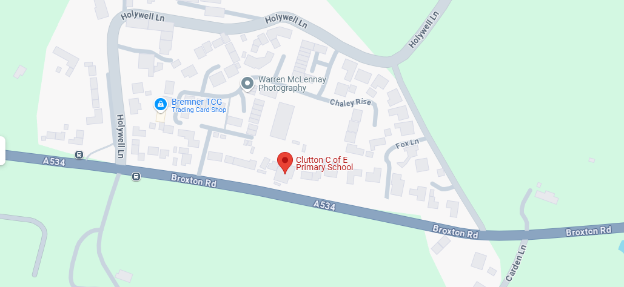
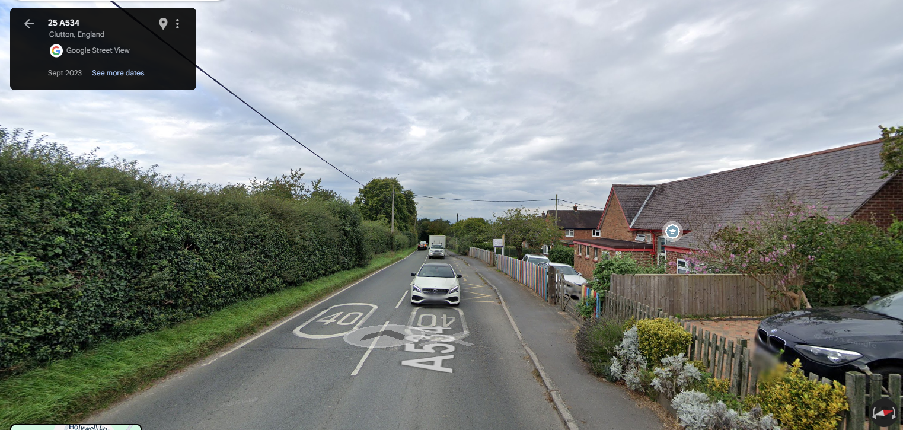
Clutton Church of England Primary School, A534 Broxton Road, Clutton
Current Speed Limit on the A534 is 40 mph
A534 Broxton was assessed as part of the 20 mph project where the lowest speed was assessed at 42.1 mph.
The entrance to this school is at the rear of the school on Lower Hall Lane. Lower Hall Lane is already 20 mph.
No personal injury collisions (PIC) in the last five years up to 13/08/24.
Speed survey results 2025: 36.3 mph.
Does not meet a 30mph criteria further investigation required.

Slide 9
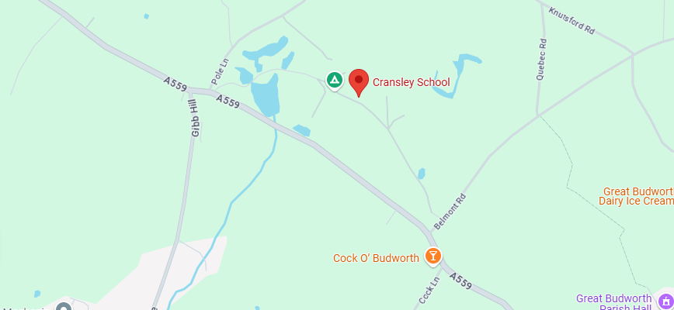
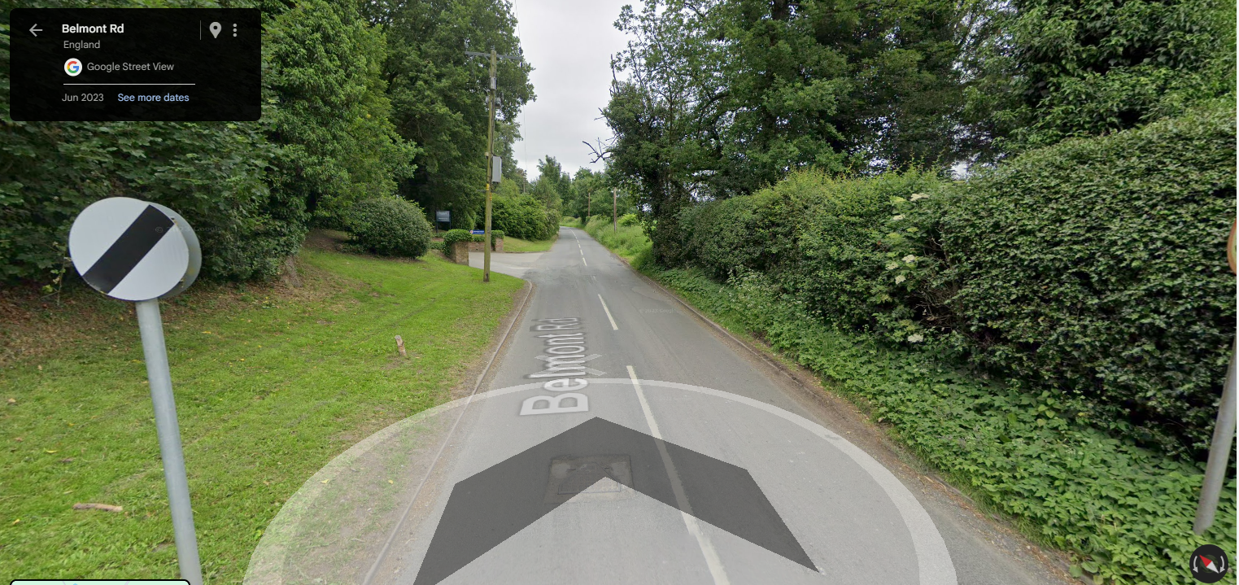
Cransley School, Belmont Hall,
A559 Warrington Road, Great Budworth
Current Speed Limit on the A559 Warrington Road is 50 mph.
There is also an entrance on Belmont Road where the current speed limit is 60 mph.
This school was not assessed as part of the 20 mph project.
Speed limit on the Cransley School Estate is 10 mph.
No personal injury collisions (PIC) in the last five years up to 13/08/24. On A559, Pole Lane or Belmont Road.
Speed limit on A559 to remain at 50 mph.
No pedestrian facilities within grounds. No further action.

Slide 10
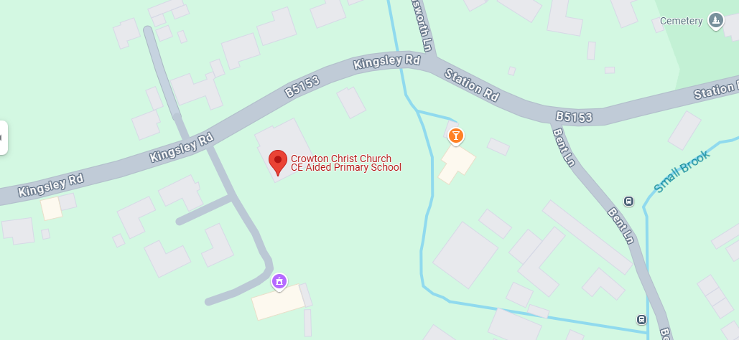
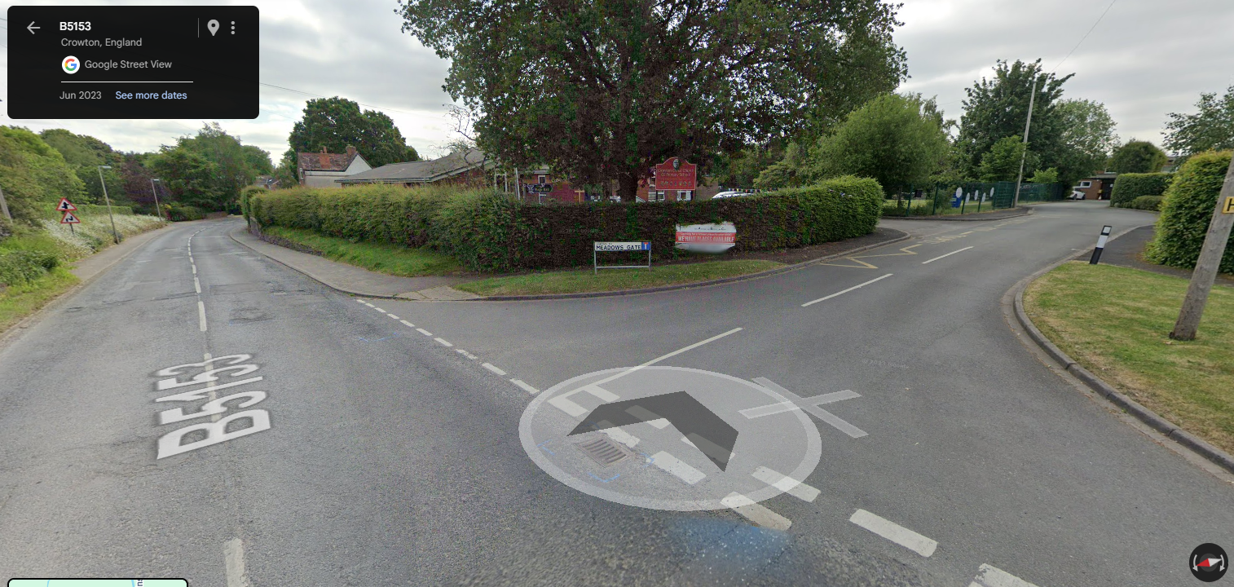
Crowton Christ Church Primary,
Kingsley Road, Crowton
Current Speed Limit on the B5153 Kingsley Road is 30 mph.
School entrance is on Meadow Gate which wasn’t assessed for 20 mph as it is only 42m in length and didn’t meet the 100m or more criteria.
No personal injury collisions (PIC) in the last five years up to 13/08/24.
Speed survey results 2025: 29.5 mph.
Signed 20mph to be progress.

Slide 11
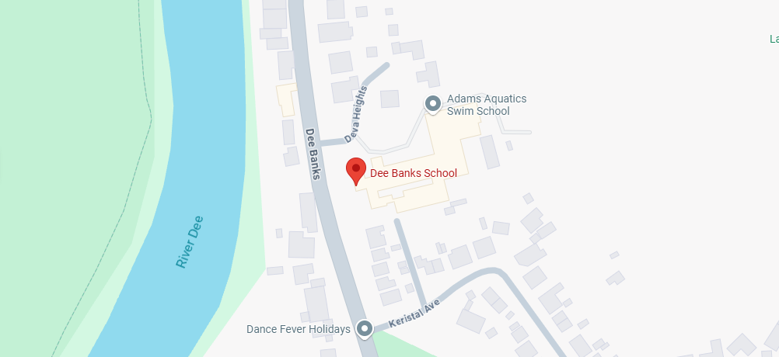
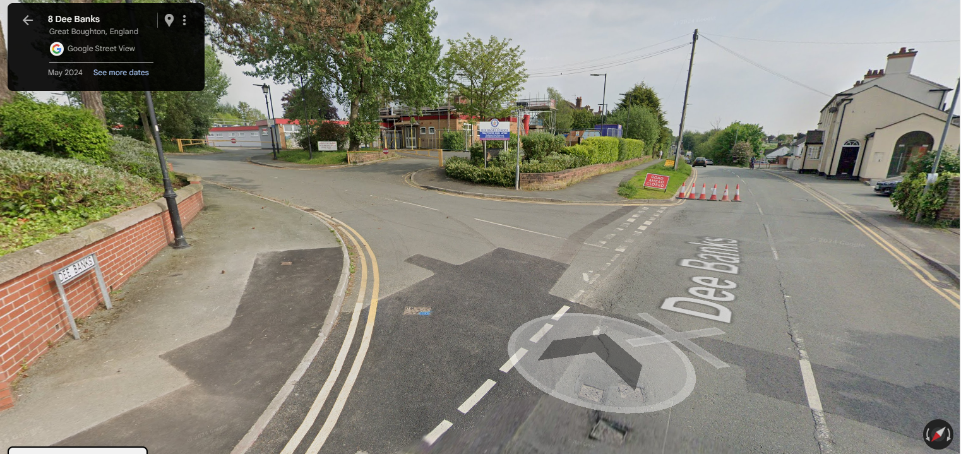
Dee Banks School, Dee Banks,
Sandy Lane, Chester
Current Speed Limit on Sandy Lane is 30 mph.
Sandy Lane was assessed as part of the 20 mph project where the lowest speed was assessed at 30.2 mph.
The school entrance is on Dee Banks which wasn’t assessed for 20 mph as it is only 31m in length and didn’t meet the 100m or more criteria.
No personal injury collisions (PIC) in the last five years up to 13/08/24.
Speed survey results 2025: 28.1 mph.
Signed 20mph to be progress.

Slide 12
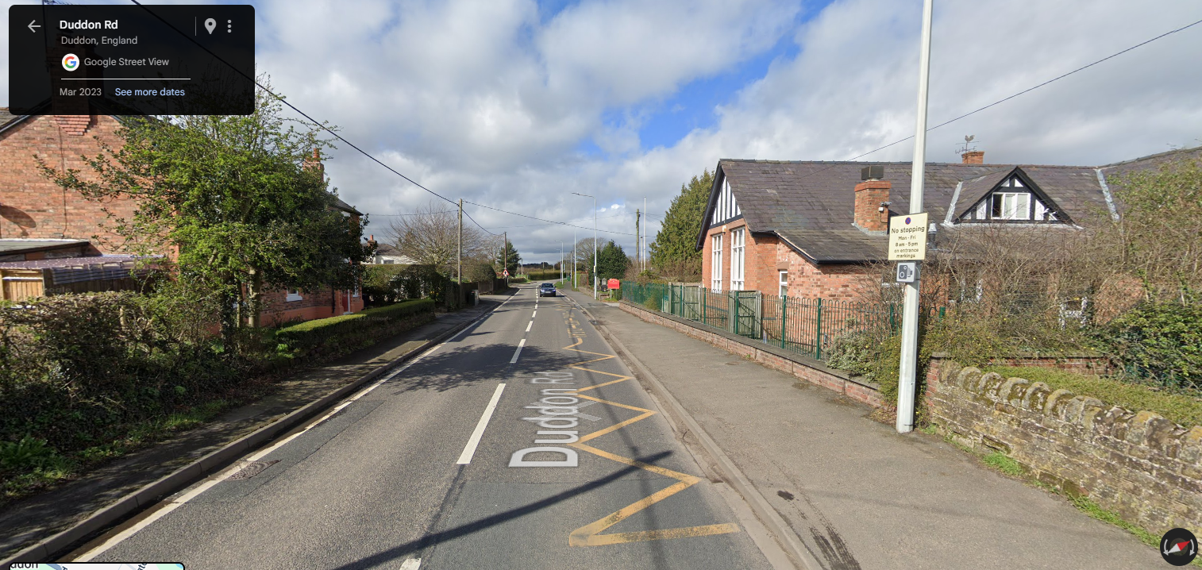
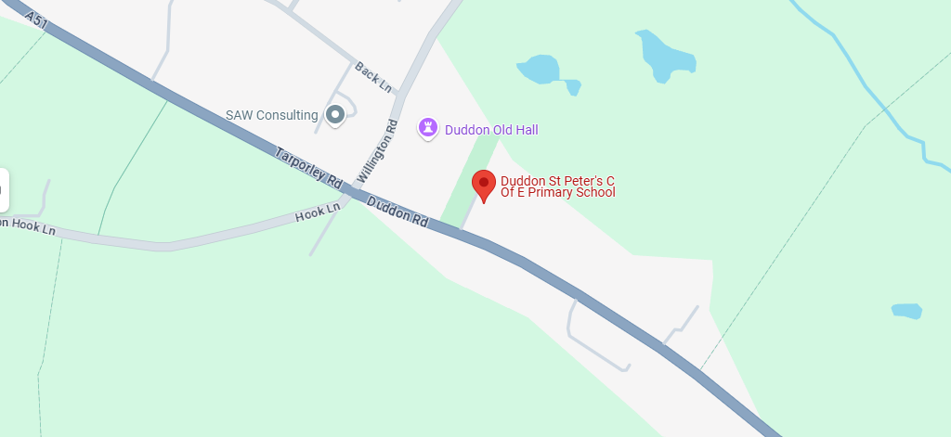
Duddon St Peters C of E Primary School,
Tarporley Road, Duddon
Current Speed Limit on A51 Tarporley Road is 30 mph.
Tarporley Road was assessed as part of the 20 mph project where the lowest speed was assessed at 33.5 mph.
1 slight personal injury collision (PIC) in the last five years up to 13/08/24.
Single vehicle (Car) collision in fog/mist on Friday 06 November 2020 at 02:00.
Speed survey results 2025: 30.8 mph.
Advisory 20mph when lights are flashing.

Slide 13
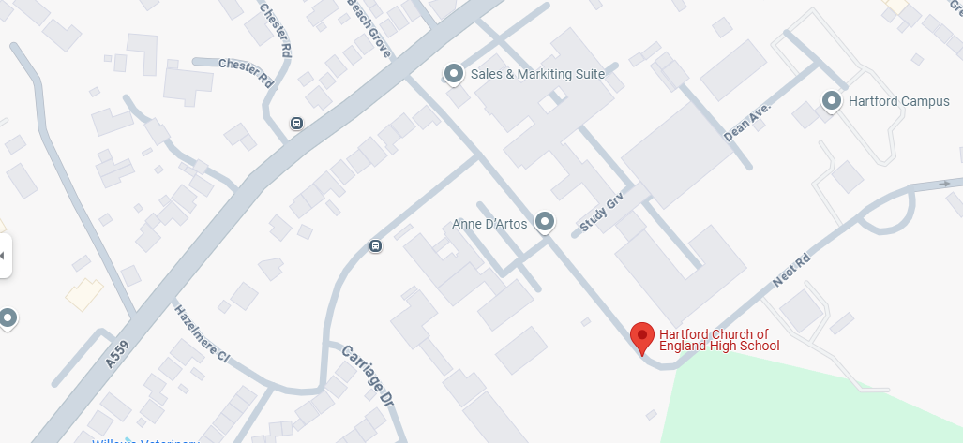
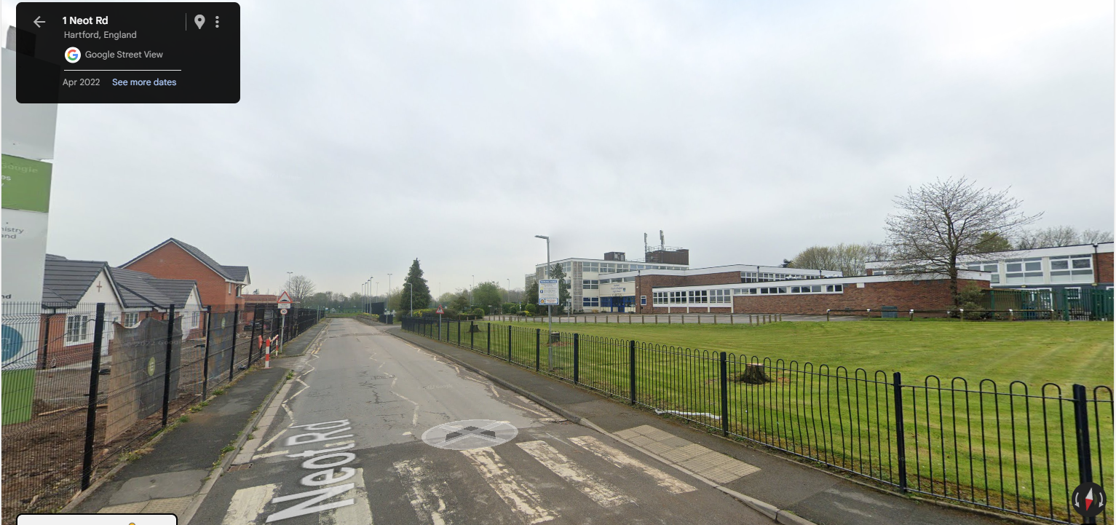
Hartford High School, Chester Road, Northwich
Current Speed Limit on the A559 Chester Road is 30 mph.
Hartford High School entrance is on Neot Road which is currently not adopted by Cheshire West and is as a speed limit of 10 mph.
No personal injury collisions (PIC) in the last five years up to 13/08/24 on A559.
Speed survey results 2025: 25.1 mph.
Signed 20mph to be progress.

Slide 14
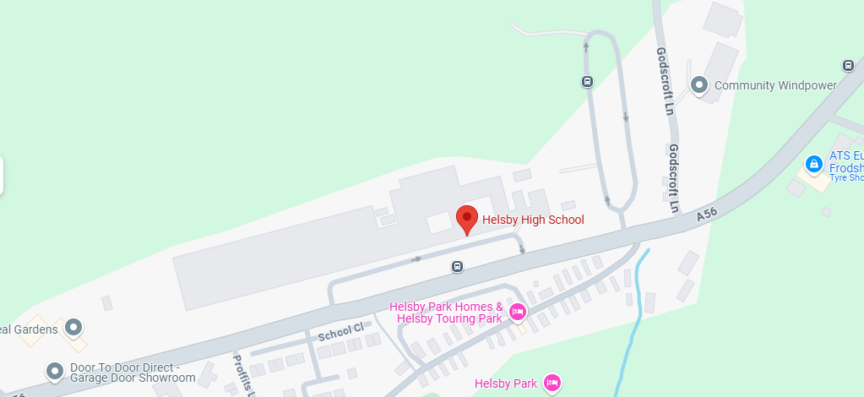
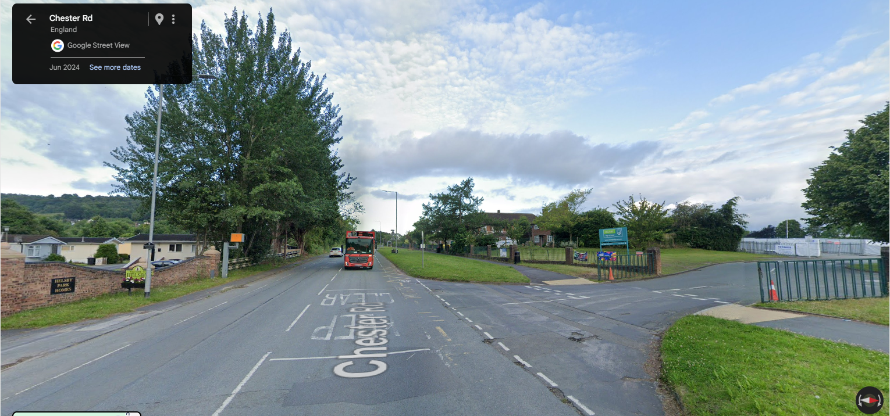
Helsby High School,
A56 Chester Road, Helsby
Current Speed Limit on the A56 Chester Road is 40 mph.
A56 Chester Road was assessed as part of the 20 mph project where the lowest speed was assessed at 37 mph.
2 slight personal injury collision (PIC) in the last five years up to 13/08/24.
Vehicle 1 (Car) collides with Vehicle 2 (Car) exiting junction with Blue Bridge Lane, vehicle 1 hit and run on Saturday 07 August at 20:40.
Single vehicle (Car) collision on Friday 04 February 2022 at 16:00.
Speed survey results 2025: 34.1 mph.
Does not meet the 30mph criteria requires further investigations.

Slide 15
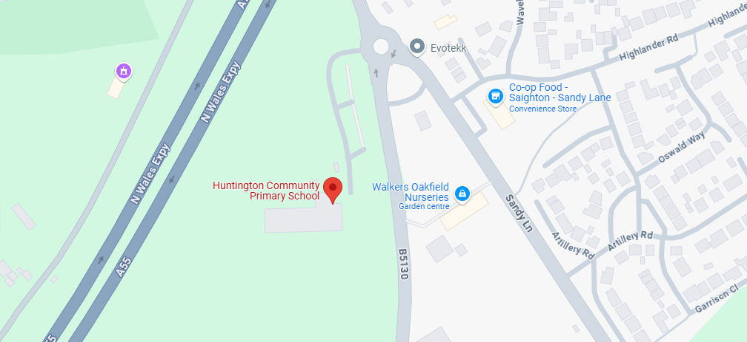
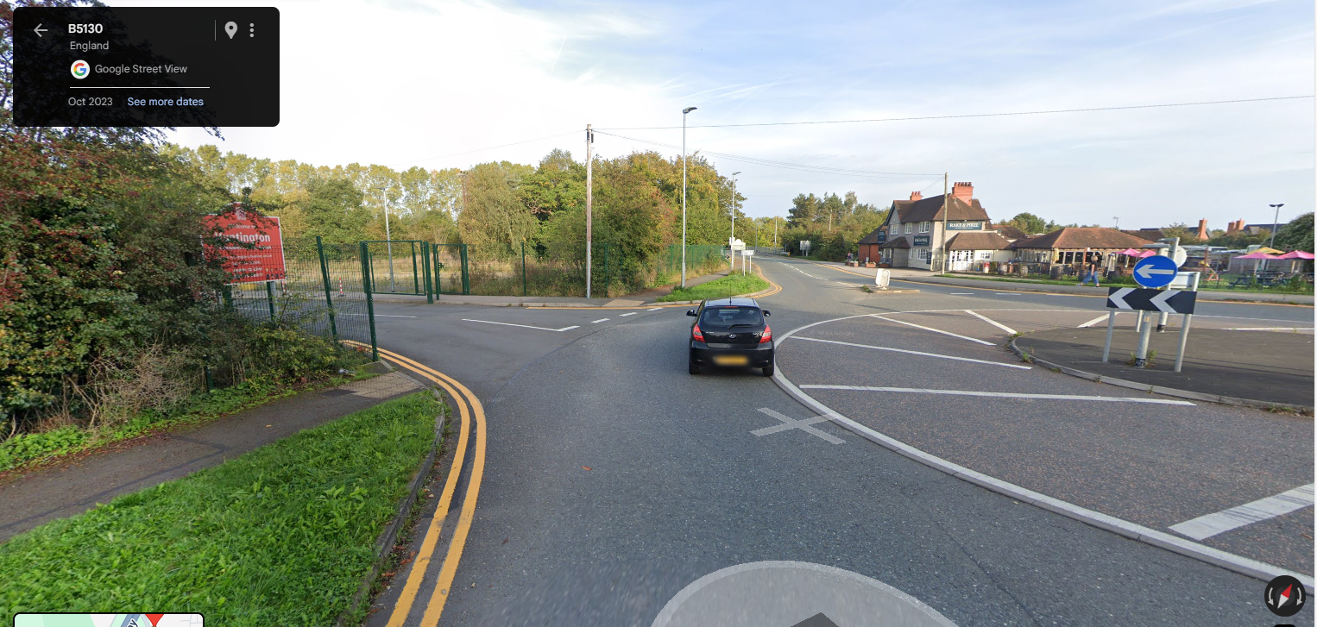
Huntington Community Primary,
B5130 Aldford Rd, Huntington
Current Speed Limit on the B5130 Aldford Road is 30 mph.
B5130 Aldford Road was assessed as part of the 20 mph project where the lowest speed was assessed at 30.1 mph.
The vehicle entrance to this school is off the roundabout at the junction with Sandy Lane. There are pedestrian crossing facilities on all arms of this roundabout.
Should we assess all arms?
4 slight personal injury collision (PIC) in the last five years up to 13/08/24.
Sandy Lane – 2 vehicle collision (Both Cars) on Thursday 06 August 2020 at 09:22.
Aldford Road –Single vehicle collision (Car) on Saturday 08 August 2021 at 12:58.
On roundabout – Vehicle 1 (Goods >7.5t) collides with Vehicle 2 (Pedal cycle) on Monday 13 February 2023 at 15:00.
Chester Road – Single vehicle collision (Car) on Thursday 11 January 2024 at 19:20.
Speed survey results 2025 - B5130 (N) : 27.3 mph.
Speed survey results 2025 - B5130 (S) : 30.4 mph.
Speed survey results 2025 – Sandy Lane: 25.7 mph.
Signed 20mph to be progress.

Slide 16
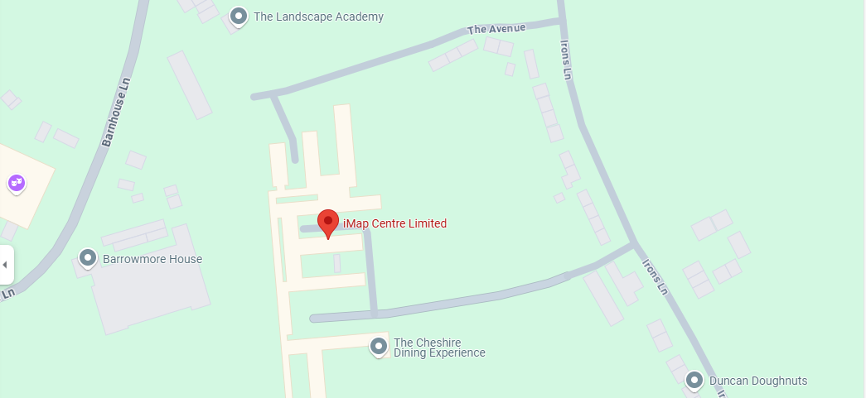
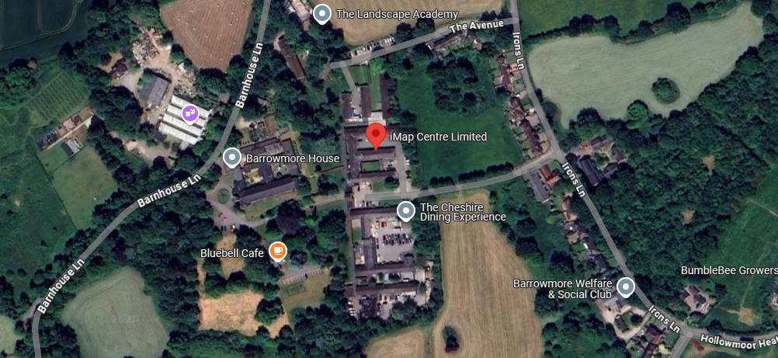
Imap (Individuals making autism positive)
Centre Limited, Barrowmore Estate, Barnhouse Lane, Great Barrow
Current Speed Limit on the Barnhouse Lane is 60 mph.
This centre was not assessed as part of the 20 mph project as it is on private land.
An SLA was completed in Hollowmoor Heath in September 2022. It was suggested that the speed limit on Irons Lane should be reduced to 30 mph. This SLA has never been implemented.
No personal injury collisions (PIC) in the last five years up to 13/08/24 on Barnhouse Lane or Irons Lane.
No pedestrian facilities on private access roads, no further action

Slide 17
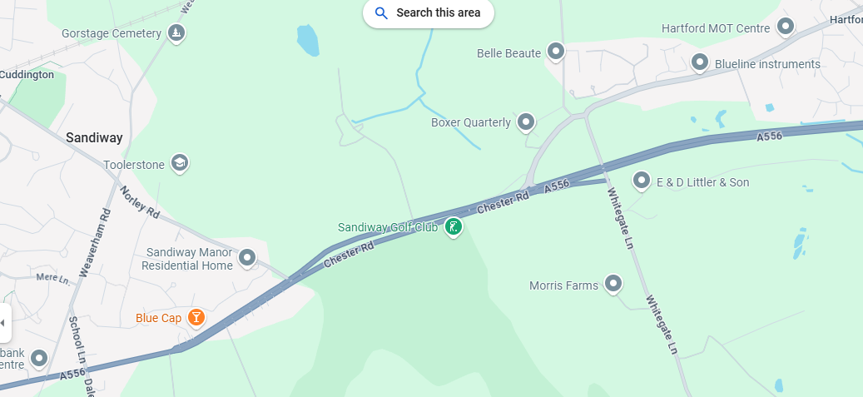
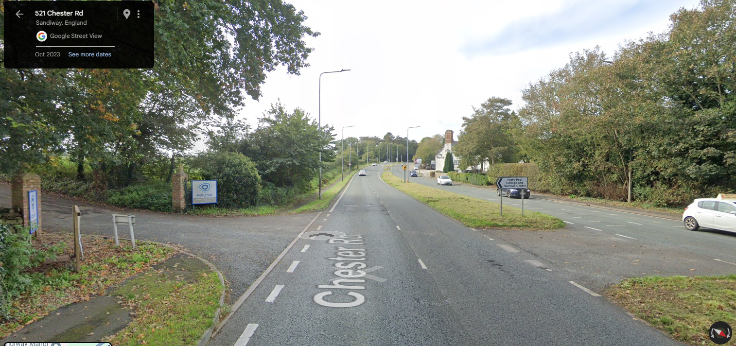
Petty Pool College, Pool Lane, Sandiway
Pool Lane is a private road doesn’t have a speed limit.
This centre was not assessed as part of the 20 mph project as it is on private land.
A556 has a 40 mph speed limit and benefits from a safety camera on each side of the dual carriageway
No personal injury collisions (PIC) in the last five years up to 13/08/24 on A556 Chester Road.
Speed survey results 2025 A556 (E/B): 35.2 mph.
Speed survey results 2025 A556 (W/B): 37.0 mph.
No pedestrian facilities on access road, no further action.

Slide 18
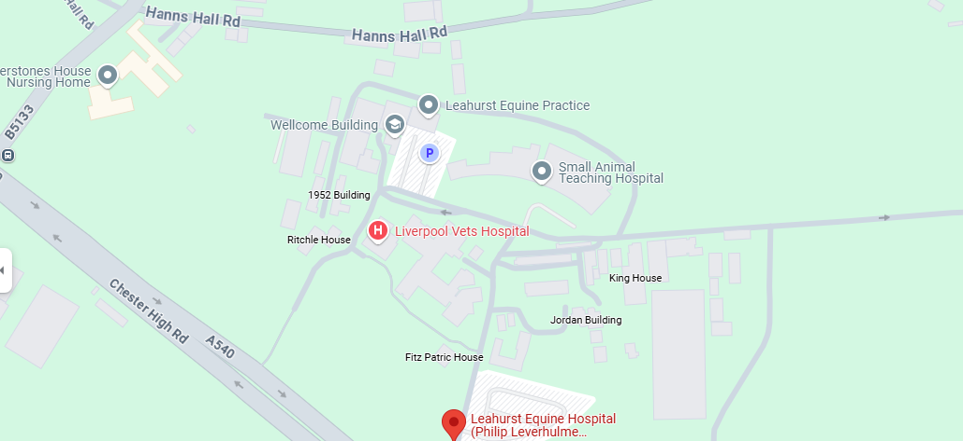
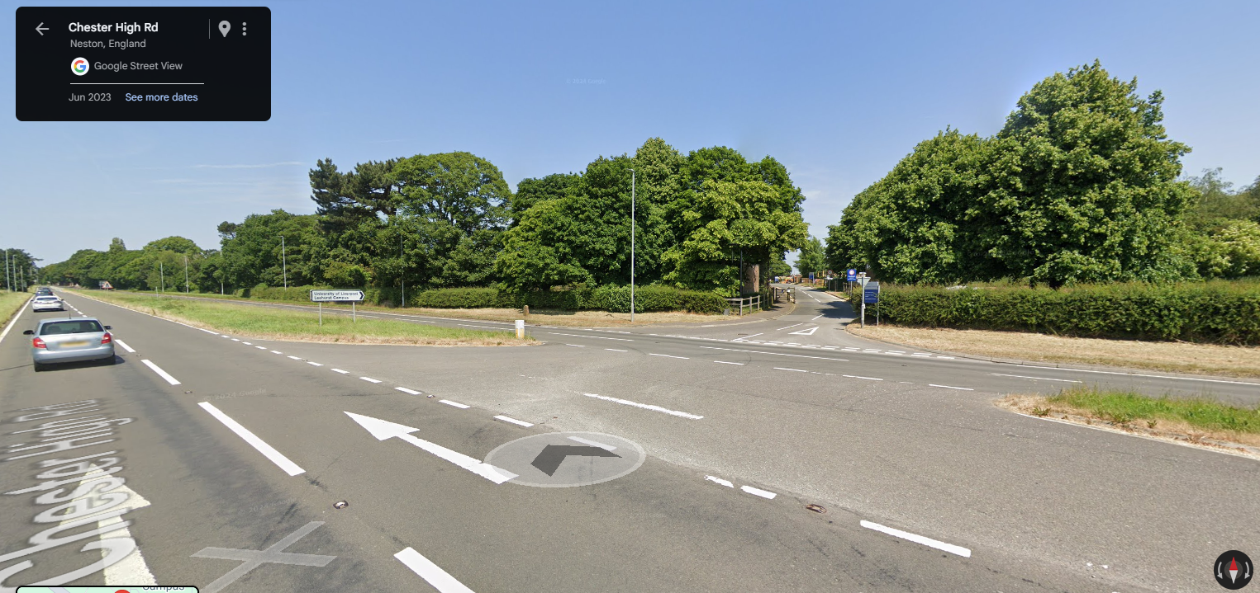
University of Liverpool, School of Veterinary Science, A540 Chester High Road, Leahurst.
Current speed limit on the A540 Chester High Road is 60 mph.
This University was not assessed as part of the 20 mph project as it is a University and only primary and high schools where assessed.
1 serious personal injury collision (PIC) in the last five years up to 13/08/24.
Single vehicle (M/C) collision Friday 16 June 2023 at 14:57.
Under further investigation: radar survey complete analysing data w/c 30th June 2025

Slide 19
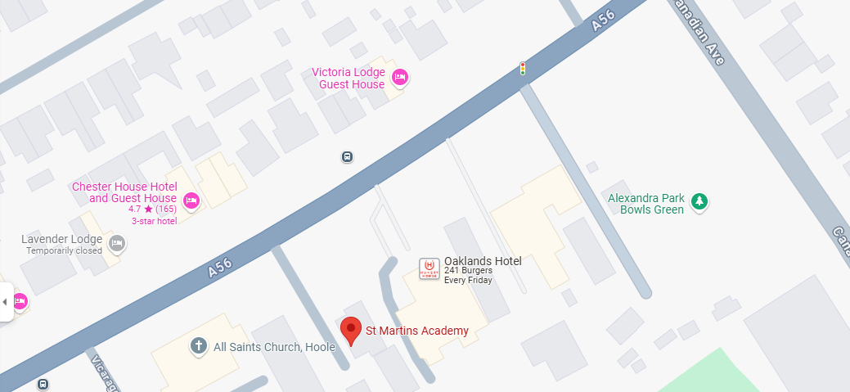
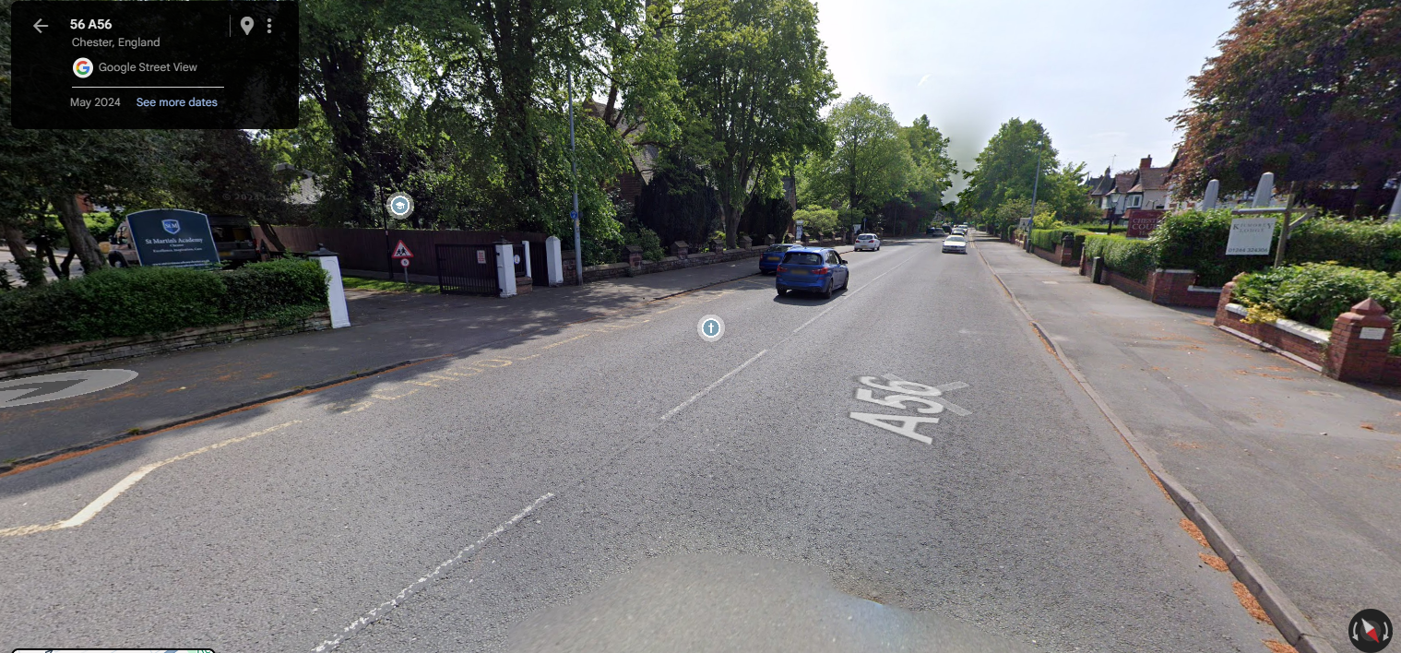
St Martins Academy, A56 Hoole Road, Chester
Current Speed Limit on the A56 Hoole Road is 30 mph.
A56 Hoole Road was assessed as part of the 20 mph but it was decided to leave the speed limit at 30 mph and no report was written. Mean speeds where 24.5. Jan 18 and 25.1 Jun 18.
1 serious personal injury collision (PIC) in the last five years up to 13/08/24.
5 vehicle (5 Cars) collision on Saturday 06 January 2024 at 14:57.
Speed survey results 2025: 21.2 mph.
Signed 20mph to be progress.

Slide 20
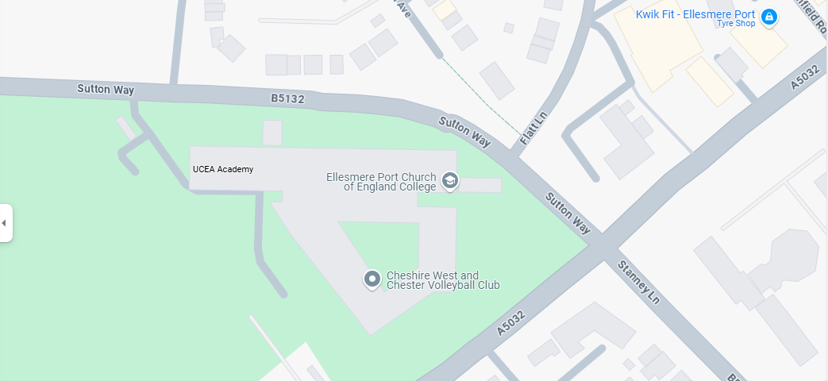
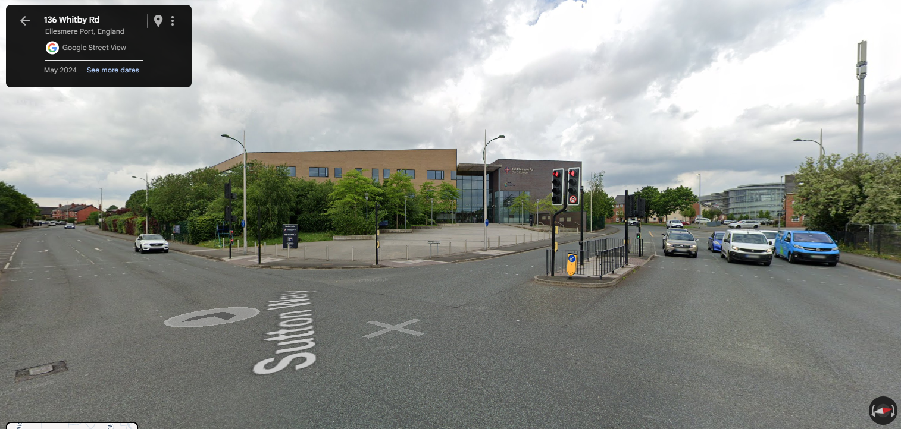
Ellesmere Port C or E College, A5032 Whitby Road, Ellesmere Port
Current Speed Limit on the A5032 Whitby Road is 30 mph.
A5032 Whitby Road was assessed as part of the 20 mph but it was decided to leave the speed limit at 30 mph. Mean speed was 25.5.
Should we assess Sutton Way also as there is a pedestrian entrance?
6 slight personal injury collision (PIC) in the last five years up to 13/08/24. 3 on Whitby Road and 3 on Sutton Way including 1 pedestrian casualty.
Sutton Way Vehicle 1 (Pedal Cycle) and Vehicle 2 (Car) both moving off and collide on Saturday 05 September 2020.
Sutton Way Vehicle 1 (Pedal Cycle) Going ahead collides with Vehicle 2 (Car) which was moving off on Tuesday 11 May 2021 at 15:15 age of casualty was 11.
Sutton Way Vehicle 1 (Car) collides with pedestrian on Friday 11 March 2022 at 15:40 pedestrians aged 15.
Whitby Road Vehicle 1 (Car) and Vehicle 2 (Car) both collide whilst moving off on Saturday 28 January 2023.
Whitby Road Vehicle 1 (P2W) turning right and Vehicle 2 (Car) Going ahead collide on Monday 13 February 2023 at 17:50 two children on P2W age 12 and age 6.
Whitby Road Vehicle 2 (Goods <3.5t) is hit by Vehicle 2 (Car) in rear shunt type collision on Wednesday 19 June 2024.
Speed survey results 2025: 26.1 mph.
Signed 20mph to be progress.

Slide 21
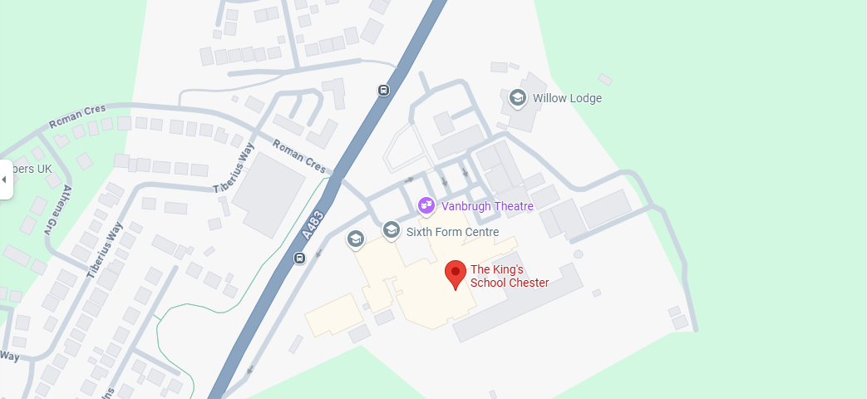
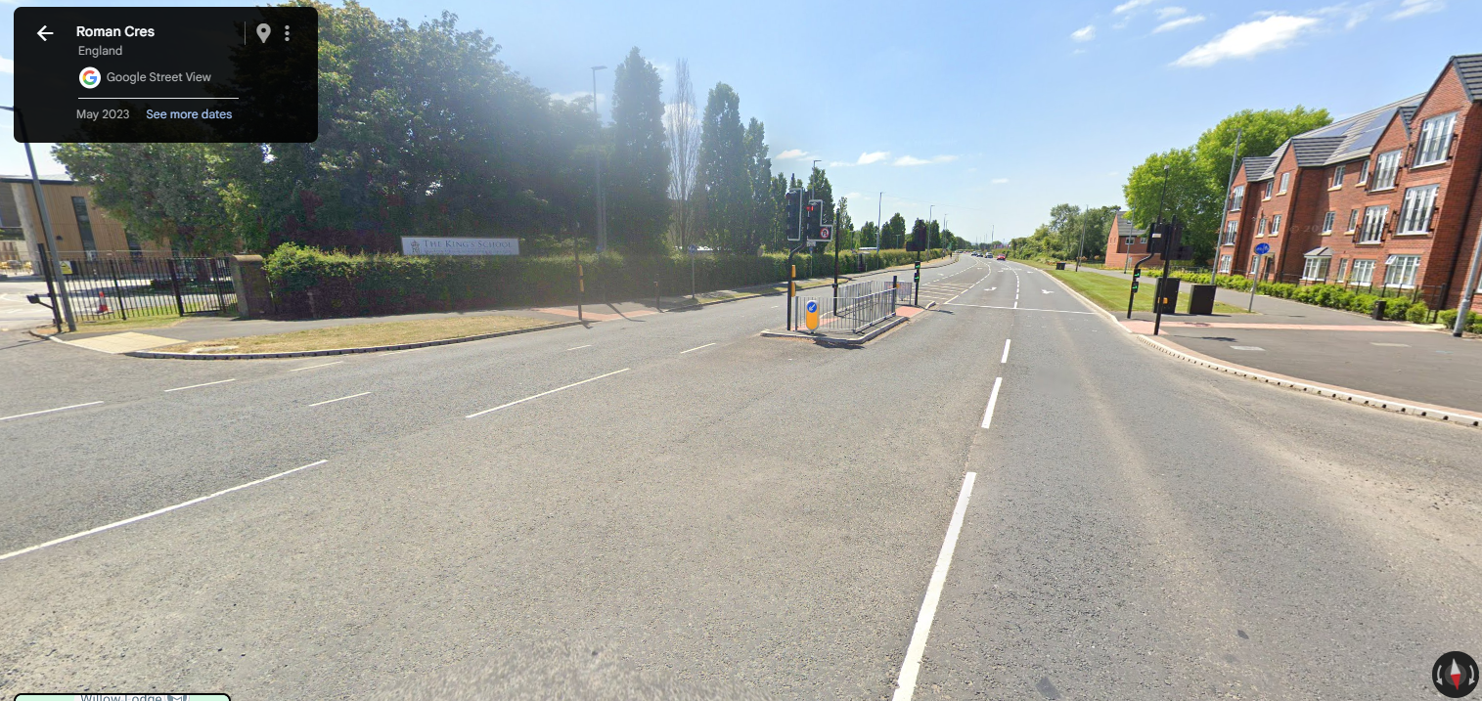
The Kings School, A483 Wrexham Road, Chester
Current Speed Limit on the A483 is ETRO 30 mph.
Wrexham Road was assessed as part of the 20 mph project where the lowest speed was assessed at 30.2 mph.
1 fatal collision. Including 1 pedestrian fatality.
Pedestrian exits Kings School on A483 and is crossing the road from Vehicle 1 (Car) nearside when collision occurs on Tuesday 12 November 2024 at 17:11. Pedestrian was age 11.
2 slight personal injury collisions (PIC) in the last five years up to 13/08/2024.
Vehicle 1 (Car) slowing or stopping and Vehicle 2 (Car) slowing or stopping in rear shunt type collision on Wednesday 30 March 2022 at 17:18.
Vehicle 1 (Car) overtaking moving vehicle collides with Vehicle 2 (Car) Going ahead on Monday 17 October 2022 at 22:48.
Speed survey results 2025 A483 (N): 33.9 mph. (CWAC)
Speed survey results 2025 A483 (S): 37.0 mph. (CWAC)
TRACSIS data at this location is incomplete for A483 (N) and adjusted for A483 (S). Therefore, the survey were completed via radar.
Continue to monitor, for a period of 6 months after all s278 works are completed in the area.

Slide 22
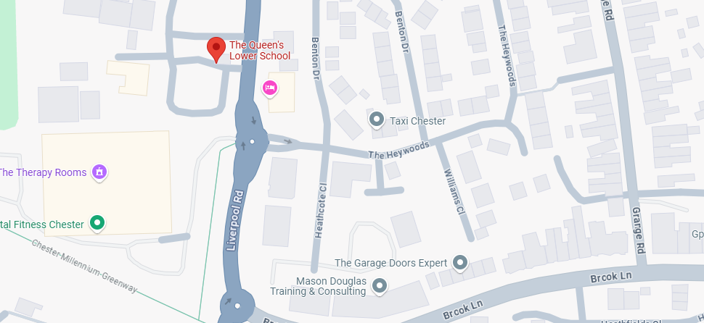
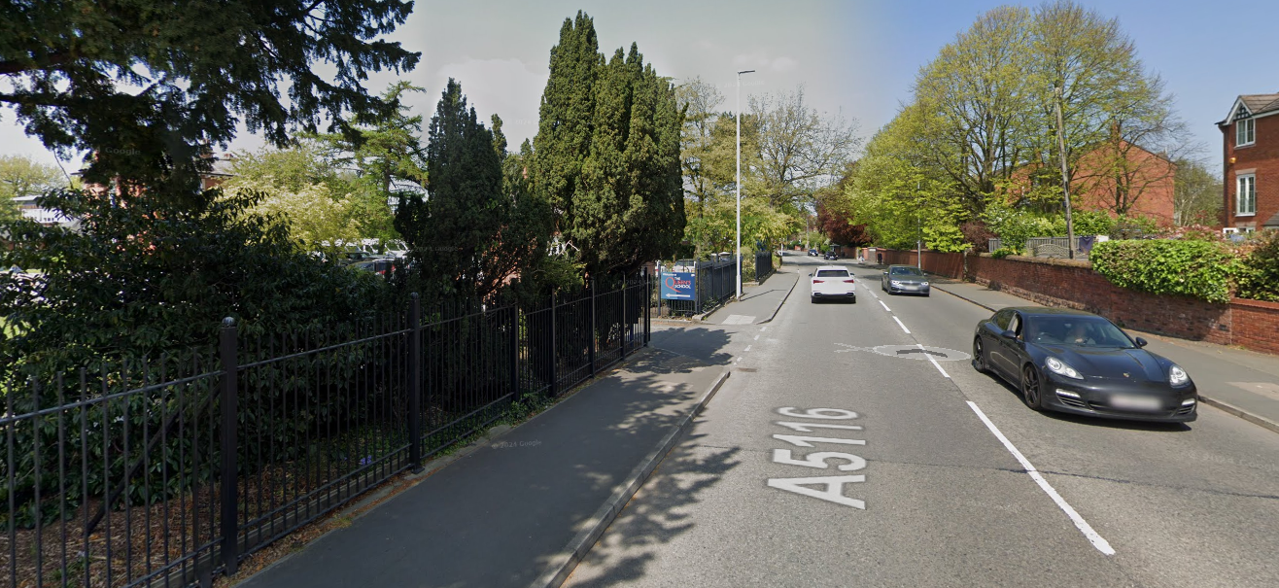
The Queens Lower School, Liverpool Road, Chester
Current Speed Limit on the A5116 Liverpool Road is 30 mph.
Liverpool Road was assessed as part of the 20 mph project where the lowest speed was assessed at 30.8 mph.
1 slight personal injury collision (PIC) in the last five years up to 13/08/24.
Vehicle 1 (Car) moving off collides with Vehicle 2 (Car) waiting to turn right on Tuesday 25 July 2023 at 12:00.
Speed survey results 2025: 24.4 mph.
Signed 20mph to be progress.

Slide 23
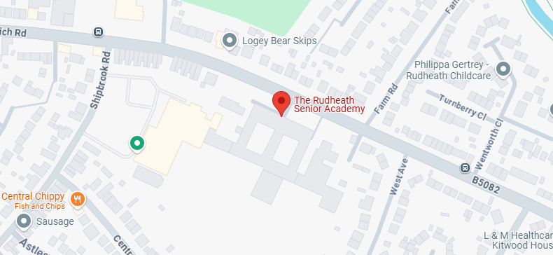
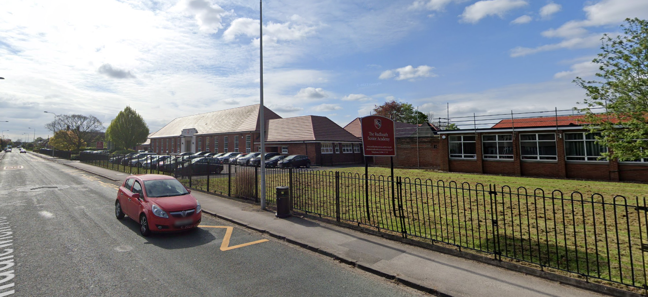
Rudheath Senior Academy, Shipbrook Road, Northwich
Main entrance is on Shipbrook Road which is 20 MPH
Middlewich Road was assessed as part of the 20 mph project where the lowest speed was assessed at 31.7 mph.
2 slight personal injury collisions (PIC) in the last five years up to 13/08/24 on B5082.
Vehicle 1 (Car) turning right collides with Vehicle 2 (Car) going ahead on Friday 07 February 2020 at 06:44.
Vehicle 1 (Car) going ahead collides with Vehicle 2 (Pedal Cycle) also going ahead on Thursday 18 June 2020 at 18:55.
Speed survey results 2025: 28.9 mph.
Signed 20mph to be progress.

Slide 24
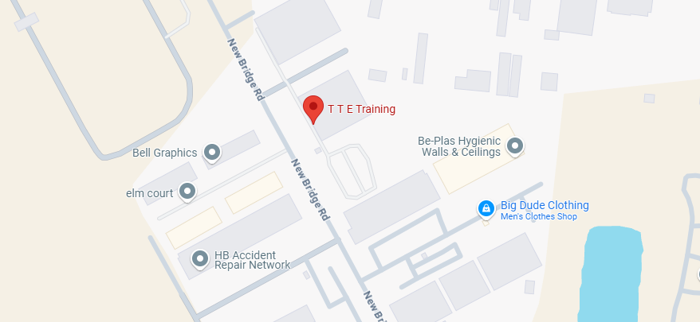
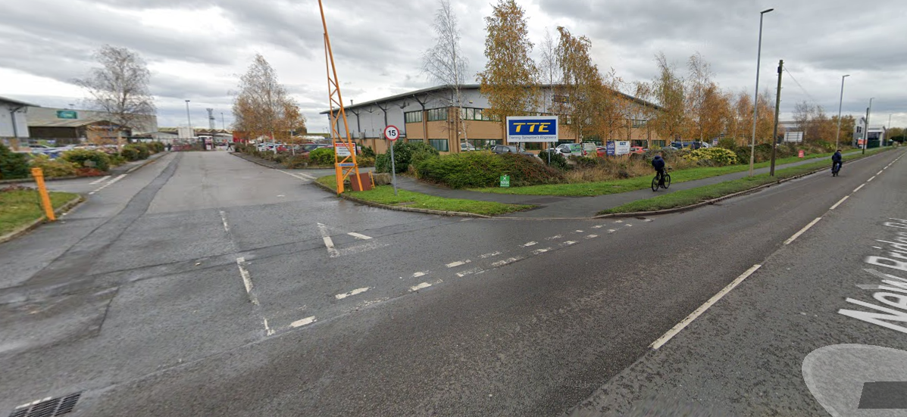
TTE Training Ltd, New Horizons House, New Bridge Road, Ellesmere Port
TTE Training is a further education college. Colleges where not assessed as part of the 20 mph scheme.
TTE is on a trading estate off New Bridge Road, which has a speed limit of 30 mph. The entrance is on a section of the trading estate which is 15 mph
No personal injury collisions (PIC) in the last five years up to 13/08/24.
Speed limit recently reduced from 40mph to 30mph, no further action.

Slide 25
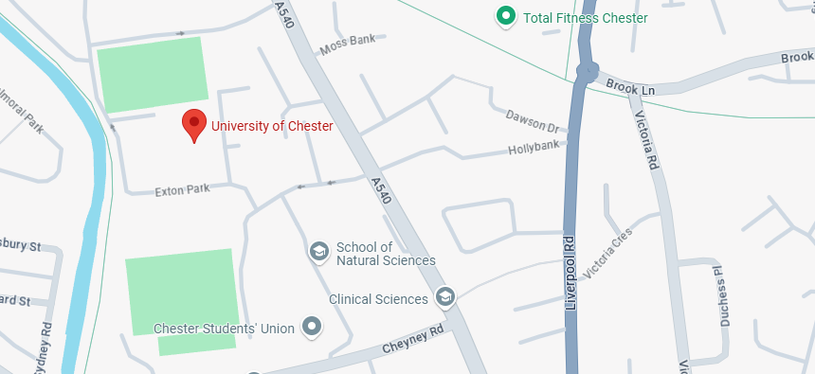
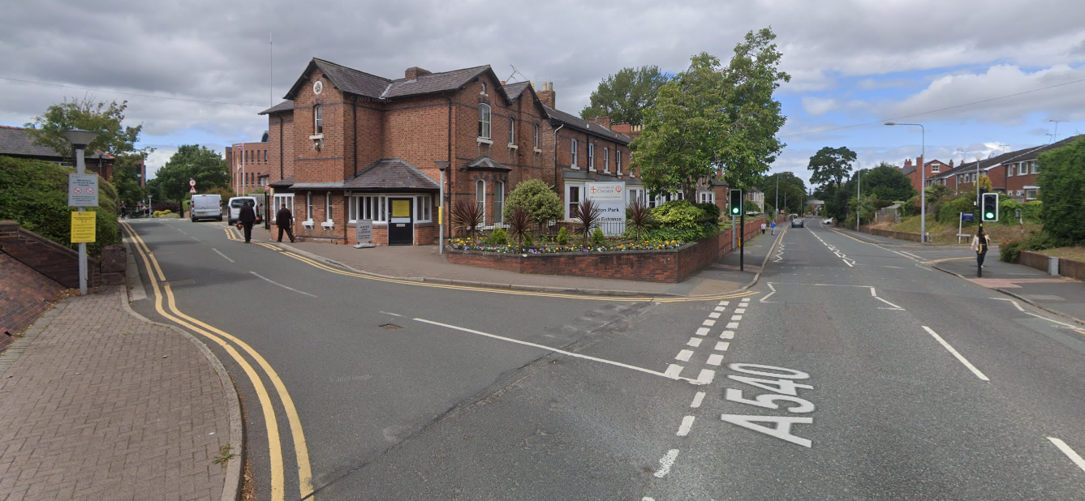
University of Chester, Chester Campus, Parkgate Road, Chester
University's where not assessed as part of the 20 mph scheme.
There are two entrances for this University. Cheyney Road is already 20 mph. A540 Parkgate Road is currently 30 mph.
1 slight personal injury collision (PIC) in the last five years up to 13/08/24.
Vehicle 1 (Minibus) turning right collides with Vehicle 2 (M/C) going ahead om Wednesday 25 September 2019 at 15:50.
Speed survey results 2025: 25.0 mph.
Signed 20mph to be progress.

Slide 26
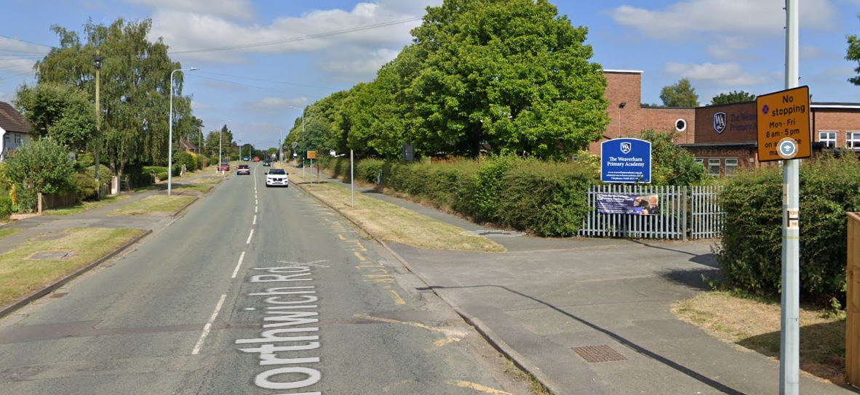
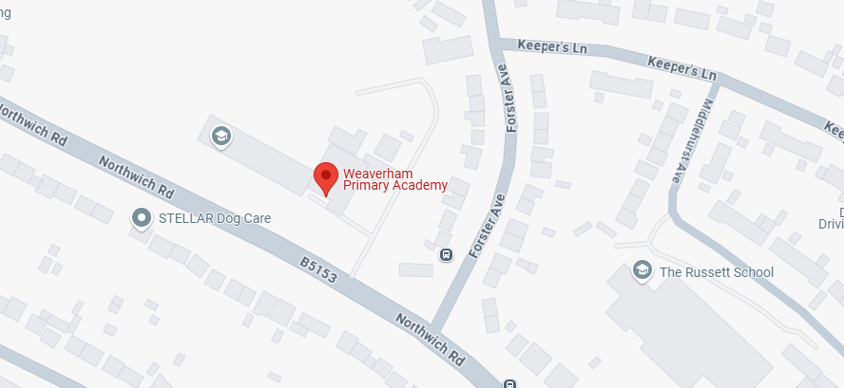
Weaverham Primary Academy, Northwich Road, Weaverham
Current Speed Limit on the B5132 Northwich Road is 30 mph.
Northwich Road was assessed as part of the 20 mph project where the lowest speed was assessed at 37 mph.
No personal injury collisions (PIC) in the last five years up to 13/08/24.
Speed survey results 2025: 30.3 mph.
Advisory 20mph when light are flashing.

Slide 27


Whitegate C of E Primary, Cinder Hill, Whitegate
Current Speed Limit on the Cinder Hill is 30 mph.
Cinder Hill was assessed as part of the 20 mph project where the lowest speed was assessed at 30.5 mph.
Whitegate PC have recently had a speed survey completed by Cheshire Police which showed an average speed of 25.4 mph
Whitegate PC have been informed of the new scheme but are still willing to share the cost with Cheshire West for new signs and TRO to be installed.
No personal injury collisions (PIC) in the last five years up to 13/08/24.
Consultation will be completed by end of July 2025.
Subject to consulted, proposed installation of Scheme prior to school return in September 2025.

Slide 28


Winsford High Street Community Primary School, Winsford
Main entrance is on A54 High Street which is a dual carriageway and as a speed of 40 mph
High Street was assessed as part of the 20 mph project where the lowest speed was assessed at 33.9 mph.
2 slight personal injury collisions (PIC) in the last five years up to 13/08/24.
Vehicle 1 (Goods <3.5t) overtaking nearside collides with Vehicle 2 (Car) going ahead on Sunday 30 August 2020 at 18:50.
Vehicle 1 (Car) slowing or stopping collides with Vehicle 2 (Car) slowing or stopping in rear shunt type collision on Thursday 30 September 2021 at 14:40.
Vehicle 1 (Pedal cycle) going ahead collides with Vehicle 2 (Car) waiting to turn left on Tuesday 05 October 2021 at 08:20 cyclist aged 18.
Speed survey results 2025 A54 29mph mean for both directions.
Propose to reduce the speed from 40mph to 30mph.

Slide 29


Witton Church Walk Primary School, Church Walk, Northwich
Witton Church Walk Primary School has an entrance off the A559 where the speed limit is 30 mph. Average speed collected on the A559 in 2021 was 38.3 mph on the school side of the dual carriageway and 31 mph on the other side (combined average 34.6 mph)
Vehicles can turn right in and out of Church Walk.
Church Walk is only 100m long and didn’t meet the criteria for assessment.
Roads around this area with walking access to this school are already 20 mph (eg Percey Street)
1 fatal, 1 serious and 5 slight personal injury collision (PIC) in the last five years up to 13/08/24 on A559.
Vehicle 1 (Car) going ahead collides with Vehicle 2 (Mobility scooter) also going ahead. Vehicle 2 performed illegal turn whilst impaired by drugs without lights at night. Vehicle 1 failed to look properly. on Friday 29 December 2023 at 18:30.
Single vehicle (M/C) collision skidded going ahead on Tuesday 30 April 2024 at 12:10.
Vehicle 1 (Car) going ahead collides with Pedestrian on Wednesday 14/10/2020 at 22:19.
Vehicle 1 (Car) going ahead collides with Pedestrian on Monday 14 March 2022 at 16:00. Pedestrian is aged 13.
Vehicle 1 (M/C) collides with Vehicle 2 (Pedal cycle) going ahead on Monday 08 May 2023 at 10:56.
Single vehicle (M/C) collision skidded going ahead on Saturday 09 September 2023 at 13:35.
Vehicle 1 (Car) turning left collides with Vehicle 2 (Pedal cycle) moving off on Friday 08 March 2024 at 16:39.
Speed survey results 2025 A559 (N/B): 32.0 mph.
Speed survey results 2025 A559 (S/B): 31.1 mph.
To remain as a 30mh, no further action.

Slide 30
Timescales
4 weeks design and consult with Councillors
1 week develop report and approvals
3 weeks legal advertisement
2 week review any objections, report and approvals
4 week Health and safety docs, permits, programming works
2 week installation
Scheme currently being designed up and costed ready with expected installation late 2025 early 2026

